Slide 1
OPEN TELCO TRANSFORMATION
Michael Hansen
AVP, Open Telco Strategies
“We have to embrace open source, software-centric solutions. We know this drives flexibility and scalability with the growth of the network. It makes everything faster, better, and cheaper,”
AT&T Mobility CEO Glenn Lurie, highlighting the role of open source software in the 5G roadmap

Slide 2
Open Source Building Blocks of the Modern Telco
Modern Telco: Platform for development and distribution of digital goods and services
APPLICATION
Application Platform
Consumes data from data platform
Delivers data via network infrastructure
Supports DevOps, CI/CD, Containers, microservices
Outputs cloud-native application code
DATA
INFRASTRUCTURE
(NFVI)
DATA
MANAGEMENT
Data Management Platform:
Collects device and Network telemetry data
Transforms, Distributes, and Stores this data for Applications
Provides governance and APIs to manage access to the data
Network Infrastructure Platform:
Transports data
Generates data
Transforms network from mainframe to cloud era
Delivers ROI thru automation and reduced vendor lock-in
Notes:
Create Links from ROI Figures to Backup Slides Supporting These Figures
The modern CSP is all about the data! These Red Hat platforms allow CSPs to surf the data tsunami, not be engulfed by it
Each core platform has outstanding ROI. According to Industry Analyst IDC:
- Openstack ROI 359% versus virtualized and bare metal combo
- Openshift ROI 531% average across 9 organizations studied
- Primary Middleware component JBOSS Fuse ROI 488%

Slide 3
Why Open Source?
Notes:
Proprietary software companies get overtaken by the peloton. (Linux examples)
Worse: Open Core companies start in the peloton, break away - wrong direction!

Slide 4
Community Efficiencies
Notes:
Proprietary software companies get overtaken by the peloton. (Linux examples)
Worse: Open Core companies start in the peloton, break away - wrong direction!

Slide 5
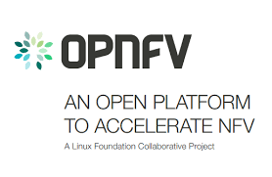
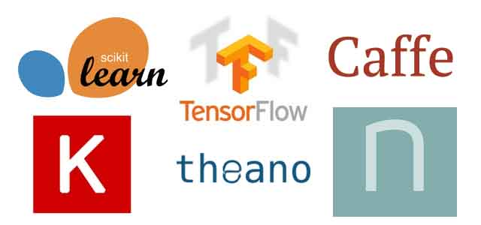
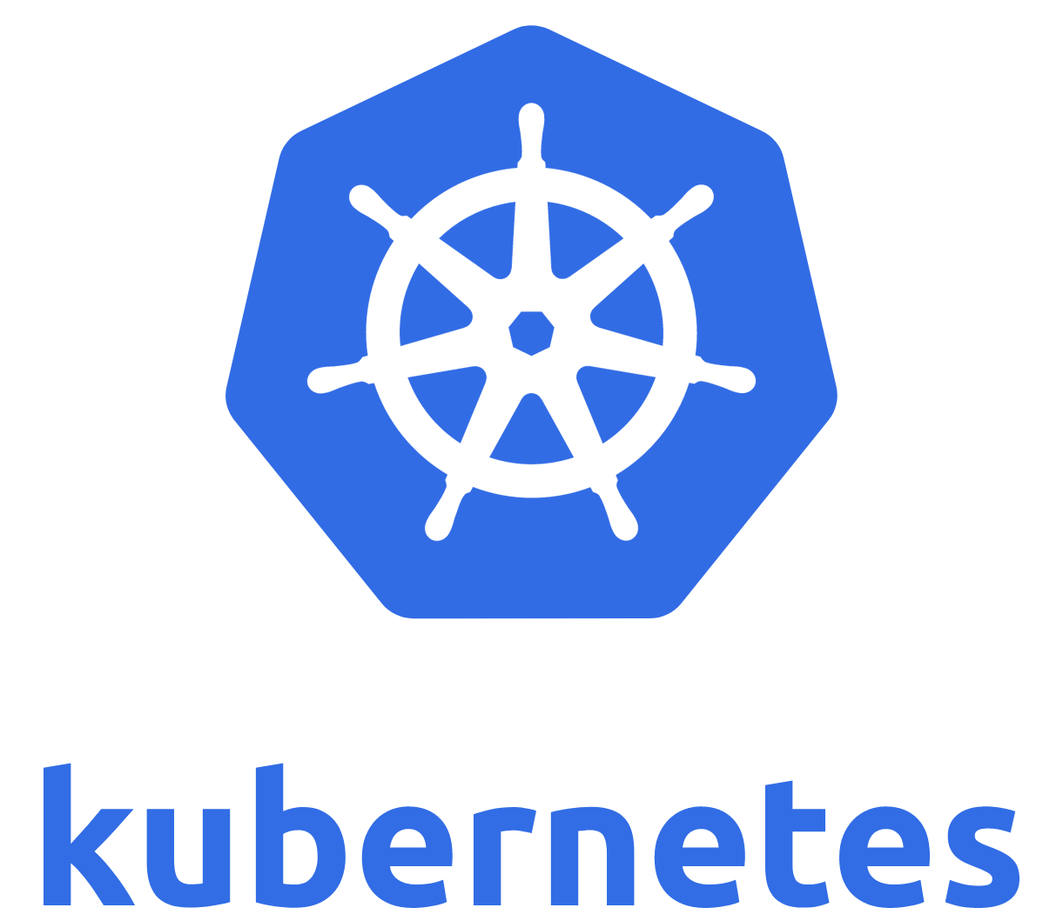
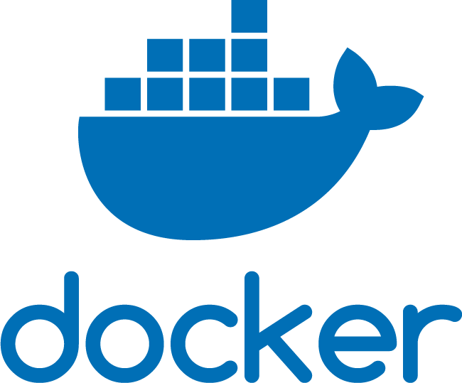
Significant Telco Open Source Communities
Sprint Launches C3PO – Open Source NFV/SDN–Based Mobile Core Reference Solution
Notes:
Puck is going: Radios, commodity servers and switches, Open Source software

Slide 6
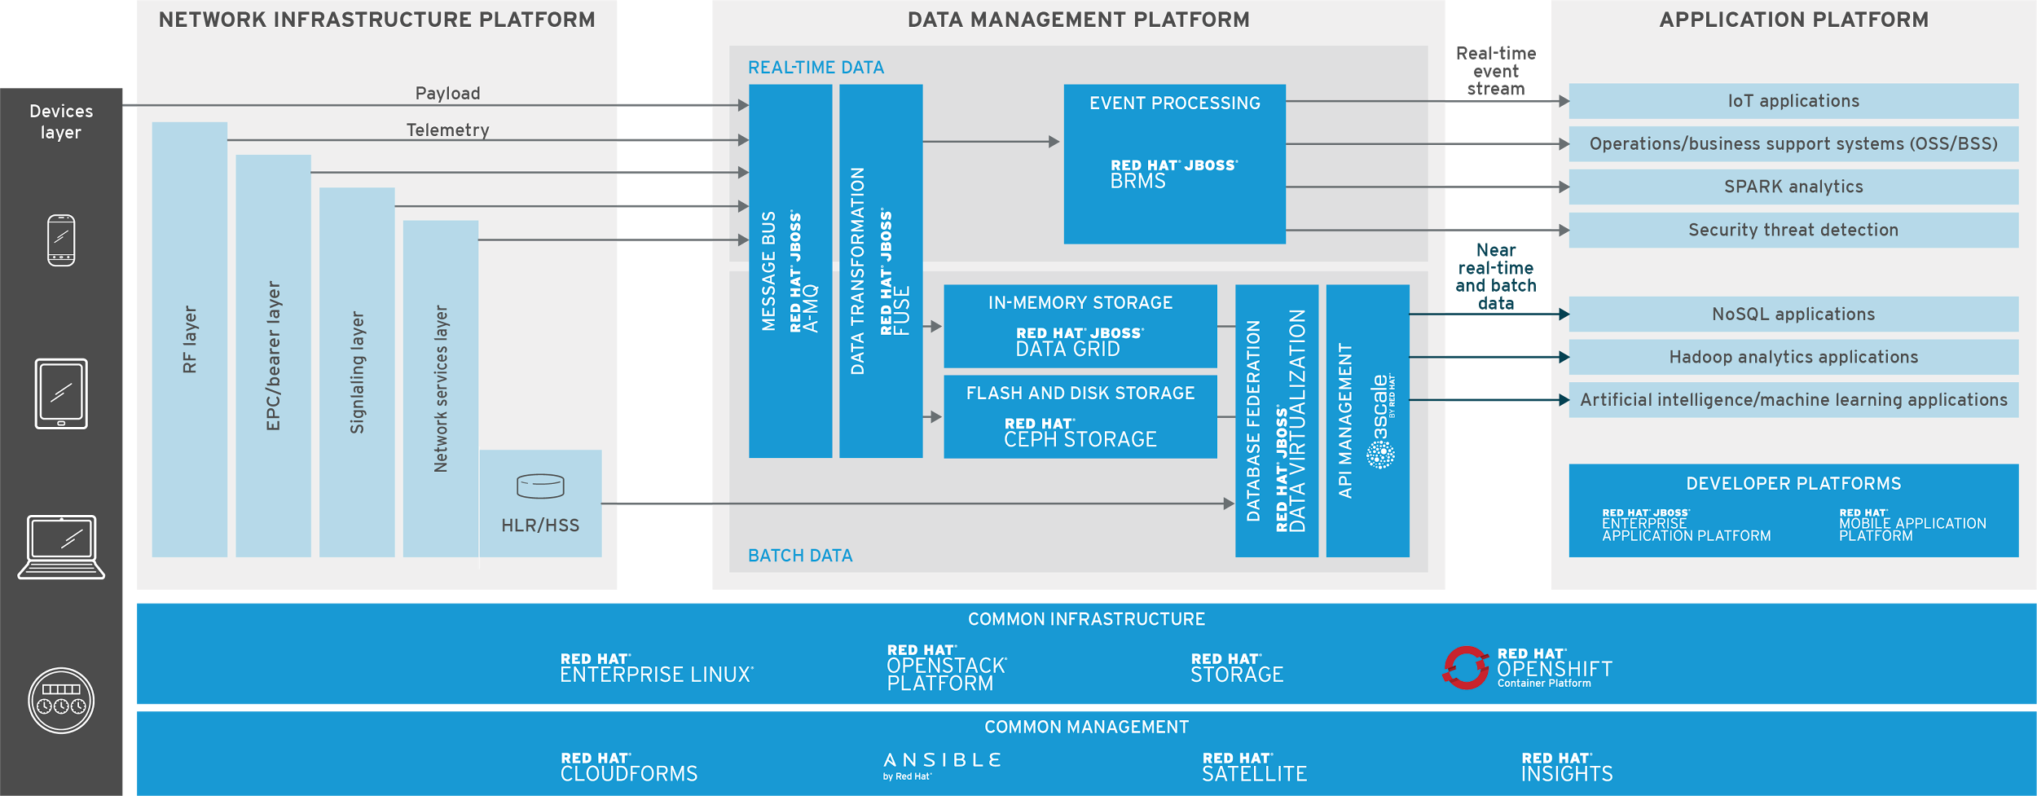
Platforms Must Share Common Infrastructure and Management
Notes:
standard red hat slide - no changes
With Mobile Edge Computing (MEC), all three of these platforms may reside at the edge, in 10’s of thousands of locations. You need a common horizontal infrastructure to support everything at the site, and the ability to centrally manage that remote infrastructure.

Slide 7
NFV Moves Networks from Mainframe Era to Cloud Era
TRADITIONAL NETWORK APPLIANCE APPROACH
VIRTUALIZED NETWORK APPLIANCE APPROACH
DPI
SBC
BRAS
VNFs
MANO
DPI
GGSN/SGSN
BRAS
PE router
Firewall
CG-NAT
RNC
GGSN/SGSN
PE router
WAN accel.
WAN
acceleration
Carrier-grade
NAT
Session Border
Controller
Message
router
NFVi
Firewall
Radio Access
Network Controller
CDN
NFVi Hardware
Network functions based on specific hardware/software
Fragmented non-commodity hardware
One physical node per role
Notes:
By running core network functions as software on common hardware platforms, virtualization reduces cost of equipment and operations in the core network

Slide 8
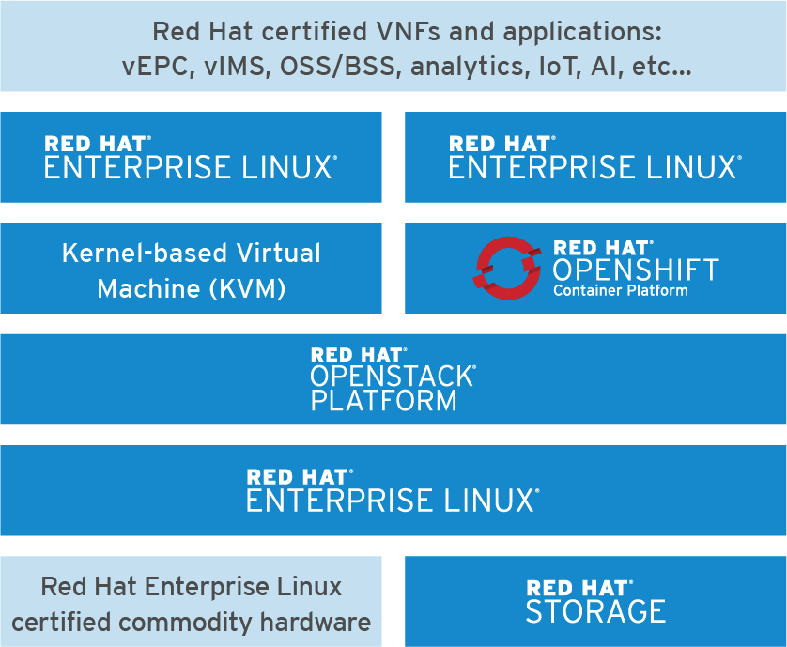
Red Hat Telco Cloud / NFV Infrastructure
OpenStack IaaS with OpenShift Container PaaS
Common Infrastructure for all workloads:
Supports VNFs and Applications on Virtual Machines or Containers*
Scales by adding x86 servers and commodity switches
Red Hat certification of stack from application through hardware enables full stack supportability
Management and Automation with Red Hat CloudForms and Ansible
Notes:
Common mistake made by others – start with OpenStack, customize with proprietary code to make an NFV VIM.
Red Hat did not set out to create a specialized NFV VIM. Instead, we worked within the community to develop an OpenStack cloud platform that is sufficiently robust to serve as an NFV VIM.

Slide 9
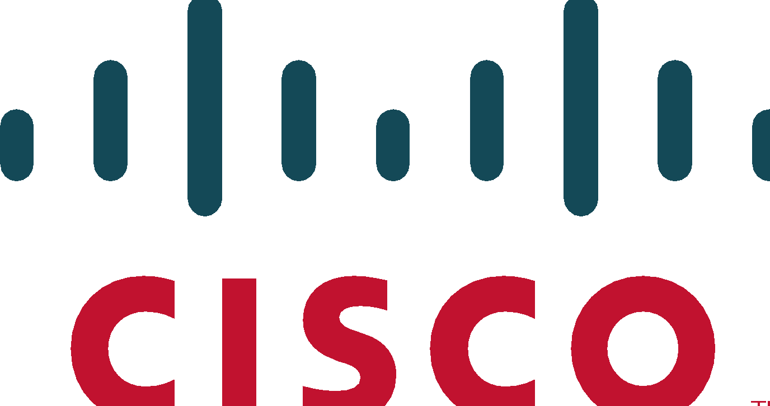
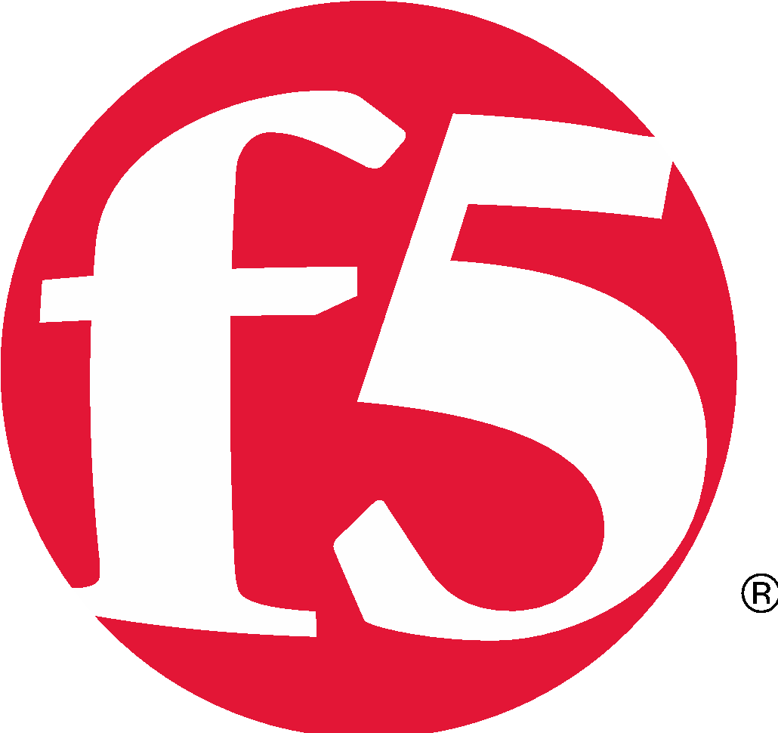
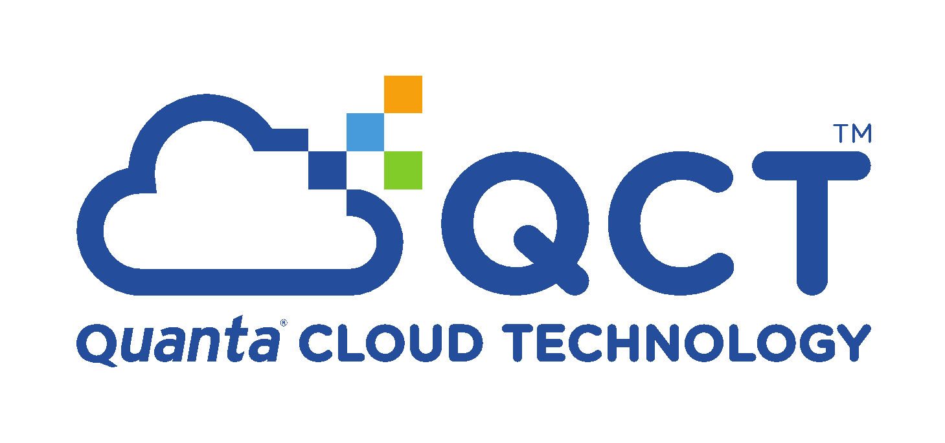
Robust Ecosystem Prevents Vendor Lock-in
Telco ISV ecosystem
Telco NEP ecosystem
Telco OEM ecosystem
Telco GSI ecosystem
Notes:
Helps explain what I believe is an important reason why John selected us - we offer vendor choice, reducing vendor lock-in and making the next slide reality

Slide 10
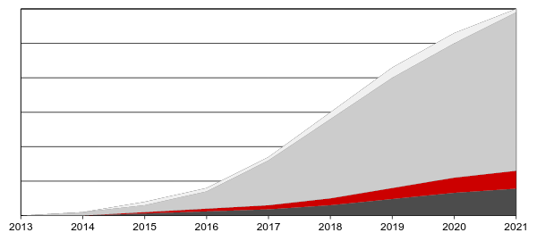
VNF SPEND IS MUCH LARGER THAN NFVI SPEND
OpenStack NFVi software creates abstraction layer that reduces vendor lock-in
Spend on NFV will accelerate in 2017, and is expected to grow at 116% CAGR through 2021 to nearly $158B*
MANO
VNF
NFVi Software
NFVi Hardware
Result: VNF vendors compete for CSP business every day, not just during the RFX
Source: Dell’Oro NFV Forecast, May 2017
*TBR NFV/SDN Telecom Market Landscape Report- March 2017
Notes:
Note that NFVi includes the hardware – the Red Hat software portion is less than 10% of the total NFV costs.
Our ecosystem helps avoid vendor lock-in, forcing VNF vendors to compete every day, not just during RFX.
Red Hat NFVi provides leverage for initial and ongoing negotiations with VNF vendors
A common NFVi reduces vendor lock-in, so VNF vendors must constantly compete.

Slide 11
Platforms Must Share Common Infrastructure and Management
Notes:
focus on new ETSI Zero Touch ISG initiatives using Data Management Platform, Analytics, and AI. All of these innnovations are being developed in Open Source. Perhaps we should add an EBTO slide and discuss it within the scope of Zero Touch? Perhaps we want to shrink this graphic and add the AI/ 0Touch / MANO pieces, all of which are going to be Open Source?
This is the closing slide, should emphasize our opening statement about radio, hardware, and open source comprising the entire network

Slide 12
SPRINT – LEVERAGING RED HAT
SOLUTIONS
John Felton, Vice president, Enterprise Services

Slide 13
RED HAT ENTERPRISE LINUX OS AND CLUSTER
Over 7,000 images supporting business platforms
Target-state for web and app, displacing competitors’ solutions
Cost-effective x86 solution
Stable and highly available
Responsive Red Hat® support

Slide 14
RED HAT CLOUDFORMS PORTAL
Internal cloud service for IT developers
Displaced competitor cloud solution
Enables agile deployment and creative solutions
Self-service capabilities provides instant access to infrastructure
Promotes a standardized development environment, reducing variation

Slide 15
RED HAT OPENSTACK PLATFORM
AND ANSIBLE TOWER BY RED HAT
Strategic VIM solution for NFV deployments
30+ Red Hat Openstack® Platform deployments underway for voice over long-term evolution (VoLTE) and other network functions
Integration with data plane development kit (DPDK) for greater network throughput
Ansible Tower by Red Hat advances NFV automation strategy with playbooks
Innovative support services and cost model

Slide 16
OPERATIONAL BENEFITS
Red Hat Enterprise Linux® displaces other UNIX platforms with a low-complexity maintenance model
Ease of packaging and distribution; improved stability
Red Hat CloudForms integrates well with our automation platform
Easy access to skilled Red Hat support personnel
Knowledgeable professional services staff engaged in our NFV program for Red Hat OpenStack Platform and Ansible Tower by Red Hat

