Slide 1
Bringing Together Linux-based Switches and Neutron
Notes:
Speaker: Nolan

Slide 2
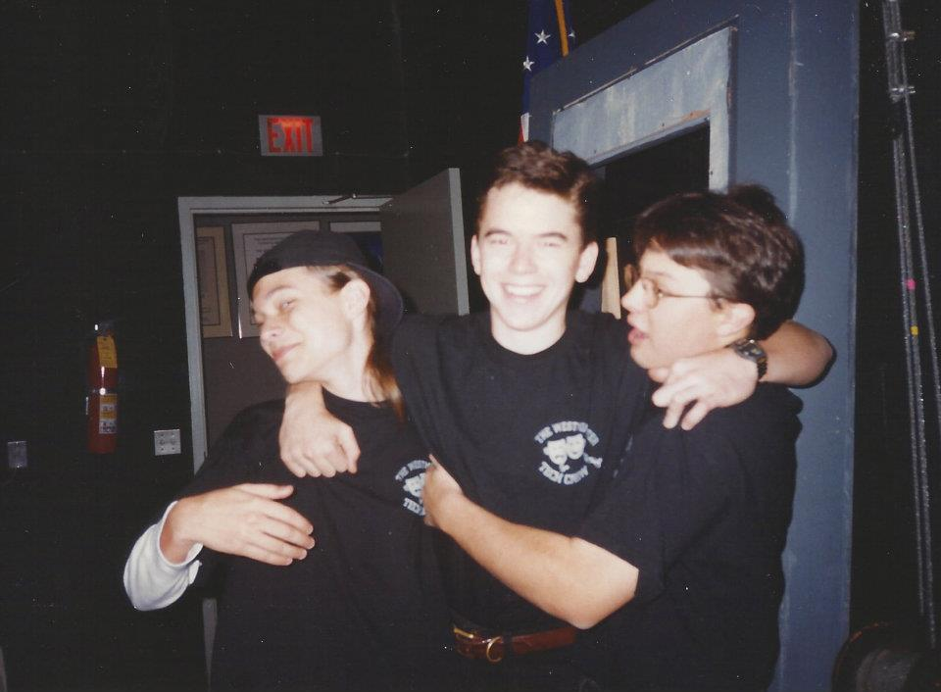
Who We Are
Nolan Leake
Cofounder, CTO
Cumulus Networks
Chet Burgess
Senior Director, Engineering
Metacloud
Notes:
Speaker: Nolan & Chet

Slide 3
Why Linux-Based Switches?
Everyone knows how to configure Linux Networking
VMs
Development, Testing, Demos
Create complex topologies on laptops
Cumulus Linux
Linux Distribution for HW switches (Debian based)
Hardware accelerate Linux kernel forwarding using ASICs
Just like a Linux server with 64 10G NICs, but ~50x faster
Notes:
Speaker: Nolan

Slide 4
“Unmanaged”
Physical
Switches
eth1
DHCP agent
Network Controller
dnsmasq
L3 Agent
L3 agent
Neutron Server
br101
br102
Neutron ML2 Driver
eth0.101
eth0.102
Linux Bridge ML2 mechanism driver
eth0
Trunked
Linux Bridge Agent
Switch
swp2
vm01
vm02
vm03
br0
tap01
tap02
tap03
swp1
br101
br102
Trunked
eth0.101
eth0.102
Hypervisor
eth0
vlan101
vlan102
Trunked
Notes:
Speaker: Nolan

Slide 5
Configured by Vendor Proprietary ML2 Mechanism Driver
eth1
DHCP agent
Network Controller
dnsmasq
L3 Agent
L3 agent
Vendor Proprietary
Managed Physical
Switches
br101
br102
Neutron Server
Neutron ML2 Driver
eth0.101
eth0.102
Vendor Proprietary ML2 mechanism driver
eth0
Trunked
Linux Bridge Agent
Switch
swp2
vm01
vm02
vm03
Vendor Specific Magic
tap01
tap02
tap03
Vendor Agent
swp1
br101
br102
Trunked
eth0.101
eth0.102
Hypervisor
eth0
vlan101
vlan102
Trunked
Notes:
Speaker: Nolan

Slide 6
Configured by Linux Switch ML2 Mechanism Driver
eth1
DHCP agent
Network Controller
dnsmasq
L3 Agent
L3 agent
Linux Managed
Physical
Switches
br101
br102
Neutron Server
Neutron ML2 Driver
eth0.101
eth0.102
Linux Bridge ML2 mechanism driver
eth0
Trunked
Linux Bridge Agent
Switch
swp2
vm01
vm02
vm03
swp2.101
swp2.102
br101
br102
tap01
tap02
tap03
swp1.101
swp1.102
Linux Switch Agent
swp1
br101
br102
Trunked
eth0.101
eth0.102
Hypervisor
eth0
vlan101
vlan102
Trunked
Notes:
Speaker: Nolan

Slide 7
Implementation
Prototype agent that runs on Linux based switches
Based on existing Linux Bridge Agent
Leverage existing ML2 notification frame work
Agent gets notified of certain events
port create, port update, port delete
Examines event and takes action when appropriate
Notes:
Speaker: Chet

Slide 8
What’s left to do?
Add support for trunking between switches
Add support for LLDP based topology mapping
State Synchronization
agent/switch restarts
Detect topology change
Refactor to share code with Linux Bridge Agent
Upstream in Icehouse
Notes:
Speaker: Chet

Slide 9
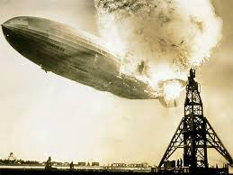
Demo

Slide 10
Is L2 the right tool for the job?
Traditional DC Network Design
L2/L3 demarcation point at aggregation layer
Challenges:
Aggregation points must be highly available and redundant
Aggregate scalability
MAC/ARP, VLANs, choke point for East-West connectivity
Too many protocols
Proprietary protocols/extensions
Notes:
Speaker: Nolan

Slide 11
Traditional Enterprise Network Design
Core
ECMP
L3
Aggregation
L2
VRRP
VRRP
STP
STP
Access
Notes:
Speaker: Nolan

Slide 12
L3: A better design
IP Fabrics Are Ubiquitous
Proven at megascale
ECMP
Better failure handling
Predictable latency
No east/west bottleneck
Simple Feature Set
Scalable L2/L3 Boundary
SPINE
LEAF
Notes:
Speaker: Nolan

Slide 13
How would this work?
VM Connectivity
ToR switches announce /32 for each VM
L3 Agents on hypervisor
Hypervisors have /32 route pointing to TAP device
No bridges
Floating IP
Hypervisor announces /32 for Floating IP
1:1 NAT to private IP on hypervisor
Notes:
Speaker: Chet
VM Mobility Notes:
-Leverage existing notification used during migrations

Slide 14
How would this work?
VM Mobility
Withdraw /32 from source, announce on destination
Scalability
Average VM will have 1-2 IP addresses (fixed, floating)
Current gen switching hardware handles ~20K routes
Next gen switches hardware handles ~100K routes
1 OSPF zone per ~500 hypervisors*
Security/Isolation
VMs are L2 isolated (no bridges)
L3 isolation via existing security groups
Notes:
Speaker: Chet
Scaling Notes:
-If route limit exceeded create OSPF areas and use inter-area routers for connectivity

Slide 15
Q&A

