Slide 1
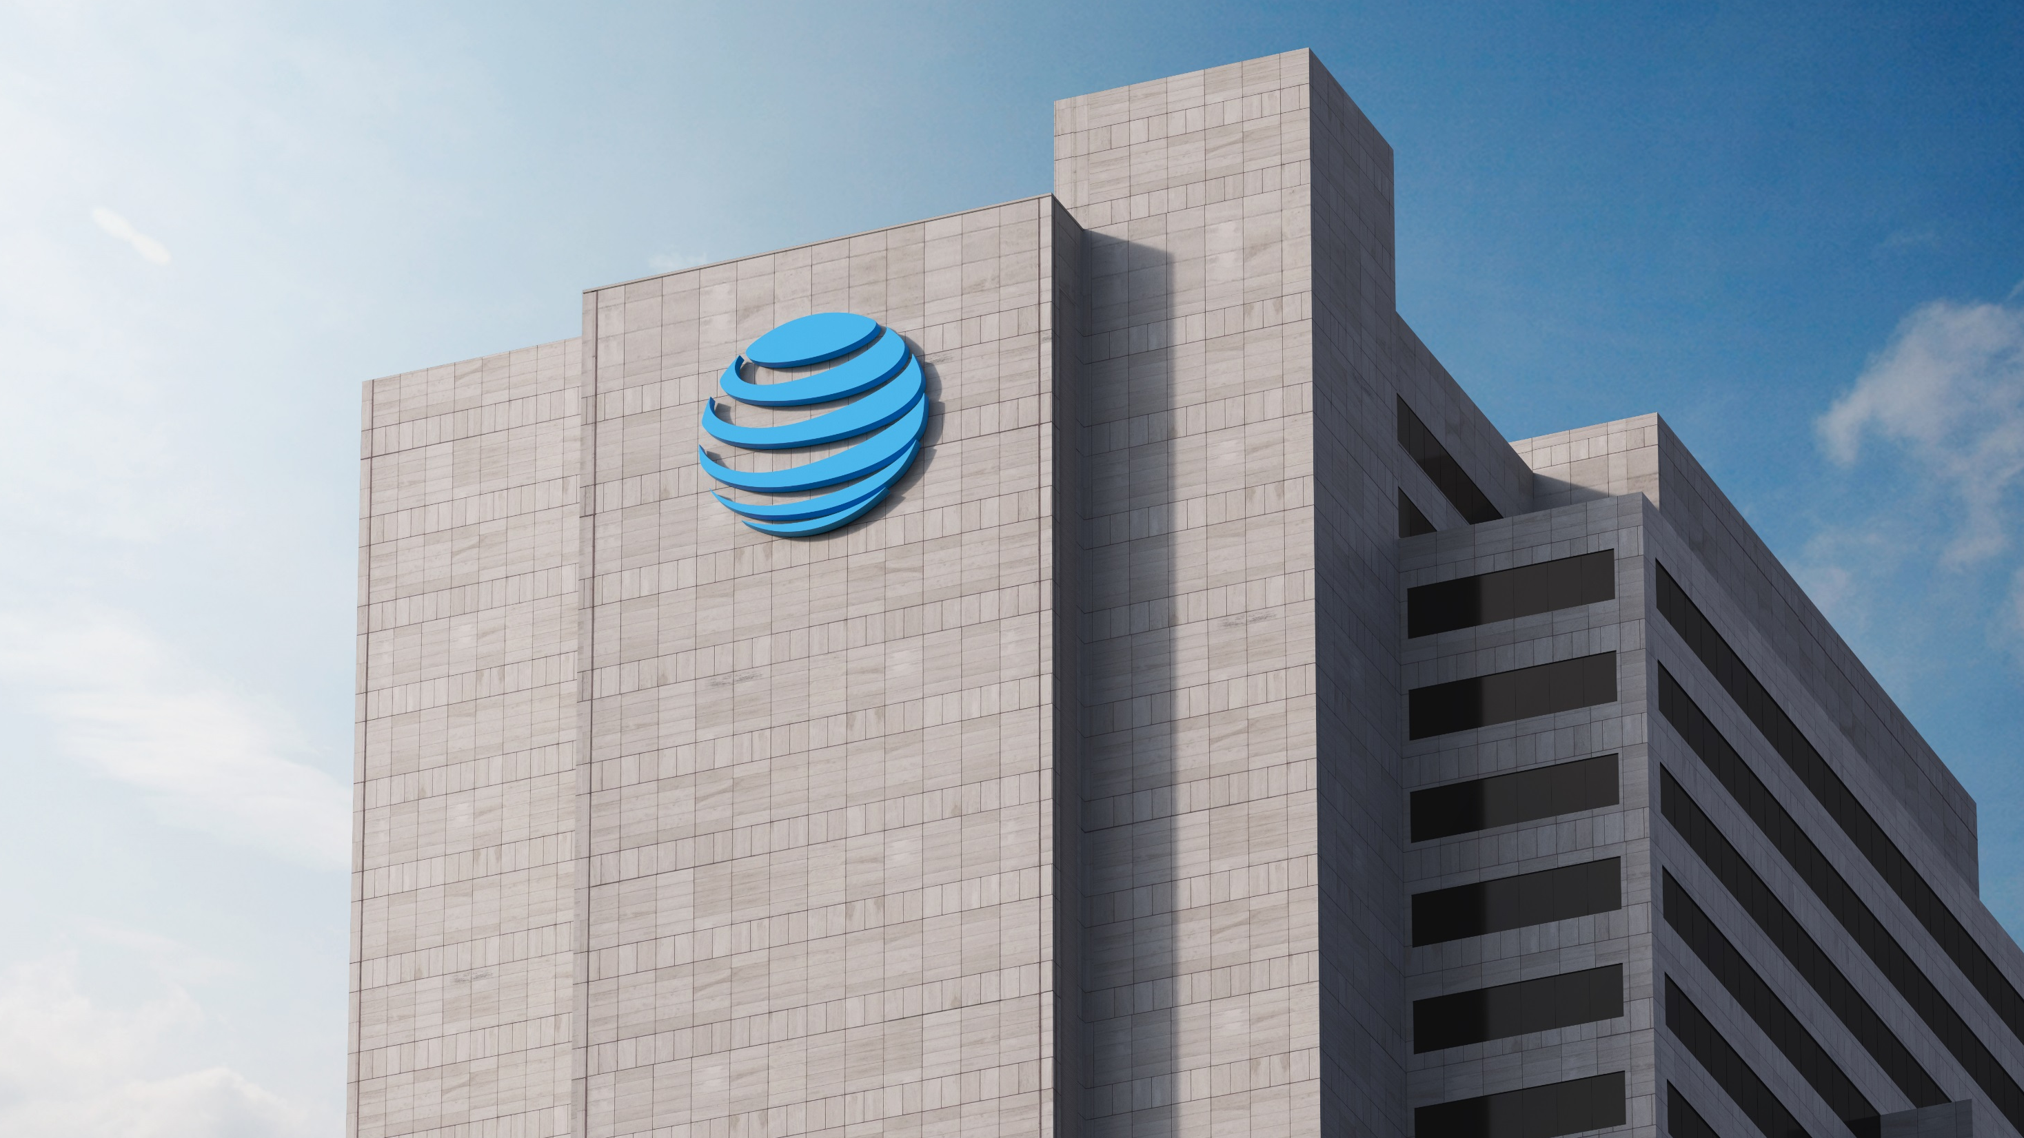
TELCO CLOUD NEXT GENERATION STACK UPDATE
What’s Changed with OpenStack-Helm and Tungsten Fabric-Helm
Alan Meadows – AT&T
Pete Birley – AT&T
Vinay Rao - Juniper
OpenStack Support Summit – 5/24/2018
ENTER THE TITLE OF YOUR OPENSTACK
PRESENTATION

Slide 2
AGENDA
Security
Containerization
Quality
Introduction
To Helm
AT&T
Usage Update
OpenStack-Helm
Project Update
Tungsten Fabric-Helm
Project Update
© 2018 AT&T Intellectual Property. All Rights Reserved. AT&T, the Globe logo, Mobilizing Your World and DirecTV are registered trademarks and service marks of AT&T Intellectual Property and/or AT&T affiliated companies. All other marks are the property of their respective owners.

Slide 3
INTRODUCTION to HELM
Security
Containerization
Quality
WHAT IS HELM?
Helm helps you manage Kubernetes applications with Charts. Helm Charts help you define, install,
and upgrade even the most complex Kubernetes applications.
WHAT IS OPENSTACK-HELM?
OpenStack-Helm provides a collection of Helm charts that deploy OpenStack and its related infrastructure services
on Kubernetes. It has an acute focus on the production quality as well as the life cycle management for each chart.
WHO CONTRIBUTES TO OPENSTACK-HELM?
AT&T
SKTelecom
99 Cloud
Nokia
© 2018 AT&T Intellectual Property. All Rights Reserved. AT&T, the Globe logo, Mobilizing Your World and DirecTV are registered trademarks and service marks of AT&T Intellectual Property and/or AT&T affiliated companies. All other marks are the property of their respective owners.

Slide 4
OPENSTACk-HELM RECAP
Security
Containerization
Quality
WHERE WERE WE IN SYDNEY?
All core OpenStack services working, and upgradable
All ancillary services to support OpenStack installable
Demonstrated hitless upgrades via Armada for all core services
Running services with OpenvSwitch and OpenContrail
Running Newton
© 2018 AT&T Intellectual Property. All Rights Reserved. AT&T, the Globe logo, Mobilizing Your World and DirecTV are registered trademarks and service marks of AT&T Intellectual Property and/or AT&T affiliated companies. All other marks are the property of their respective owners.

Slide 5
Progress since last summit
Security
Containerization
Quality
WHAT HAS CHANGED?
WHAT HAS CHANG
Dynamic Configuration & Dependencies
Consistent Patterns Across Charts
CronJobs for Maintenance
Incorporation of Operator Feedback
Network Enhancements: Linux Bridge, SRIOV support
Production Ready Ancillary Services
Using New Kubernetes Features
Gate on multiple versions of OpenStack and Images
Logging, Monitoring, and Alerting
© 2018 AT&T Intellectual Property. All Rights Reserved. AT&T, the Globe logo, Mobilizing Your World and DirecTV are registered trademarks and service marks of AT&T Intellectual Property and/or AT&T affiliated companies. All other marks are the property of their respective owners.

Slide 6
Progress since last summit
Security
Containerization
Quality
Combined Helm-Toolkit
Documentation, Documentation, Documentation
Goals of 1.0
Formalization of Standardization
Well Upgradability of All OpenStack-Helm Charts, not just OpenStack itself!
Defined Release Process
© 2018 AT&T Intellectual Property. All Rights Reserved. AT&T, the Globe logo, Mobilizing Your World and DirecTV are registered trademarks and service marks of AT&T Intellectual Property and/or AT&T affiliated companies. All other marks are the property of their respective owners.

Slide 7
AT&T USAGE
Security
Containerization
Quality
NETWORK CLOUD 1.0
PROGRESS SO FAR
How is AT&T changing the way we deploy and manage OpenStack in our Network Cloud?
Containers are now our new unit of software delivery across the stack
Sites defined declaratively in YAML – everything from Baremetal and Network assets (Hardare) to Helm Charts (Software)
OpenStack-Helm helps us deliver seamless updates, upgrades, and configuration changes to OpenStack based sites
Network Cloud deployed by Airship is the foundation to our 5G core platform supporting our 5G launch in 12 Cities this year.
We have already successfully deployed 5G PODs for system validation and are in the process of deploying several more to enable 5G delivery using Airship.
© 2018 AT&T Intellectual Property. All Rights Reserved. AT&T, the Globe logo, Mobilizing Your World and DirecTV are registered trademarks and service marks of AT&T Intellectual Property and/or AT&T affiliated companies. All other marks are the property of their respective owners.

Slide 8
AT&T USAGE
Security
Containerization
Quality
CP
© 2018 AT&T Intellectual Property. All Rights Reserved. AT&T, the Globe logo, Mobilizing Your World and DirecTV are registered trademarks and service marks of AT&T Intellectual Property and/or AT&T affiliated companies. All other marks are the property of their respective owners.

Slide 9
AT&T USAGE
Security
Containerization
Quality
CP
Host OS
Baremetal Operating System (Ubuntu 16.04)
© 2018 AT&T Intellectual Property. All Rights Reserved. AT&T, the Globe logo, Mobilizing Your World and DirecTV are registered trademarks and service marks of AT&T Intellectual Property and/or AT&T affiliated companies. All other marks are the property of their respective owners.

Slide 10
AT&T USAGE
Security
Containerization
Quality
CP
Docker
Container Runtime Engine
Host OS
Baremetal Operating System (Ubuntu 16.04)
© 2018 AT&T Intellectual Property. All Rights Reserved. AT&T, the Globe logo, Mobilizing Your World and DirecTV are registered trademarks and service marks of AT&T Intellectual Property and/or AT&T affiliated companies. All other marks are the property of their respective owners.

Slide 11
AT&T USAGE
Security
Containerization
Quality
CP
Kubernetes
Container Runtime Orchestration
Docker
Container Runtime Engine
Host OS
Baremetal Operating System (Ubuntu 16.04)
© 2018 AT&T Intellectual Property. All Rights Reserved. AT&T, the Globe logo, Mobilizing Your World and DirecTV are registered trademarks and service marks of AT&T Intellectual Property and/or AT&T affiliated companies. All other marks are the property of their respective owners.

Slide 12
AT&T USAGE
Security
Containerization
Quality
Helm
Kubernetes Release Management
CP
Kubernetes
Container Runtime Orchestration
Docker
Container Runtime Engine
Host OS
Baremetal Operating System (Ubuntu 16.04)
© 2018 AT&T Intellectual Property. All Rights Reserved. AT&T, the Globe logo, Mobilizing Your World and DirecTV are registered trademarks and service marks of AT&T Intellectual Property and/or AT&T affiliated companies. All other marks are the property of their respective owners.

Slide 13
AT&T USAGE
Security
Containerization
Quality
Ceph(SDS)
CNI (SDN)
Promenade
Shipyard
Drydock
Armada
Deckhand
Helm
Kubernetes Release Management
CP
Kubernetes
Container Runtime Orchestration
Docker
Container Runtime Engine
Host OS
Baremetal Operating System (Ubuntu 16.04)
© 2018 AT&T Intellectual Property. All Rights Reserved. AT&T, the Globe logo, Mobilizing Your World and DirecTV are registered trademarks and service marks of AT&T Intellectual Property and/or AT&T affiliated companies. All other marks are the property of their respective owners.

Slide 14
AT&T USAGE
Security
Containerization
Quality
Ops
Logging
Monitoring
Alerting
Security
Ceph(SDS)
CNI (SDN)
Promenade
Shipyard
Drydock
Armada
Deckhand
Helm
Kubernetes Release Management
CP
Kubernetes
Container Runtime Orchestration
Docker
Container Runtime Engine
Host OS
Baremetal Operating System (Ubuntu 16.04)
© 2018 AT&T Intellectual Property. All Rights Reserved. AT&T, the Globe logo, Mobilizing Your World and DirecTV are registered trademarks and service marks of AT&T Intellectual Property and/or AT&T affiliated companies. All other marks are the property of their respective owners.

Slide 15
AT&T USAGE
Security
Containerization
Quality
Service
SDN
OpenStack
Ops
Logging
Monitoring
Alerting
Security
Ceph(SDS)
CNI (SDN)
Promenade
Shipyard
Drydock
Armada
Deckhand
Helm
Kubernetes Release Management
CP
Kubernetes
Container Runtime Orchestration
Docker
Container Runtime Engine
Host OS
Baremetal Operating System (Ubuntu 16.04)
© 2018 AT&T Intellectual Property. All Rights Reserved. AT&T, the Globe logo, Mobilizing Your World and DirecTV are registered trademarks and service marks of AT&T Intellectual Property and/or AT&T affiliated companies. All other marks are the property of their respective owners.

Slide 16
AT&T USAGE
Security
Containerization
Quality
Service
SDN
OpenStack
Ops
Logging
Monitoring
Alerting
Security
Ceph(SDS)
CNI (SDN)
Promenade
Shipyard
Drydock
Armada
Deckhand
CI / CD Drives Life-cycle Mgmt.
Helm
Kubernetes Release Management
CP
Kubernetes
Container Runtime Orchestration
Docker
Container Runtime Engine
Host OS
Baremetal Operating System (Ubuntu 16.04)
© 2018 AT&T Intellectual Property. All Rights Reserved. AT&T, the Globe logo, Mobilizing Your World and DirecTV are registered trademarks and service marks of AT&T Intellectual Property and/or AT&T affiliated companies. All other marks are the property of their respective owners.

Slide 17
AT&T USAGE
Security
Containerization
Quality
Service
SDN
OpenStack
Ops
Logging
Monitoring
Alerting
Security
OpenStack HELM
Ceph(SDS)
CNI (SDN)
Promenade
Shipyard
Drydock
Armada
Deckhand
CI / CD Drives Life-cycle Mgmt.
Helm
Kubernetes Release Management
CP
Kubernetes
Container Runtime Orchestration
Docker
Container Runtime Engine
Host OS
Baremetal Operating System (Ubuntu 16.04)
© 2018 AT&T Intellectual Property. All Rights Reserved. AT&T, the Globe logo, Mobilizing Your World and DirecTV are registered trademarks and service marks of AT&T Intellectual Property and/or AT&T affiliated companies. All other marks are the property of their respective owners.

Slide 18
OPENSTACK-HELM UPDATE
Security
Containerization
Quality
Ceph-Helm
Helm
Tungsten Fabric
Kubernetes Entry Point
Airship
LOCI
Akraino
Calico
What’s Next?
Stickers
Project Approachability
Core Team Expansion
Cross Community Collaboration
Other
Community
Impacts
© 2018 AT&T Intellectual Property. All Rights Reserved. AT&T, the Globe logo, Mobilizing Your World and DirecTV are registered trademarks and service marks of AT&T Intellectual Property and/or AT&T affiliated companies. All other marks are the property of their respective owners.

Slide 19
TUNGSTEN FABRIC-HELM
19

Slide 20
TUNGSTEN FABRIC-HELM RECAP
WHERE WERE WE IN SYDNEY?
Introduced OpenContrail Helm charts
All Opencontrail components were containerized working and upgradable
Demonstrated hitless upgrades
Dynamic VNF Service Chaining DEMO
Running Newton
20

Slide 21
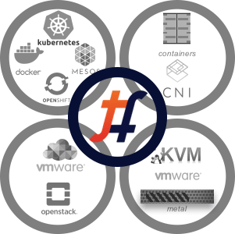
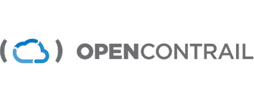
Project Evolved
TUNGSTEN FABRIC-HELM WHAT’s CHANGED ?
https://opencontrail.org/
https://tungstenfabric.io
© 2018 AT&T Intellectual Property. All Rights Reserved. AT&T, the Globe logo, Mobilizing Your World and DirecTV are registered trademarks and service marks of AT&T Intellectual Property and/or AT&T affiliated companies. All other marks are the property of their respective owners.

Slide 22
SINGLE SDN ACROSS PLATFORMS
Web UI
Apps
OpenStack
Other Orch.
Operator
Config
Analytics
Network & Policy Definition
HA enabled, logically centralized
On-prem / Public Cloud
Connectivity, Security Policies & Analytics / Monitoring
Tags, Address Groups & FW Policies through API’s
CONTROLLER
FW Mgmt Platform
L4 policy configurations
Multiple Policy Enforcement points
Host Based L7 Firewall
Bare Metal Server
Compute with vRouter
(Kernel / DPDK, vCenter)
Public Cloud Instance
Smart NIC vRouter
FIREWALL
vRouter enforcing L4 policies and sending traffic to L7 FW for advanced security services
© 2018 AT&T Intellectual Property. All Rights Reserved. AT&T, the Globe logo, Mobilizing Your World and DirecTV are registered trademarks and service marks of AT&T Intellectual Property and/or AT&T affiliated companies. All other marks are the property of their respective owners.

Slide 23
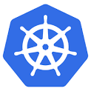
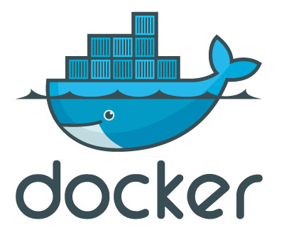
Tungsten Fabric Evolution to Micro services
Contrail-Control (5 daemons)
Contrail-Config ( 8 daemons)
Contrail-Analytics (5 daemons)
Contrail-WebUI ( 4 daemons)
Contrail-DB (3 daemons)
Contrail-vRouter (3 D) + Kernel/DPDK (FP)
Multiple Process running in one Container (FAT Containers)
Contrail Controller: 2n+1
VM
VM
VM
27-30 Containers Images
OR
Analytics
DB
Config +
Control
Analytics
BMS
Kube
MGR
HA
Proxy
vRouter
Agent
Contrail 1.X/2.X/3.X
BMS or VMs base
(SDN Controller)
Contrail 5.X (Containers)
Microservices
(SDN Controller)
Contrail 4.X (Containers)
BMS or VMs base
(SDN Controller)
© 2018 AT&T Intellectual Property. All Rights Reserved. AT&T, the Globe logo, Mobilizing Your World and DirecTV are registered trademarks and service marks of AT&T Intellectual Property and/or AT&T affiliated companies. All other marks are the property of their respective owners.

Slide 24
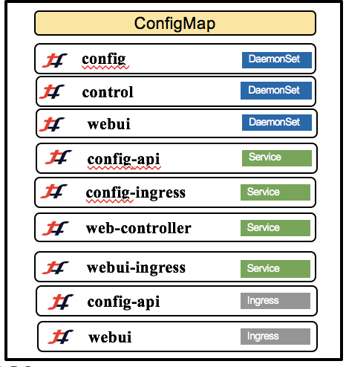
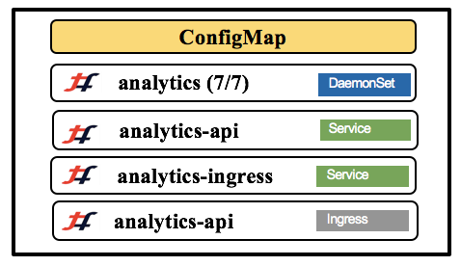
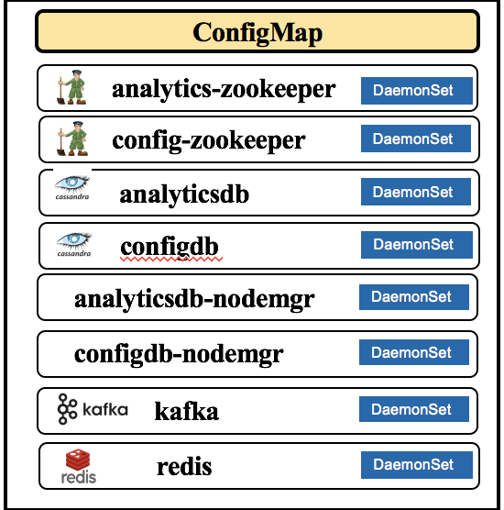
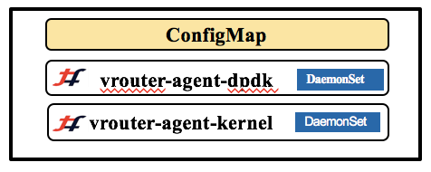
HELM CHART EVOLUTION
OpenContrail Controller
OpenContrail Vrouter
SYDNEY
VANCOUVER
Controller
Analytics
3rd Party
VRouter
DPDK BASED VROUTER
© 2018 AT&T Intellectual Property. All Rights Reserved. AT&T, the Globe logo, Mobilizing Your World and DirecTV are registered trademarks and service marks of AT&T Intellectual Property and/or AT&T affiliated companies. All other marks are the property of their respective owners.

Slide 25
FEATURES ENHANCHED
REMOTE COMPUTE
VROUTER TO VROUTER ENCRYPTION
FAT FLOW ENCHANCHMENTS
SUPPORT FOR HYBRID CLOUD ARCHITECTURES
INTENT DRIVEN POLICY FRAMEWORK
OCATA SUPPORT
GATEWAYLESS FORWARDING
UPSTREAM GATE ENABLED
© 2018 AT&T Intellectual Property. All Rights Reserved. AT&T, the Globe logo, Mobilizing Your World and DirecTV are registered trademarks and service marks of AT&T Intellectual Property and/or AT&T affiliated companies. All other marks are the property of their respective owners.

Slide 26
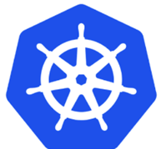
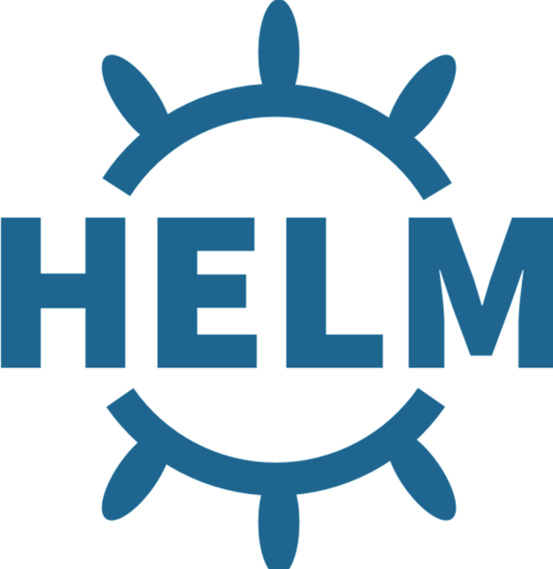
NEXT STEPS FOR TF HELM
OPENSTACK HELM NAMESPACE
TF for OS-HELM-INFRA
DPDK/VROUTER & SRIOV COEXISTENCE
Neutron ML2 PLUGIN
COMMUNITY COLLABORATIONS
TF Helm
© 2018 AT&T Intellectual Property. All Rights Reserved. AT&T, the Globe logo, Mobilizing Your World and DirecTV are registered trademarks and service marks of AT&T Intellectual Property and/or AT&T affiliated companies. All other marks are the property of their respective owners.

Slide 27
Where to Start
Openstack Helm:
https://wiki.openstack.org/wiki/Openstack-helm
Tungsten Fabric Helm:
https://tungsten.io/

Slide 28
CREDITS
Madhukar Nayakbomman -Juniper Networks
Qasim Araham - Juniper Networks

Slide 29
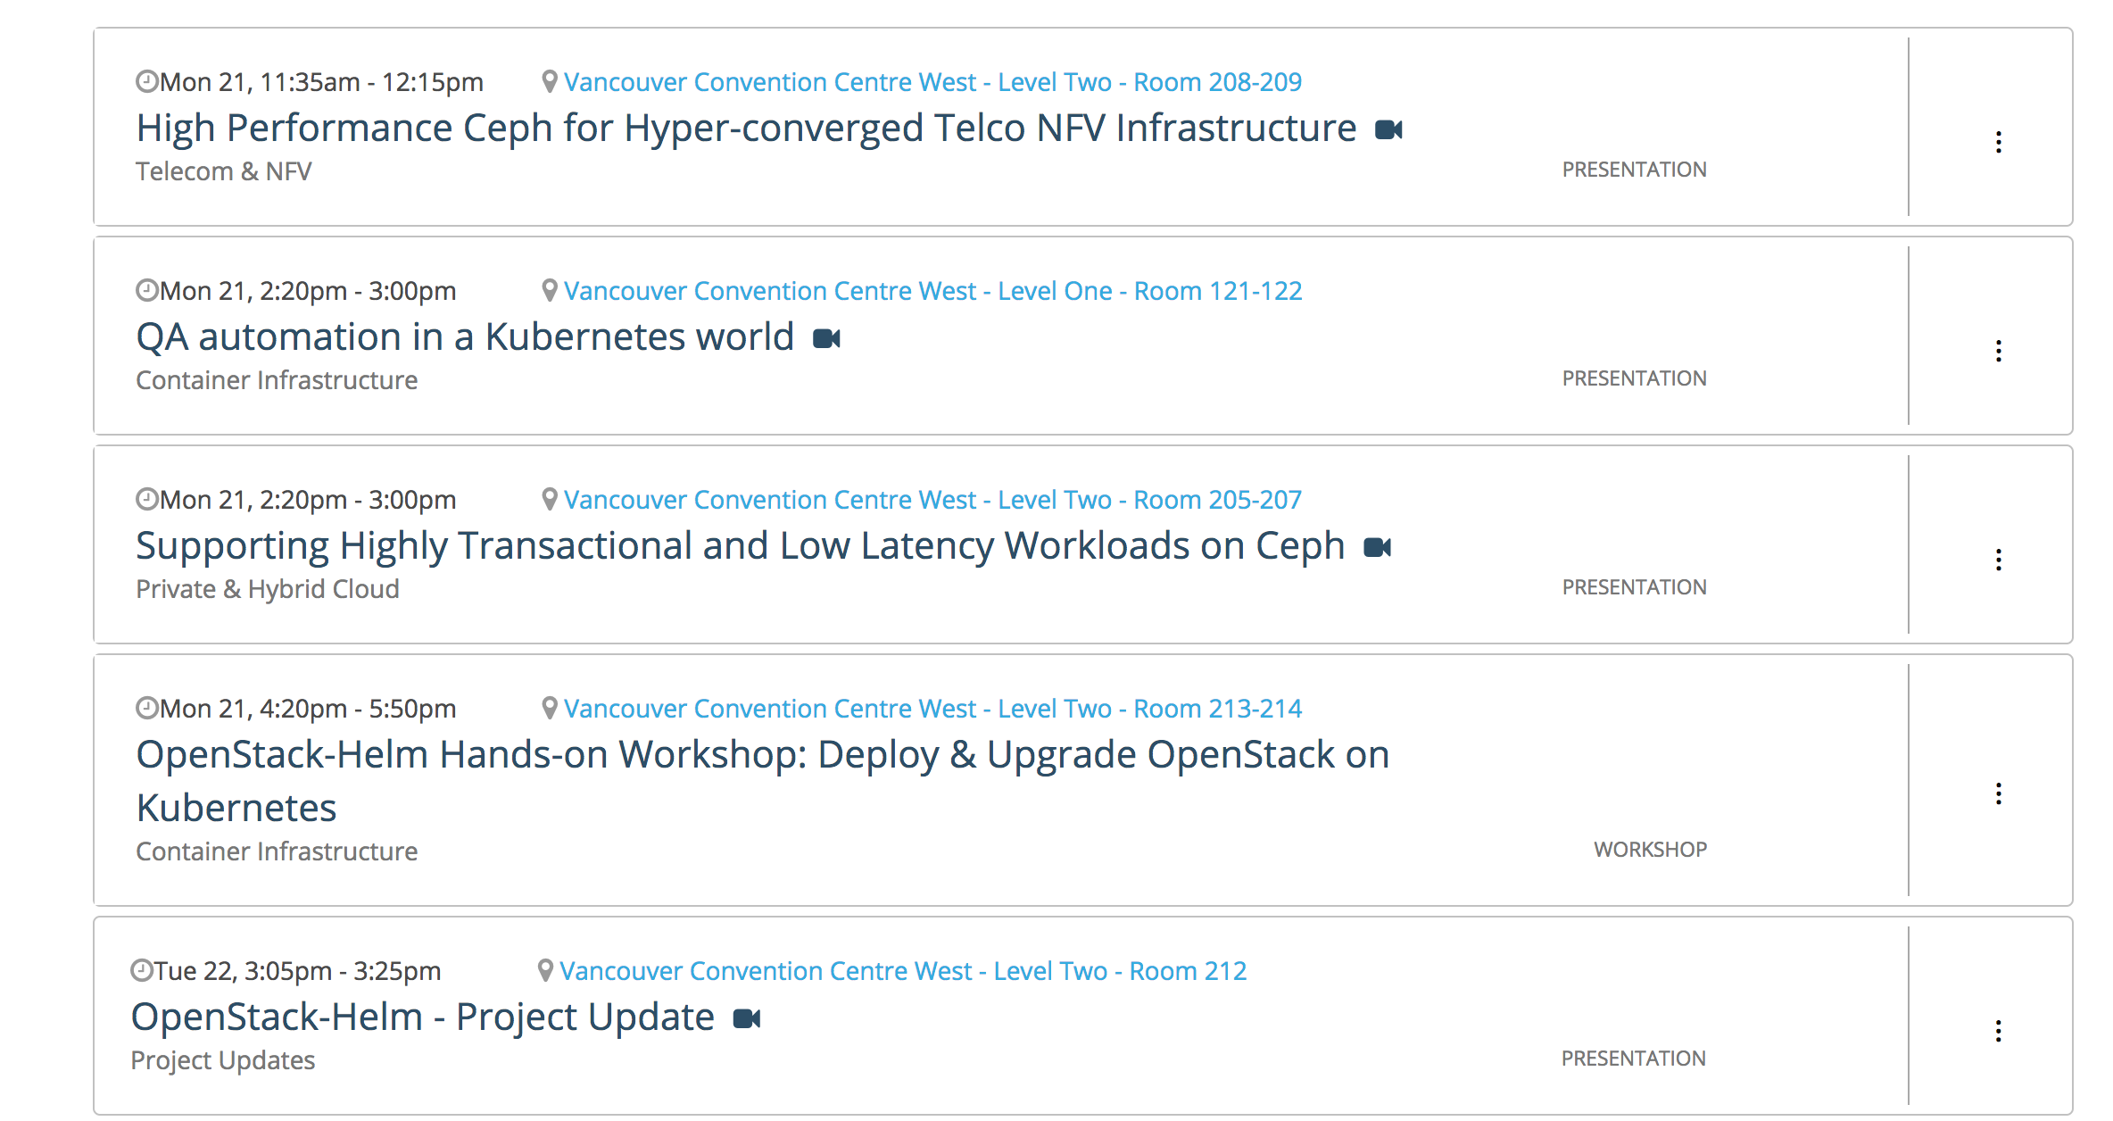
HELM SESSIONS AT VANCOUVER

Slide 30
Questions?
Alan Meadows (alan.meadows@att.com)
Rodolfo Pacheco (rodolfo.pacheco@att.com)
Vinay Rao (vinayrao@juniper.net)
LEARN MORE
Three Ways to Learn More About Airship
- https://airshipit.org
- IRC: #airshipit
- Mailing List: lists.airshipit.org
Three Ways to Learn More About OSH
https://github.com/openstack/openstack-helm
- IRC: #openstack-helm
- Mailing List: OpenStack Dev Mailing List
30
© 2018 AT&T Intellectual Property. All Rights Reserved. AT&T, the Globe logo, Mobilizing Your World and DirecTV are registered trademarks and service marks of AT&T Intellectual Property and/or AT&T affiliated companies. All other marks are the property of their respective owners.

