Slide 1
Seamless migration from Nova-network to Neutron in eBay production
Chengyuan Li, Han Zhou

Slide 2
Agenda
Overview of eBay Cloud Environment
Nova-network to Neutron Migration
Control Plane Migration
Data Plane Migration
Post-migration.
Demo

Slide 3
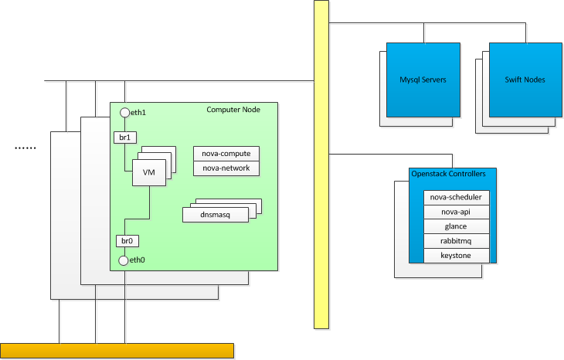
Folsom Nova-network

Slide 4
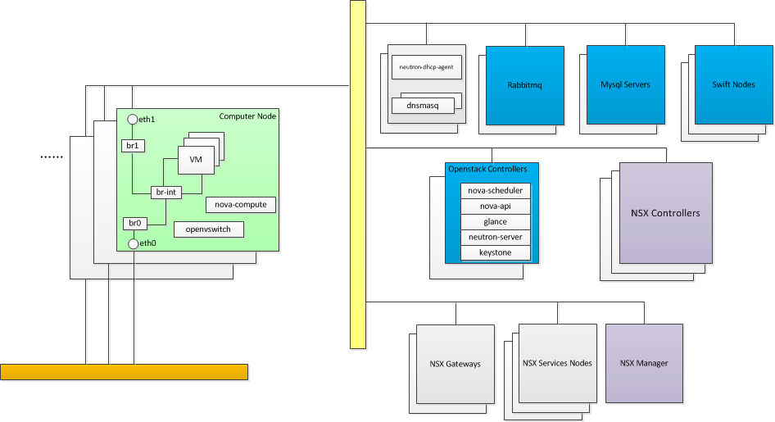
Havana Neutron + SDN Controller

Slide 5
Control Plane Migration
Setup Havana Openstack nodes
Openstack Controllers. (Keystone, Nova, Glance, Neutron)
Rabbitmq Servers.
MySQL Servers.
Setup NSX Nodes
NSX Controllers
NSX Manager
Transport zone creation in NSX controller.
All Hypervisors registration to NSX controller.
Havana OS Controller Nodes
NSX Nodes
Folsom OS Controller Nodes
Folsom
Nova-compute
VM
VM
VM
Compute Node

Slide 6
Control Plane Migration
Keystone, Nova, Glance DB migration.
Neutron net/subnet creation according to the information in
folsom nova.networks and nova.fixed_ips tables.
havana
export, import, db_sync
folsom
Keystone DB
Glance DB
Nova DB
Keystone DB
Glance DB
Nova DB
net-create
subnet-create
Neutron DB
nova.networks
nova.fixed_ips

Slide 7
Control Plane Migration
NSX Controller
Enable fake driver in nova-compute, and register to Controller.
Create port in Neutron and Attach port to VM
Neutron DB
new_port = {
"port": {
"network_id": network_id,
"mac_address": mac,
"fixed_ips": [
{
"subnet_id": subnet_id,
"ip_address": ip,
}
],
"tenant_id": tenant
}
}
neutron.create_port(new_port)
nova.interface_attach(port_id, "", "")
Havana Openstack Controller
Nova DB
Nova-compute with fake driver
VM
vnet

Slide 8
Control Plane Migration
Security Group
Default Security Group
{“remote_group_id”: “<self security group uuid>”, "direction": "ingress", "ethertype": "IPv4"},
{“remote_group_id”: “<self security group uuid>”, "direction": "ingress", "ethertype": "IPv6"},
{"direction": "egress", "ethertype": "IPv4"},
{"direction": "egress", "ethertype": "IPv6"}
Updated Security Group
{"direction": "ingress", "ethertype": "IPv4"},
{"direction": "ingress", "ethertype": "IPv6"},
{"direction": "egress", "ethertype": "IPv4"},
{"direction": "egress", "ethertype": "IPv6"}

Slide 9
Data Plane Migration
Install Open vSwitch
VM
VM
VM
Open vSwitch
vnetx
Linux bridge
br0
Host IP
eth0

Slide 10
Data Plane Migration
Remove VM interfaces from Linux bridge
Rename to tapxxxxx (Havana convention)
Remove physical interface from Linux bridge
Remove Linux bridge
VM connection lost!
VM
VM
VM
Open vSwitch
vnetx
tapxxxx
Linux bridge
br0
Host IP
Host IP
eth0

Slide 11
Data Plane Migration
Start OVS service
Create integration bridge: br-int
Create external bridge: br0, set external-id
Add eth0 to br0
Add host IP to br0, add host route
VM
VM
VM
Open vSwitch
tapxxxx
br-int
br0
Host IP
eth0

Slide 12
Data Plane Migration
Add VM interfaces to br-int
# ovs-vsctl add-port br-int vnetx -- \
set Interface tapxxxx external-ids:iface-id=<neutron port id> -- \
set Interface tapxxxx external-ids:attached-mac=<mac> -- \
set Interface tapxxxx external-ids:iface-status=active
Set SDN controller
# ovs-vsctl set-manager <NSX controller IP>
VM connection restored!
VM
VM
VM
OVSDB
NSX Controller
Open vSwitch
br-int
OpenFlow
tapxxxx
br0
Host IP
eth0

Slide 13
Post-migration
Prepare for next host reboot
Update /etc/sysconfig/network-scripts/ifcfg-xxx
For Ubuntu: update /etc/network/interface
Prepare for next VM reboot
Libvirt configuration update
# virsh define <new xml>
Problem:
Runtime information is not updated: VM reset will fail!
Hack:
Update libvirt runtime configuration under: /var/run/libvirt/qemu/<instance>.xml
Restart libvirtd service

Slide 14
Rollback
You never know …
Support rollback
Revert the steps
Automation

Slide 15
All in One
Havana Openstack Controller
neutron.create_port(new_port)
nova.interface_attach(port_id, "", "")
create port in
NSX controller
folsom
VM
(DHCP)
havana
Nova-compute
Nova-compute
(fake driver)
Nova-network
dnsmasq
br-int
vnet
OVSDB
/etc/sysconfig/network-scripts/ifcfg-ethx
/var/run/libvirt/qemu/<instance>.xml
Open vSwitch
br0
To NSX Controller
Linux bridge
br0
HV IP
openflow
HV IP
From NSX Controller
eth0

Slide 16
Demo

