Slide 1
An Evaluation of OpenStack Deployment Frameworks
November 5th, 2013
Brian Chong and Shane Gibson

Slide 2
Agenda
About Symantec and Us
What is Symantec Doing?
Proof-of-Concept Tools Requirements
Success Criteria
Testing Plan and Design
Provisioning Evaluation
Frameworks Tested
Things Not Tested
The Tools Tested
Testing OpenStack
Summary
Appendix

Slide 3
What is Symantec doing?

Slide 4
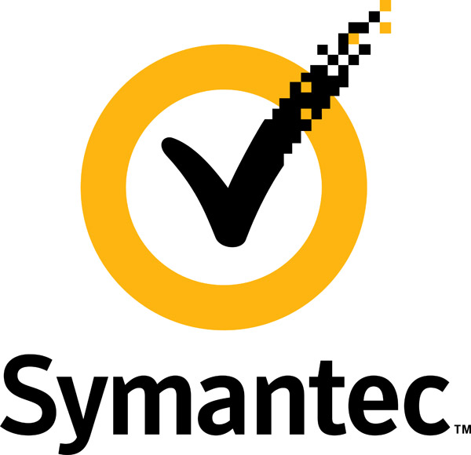
About Symantec and Us
About Symantec Making the world more secure… Enterprise system and data protection Norton branded consumer protection (not just Antivirus) Tackling the big problems… Pioneered the Big Data approach to malware detection Significant cloud presence (Norton, MessageLabs, OCSP, etc.) | About Brian Chong Infrastructure Architect for our OpenStack efforts Security & Network Focused Interested in securing OpenStack at all tiers
 | About Shane Gibson Infrastructure Architect for our OpenStack efforts Focused on the big picture from bare metal to full OpenStack clusters Interested in compute and object storage

Slide 5
What is Symantec Doing?
We are building a consolidated cloud platform that provides infrastructure and platform services to host Symantec SaaS applications
An exciting “greenfield” opportunity to re-invent our cloud infrastructure with strong executive leadership support
Building a global team in the US, Europe, and Asia of top-notch, open source minded engineers in the areas of cloud and big data
Our development model is to use open source components as building blocks
Identify capability gaps and contribute back to the community
We have selected OpenStack as one of the underlying infrastructure services layer
We plan to analyze and improve the overall security posture of OpenStack components
We are starting small, but will scale to thousands of nodes across multiple data centers
Questions? Our contact details are in the Appendix!

Slide 6
Proof-of-Concept Tools Requirements

Slide 7
Proof-of-Concept Tools Requirements
Capabilities
Bare metal provisioning and lifecycle management
Hardware/Environment Pre-Install Check
Installation/ Post-Install Check
Step Based Notification/Logging
Resilience
High Availability
Multi-Data Center Management
Multi-Zone (inter-DC, inter-region, etc.) Management
Complexity
Ability to manage complex configurations
Network, Hardware, High Availability, OpenStack configuration

Slide 8
Success Criteria

Slide 9
Success Criteria
OpenStack running in our datacenter; on our hardware
From bare metal to OpenStack running
Add/Delete/Modify OpenStack cluster members
Implementation with multi-network configuration
As few manual steps as possible (automated installation)
Ability to drive implementation via API
Completely documented steps to re-replicate
Our staff must be able to reproduce an install on additional clusters
OpenStack configuration validated via tests
Configuration/management via Horizon dashboard (“smoke test”)
Configuration/management via CLI API calls (in-house test harness)
Tempest tests run against installed configuration

Slide 10
Testing Plan and Design

Slide 11
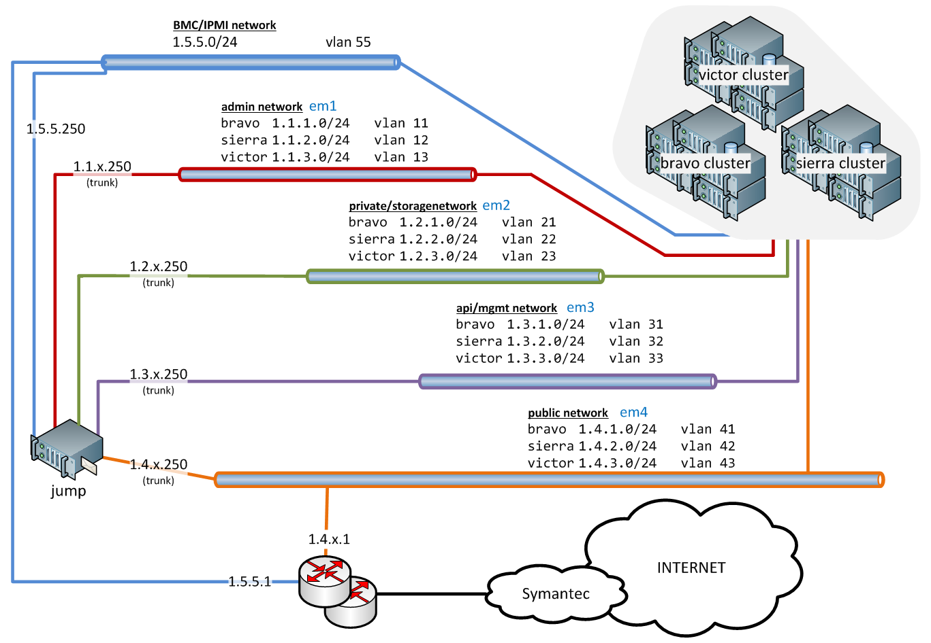
Provisioning Evaluation: Network Architecture
Yes, thank you – we know these are not valid IP addresses. IP and VLAN scheme for demonstrations purposes only.
Blah, blah blah.

Slide 12
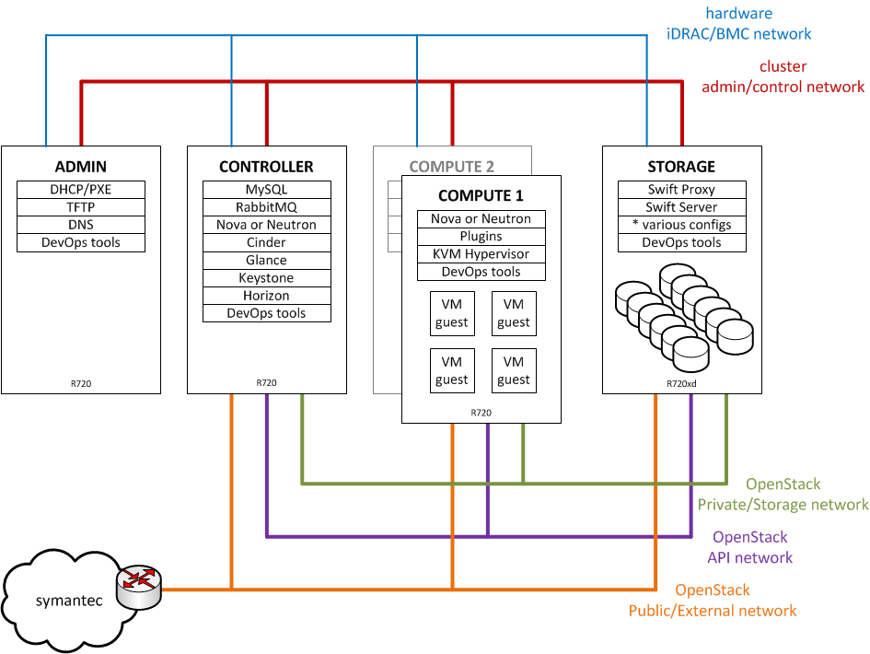
Provisioning Evaluation: OpenStack Overview

Slide 13
Provisioning Evaluation

Slide 14
Provisioning Evaluation
Results of Symantec’s testing are based on features available during the test phase
All tool chains are going through rapid development
Many new features and capabilities have been implemented since Summer 2013 testing
Sort of like OpenStack … ☺

Slide 15
Provisioning Evaluation: Frameworks Tested
Fuel Web – ver 3.0.1
Primarily open source integrated tools
Puppet for DevOps
MaaS/JuJu – ver 1.2/0.7
MaaS (Metal as a Service) provisioning
JuJu “Charms” for deployment
Crowbar – ver 1.6
“Glues” together Chef recipes
Strong integration with Dell hardware
Foreman – ver 1.2.0
Uses Puppet for DevOps
Strong enterprise features
Rackspace Priv. Cloud – ver 4.1.0
OpenStack only
Strong leader in OpenStack

Slide 16
Provisioning Evaluation: Things Not Tested
Cobbler – pure imaging/boot system
Ironic – OpenStack bare metal provisioning (still in incubation)
Razor – pure imaging/boot system, young project, great potential
COI – Cisco OpenStack Installer (puppet/cobbler tool)
FAI – around a long time
OpenQRM –strong HA design
Cloudboot – boot/install from cloud resources
Spacewalk – Red Hat/EL centric
FogProject – more “cloning” than boot control
Kickstart – general Red Hat/EL specific boot/install
etc…

Slide 17
Provisioning Evaluation: Fuel Web ver 3.0.1
Architecture
Combines many Open Source projects
Uses PostgreSQL internally
Automation “workflow” via syslog messages
OpenStack Topology
Nova Compute, Nova Networking, Cinder, Horizon, Keystone, Glance
Swift all-in-one built by hand
Comment
Fuel Web and Fuel CLI are now combined products
New Fuel product supports OpenStack HA deployments via Web UI

Slide 18
Provisioning Evaluation: MaaS/JuJu ver 1.2/0.7
Architecture
MaaS has strong distributed model (regional capabilities)
JuJu “Charms” for deploying code
OpenStack Topology
Nova Compute, Nova Networking, Cinder, Horizon, Keystone, Glance
Swift all-in-one built by hand
Comment
Required 10 nodes minimum for successful clean deployment
MaaS deployments were excellent
Strong debugging capabilities in JuJu
Charms deployment of OpenStack needs work

Slide 19
Provisioning Evaluation: Crowbar ver 1.6
Architecture
Tightly integrated with local Chef server, uses Crowbar “databags” for Chef recipes
Strong integration with Dell hardware (but not exclusively so)
Server BIOS/Firmware settings and RAID configurations
OpenStack Topology
Nova Compute, Neutron Networking, Cinder, Horizon, Keystone, Glance, Swift
Comment
Good level of features “bubbled up” to UI of OpenStack parameters
Very fast time to full OpenStack cluster implementation “out of the box”
Crowbar 2 separates DevOps from framework, future support for other DevOps tools, implements large scale cluster builds with High Availability

Slide 20
Provisioning Evaluation: Foreman ver 1.2.0
Architecture
Strong distributed model (via “smart proxies”)
Uses Puppet for OpenStack deployment
OpenStack Topology
Nova Compute, Neutron Networking, Cinder, Horizon, Keystone, Glance, Swift
Comment
Requires customization to build deployment framework
Well supported in community for deployment implementations
Integrates with Puppet (as ENC), and Rundeck

Slide 21
Provisioning Evaluation: Rackspace Priv Cloud ver 4.1.0
Architecture
Implemented via Chef recipes
Requires provisioned host OS for deployment
OpenStack Topology
Nova Compute, Nova Networking, Cinder, Horizon, Keystone, Glance, Swift
Comment
Recommended install uses Nova Networking
L3 agent in Neutron single point of failure
Did implement Neutron networking as well

Slide 22
Provisioning Evaluation: The Results
Tool | TTC * | Capabilities | Resiliency | Complexity | Version
Crowbar |  |  |  |  | ver 1.6
Fuel Web |  |  |  |  | ver 3.0.1
Rackspace P.C. |  | N/A | N/A |  | ver 4.1.0
MaaS/JuJu |  |  |  |  | ver 1.2/0.7
Foreman |  |  |  |  | ver 1.2.0
bare metal prov. HW checks notification/logging | deploy tool HA multi DC multi zone | OpenStack HA hardware/BIOS/RAID physical networks OpenStack tuning
good support
meets requirements
minimum requirements
missing features
* TTC = time-to-cluster, the time it took deployment to be customized, documented, and repeated by Symantec staff

Slide 23
Testing OpenStack

Slide 24
Testing OpenStack
Nova
Create & Manage Virtual Machines
Create & Manage Direct Connection Networks
Create & Manage Security and Availability Groups
Glance
Manage and Deploy OS Images
Boot from Volume
Neutron
Create & Manage Virtual L2/L3 Networks, Routers and Switches
Create and Manage Security Groups
Cinder
Create & Manage Block Volumes
Back Up & Restore Block Volumes
Boot VMs from Volume w/ Glance
Keystone
Create & Manage Projects
Create & Manage Users
Create & Manage RBAC for both Projects & Users
Manage Security access between services
Swift
Create Projects specifically to Swift
Create & Manage Objects

Slide 25
Summary

Slide 26
Summary
Capabilities discussed are from the specific product we tested
Different versions of the product supports different features
Eg. Fuel Web versus Fuel CLI
Vendors are rapidly improving their products
Current feature sets of products have evolved significantly since test
All vendors were strongly interested in feedback for product improvements
Check features of each vendors deployment in depth before choosing a tool
Test as many different deployment tools as you can!!

Slide 27
Appendix

Slide 28
Appendix
tool | vendor support | version tested | current version * | website
Crowbar | Dell | 1.6 | 1.6 | http://crowbar.github.com/
Fuel Web | Mirantis | 3.0.1 | 3.2 | http://fuel.mirantis.com/
RPC | Rackspace | 4.1.0 | 4.1.2 | http://www.rackspace.com/cloud/private/
Foreman | Redhat | 1.2.0 | 1.3.0 | http://theforeman.org/
MaaS/JuJu | Canonical | ver 1.2/0.7 | 1.6/1.16.0 | http://www.ubuntu.com/cloud/
As of October 26, 2013
what | reference | presentation QR code
Symantec, Corp. | http://www.symantec.com/
Brian Chong | brian_chong@symantec.com
Shane Gibson | shane_gibson@symantec.com

