Slide 1
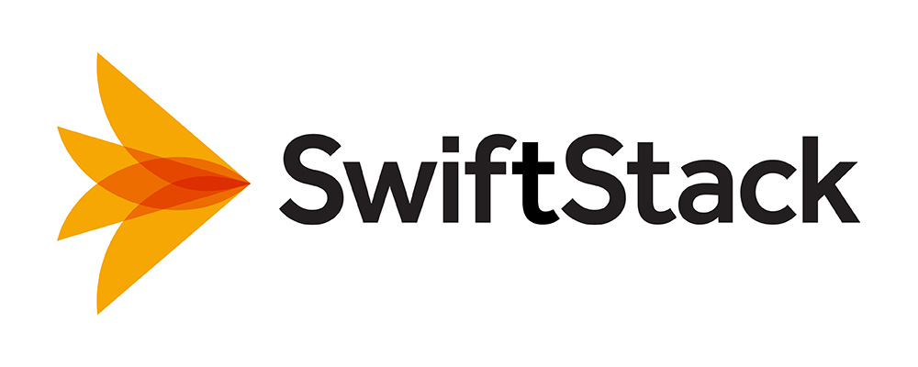
Economy File Project
Lessons Learned: Deploying Very Low Cost Cloud Storage Technology in a Traditional Research HPC Environment
Dirk Petersen Scientific Computing Manager at Fred Hutchinson Cancer Research Center (graphs by Robert McDermott, Solution Architecture, FHCRC)

Slide 2
Economy File Project at Fred Hutch, Seattle
What we’ll cover:
Who we are and what we do
Why did we do it – requirements for project
What else we tried first
What we deployed – architecture, software, hardware
How do we manage it
What did it cost
How well does it work
What was the timeline
What we learned

Slide 3
Economy File Project – Who are we and what do we do
What is Fred Hutch?
Cancer & HIV research
3 Nobel Laureates
$430M budget / 85% NIH funding
Seattle Campus with 13 buildings, 15 acre campus, 1.5+ million sq ft of facility space
Research at “The Hutch”
2,700 employees
220 Faculty, many with custom requirements
13 research programs
14 core facilities
Conservative use of information technology
IT at “The Hutch”
Multiple data centers with >1000kw capacity
100 staff in Center IT plus divisional IT
Team of 3 Sysadmins to support storage
IT funded by indirects (F&A)
Storage Chargebacks starting July 2014

Slide 4
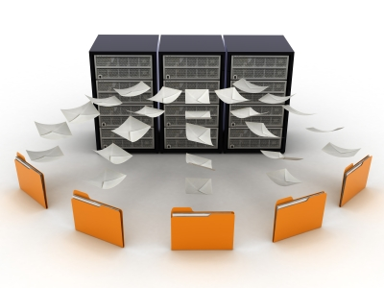
Economy File Project – Why did we do it?
Researchers concerned about ….
Significant storage costs – $40/TiB/month chargebacks (first 5 TB is free) and declining grant funding
“If you charge us please give us some cheap storage for old and big files”
(Mis)perception on storage value (I can buy a hard drive at BestBuy)

Slide 5
Economy File Project – Why did we do it?
Finance concerned about ….
Cost predictability and scale
Data growth causes storage costing up to $1M per year
Omics data grows at 40%/Y and chargebacks don’t cover all costs
Expensive forklift upgrades every few years
The public cloud (e.g. Amazon S3) set new transparent cost benchmarks

Slide 6
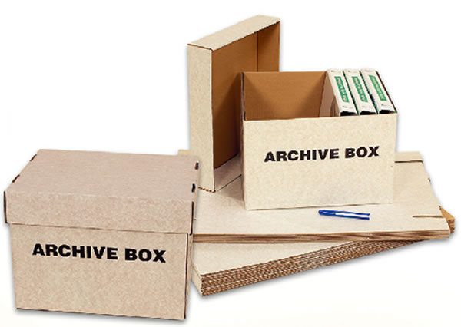
Economy File Project – Why did we do it?
Plus we had the complexities of data protection and archiving
How can I store something really long term
But so I can access it quickly whenever I need it
Difficulties meeting backup recovery time and -point objectives

Slide 7
Economy File Project – Why did we do it?
So we looked for a solution – but not necessarily object storage…
Users need to work with a mountable filesystem
Self service & access with standard unix tools
unix tools (no call to IT!!)
Need to support larger data sets for some key users
85% were okay with current free 5TB allocation on NAS
But 15% need access to older/bigger data sets
Not all resources for few customers (equity)
Directory
Directory
Directory
Directory
Directory
Directory
Directory

Slide 8
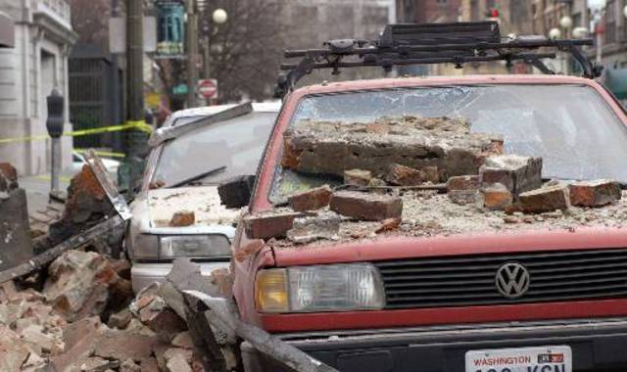
Economy File Project – Why did we do it?
So we looked for a solution – but not necessarily object storage…
Performance needs not too high, but may want to grow
Large datasets are often put on cheap storage but over time users often want it faster
Some concerns about disaster recovery and resiliency
Earthquakes in Seattle have gone up to 9.0 (in 1700)
Replicate to multiple buildings and still keep costs low?
In Phase II want to replicate to a far away place that does not rain bricks
Cars in Seattle covered in bricks after the 2001 Nisqually earthquake (AP Photo)

Slide 9
Economy File Project – Key Characteristics
Permanent, static data
CIFS and NFS access
POSIX permissions
Optimized for economy
Self-healing/self-protecting
Snapshot/versioning
Manual file migration
Very low cost

Slide 10
Economy File Project – Detailed Priorities
Must Have
Scalability
Data resilience and self-protection
Protection from accidental deletion
Adequate performance
CIFS and mountable file system with >16 groups per user
POSIX like file system
Low cost (<$20/TB/mo)
Long term storage
Supportable
Monitoring and logging
Self-service access
Active Directory integration
99.5% Availability
Should Have
Growth covered by chargeback
Ability to leverage the cloud
Ability to create an off-site replica
Role based access for sys admin
Symbolic links
Nice to Have
Capacity quotas
Migration tools
Broader storage strategy
Write Once Read Many (WORM)
Unified management interface
High-availability
Multi-tenant partitioning

Slide 11
Economy File Project – Why Object Storage?
We liked Object/Cloud Storage because:
Scaling of capacities – no forced end of life because of lack of capacity
Manageability – e.g. no RAID or lower level OS management involved
Resiliency – built-in protection, no out of band process (e.g. tape)
Consistency / predictability – no performance penalties because of data striping, RAID rebuilds
Flexibility – integration and extensibility better than file-based
But object storage was not a core requirement. We would have accepted a POSIX filesystem as well.

Slide 12
Economy File Project – Why Swift/SwiftStack?
We liked Swift/SwiftStack because:
Proven – used by some big clouds: HP Cloud, Rackspace, IBM, Disney (>50PB)
Manageability – SwiftStack makes Swift easier to install & maintain than any other storage system we currently support
Low cost – open source base plus commodity hardware
Longevity – archive life of 20+ years better supported by open source project vs. any corporate storage line (3PAR -> HP)
Performance – shared nothing architecture has no bottlenecks
Durability – redundant data accessible even when two drives, nodes, data centers fail due to unique as possible data distribution
Cloudiness – scientific applications can start adopting cloud storage paradigm (e.g. RESTful API) and data will be easy to migrate to public cloud when ready (This will take many years !!)
Future – young project/product, still adding features and growing
Swift met both current and potential future needs

Slide 13
Economy File Project – Conceptual View
Files
CIFS
Storage Gateway
NFS
E2
J4
M4
Object
Controller
Object
Controller
Object
Controller

Slide 14
Economy File Project – Swift Data Redundancy
Swift places 3+ replicas of all data as unique as possible
Single Node Cluster
Disks are “as-unique-as-possible”
Large Cluster
Storage Racks are “as-unique-as-possible”
Small Cluster
Storage Nodes are “as-unique-as-possible”
Multi-Region
Distributed data centers are “as-unique-as-possible”
FAQ: can we run only 2 replicas? Yes we can , but maintenance / quorum

Slide 15
Economy File Project – Why does Swift look so familiar?
Common foundations meant we could leverage
Ops staff expertise
Existing applications and best practices
Existing Troubleshooting tools (e.g. wireshark)
Swift object storage building blocks
Linux, Python, & rsync foundation
Swift open source storage (written in Python)
Compatible filesystem gateway (Linux / fuse mount)
On commodity hardware with consumer drives
Managed by always up to date SwiftStack Controller installed in the cloud
Hutch’s Scientific Computing / HPC building blocks
Linux, Python, & rsync foundation
Running on commodity hardware

Slide 16
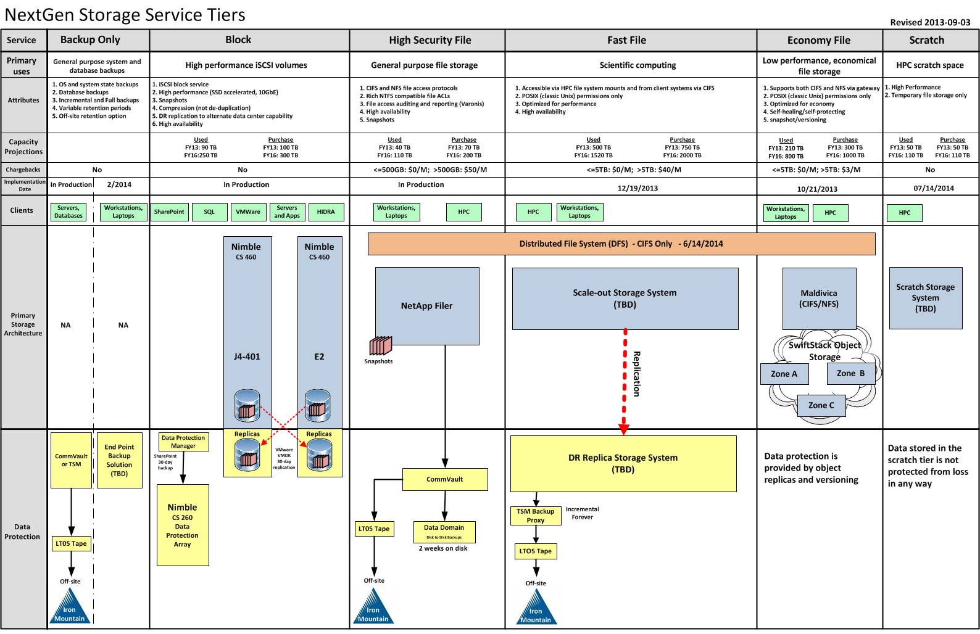
NextGen Storage Architecture at the Hutch – Where Swift Fits
$40/TB/ Month
$3/TB/ Month

Slide 17
Economy File Project – What were the other options?
Gluster FS worked well for us as scratch file system but:
Could not find any proof of scalability (<1PB)
Replication features seem complex and not widely in use (e.g. web sites like “GlusterFS replication do's and don'ts”)
Need to manage some kind raid on the underlying storage box
Looked at fully integrated and commercial HSM solutions
Hierarchical Storage Management “file stubbing” can work but…
Peers warned of too much management and unpredictable performance at times
Many require forklift upgrades at some point
Plus reviewed a number of commercial object storage vendors but didn’t meet cost/access requirements
Erasure coding is less effective if you sustain a datacenter drop-out

Slide 18
Economy File Project – how Swift compares to other OSS
 | Swift *) | Ceph | Gluster
Founded | 2010 | 2007 | 2005
Language | Python | C++ | C
Lines of Code | 72000 | 524000 | 798000
Contributors in 12 mo | 87 | 126 | 73
Commits / month | 100+ | 500+ | 100+
Is a young and lean code base a benefit?
*) without CIFS/NFS gateway

Slide 19
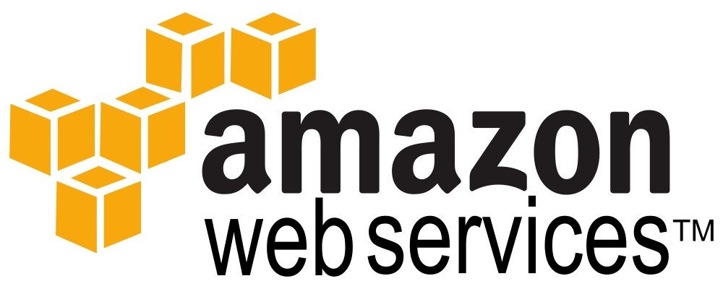
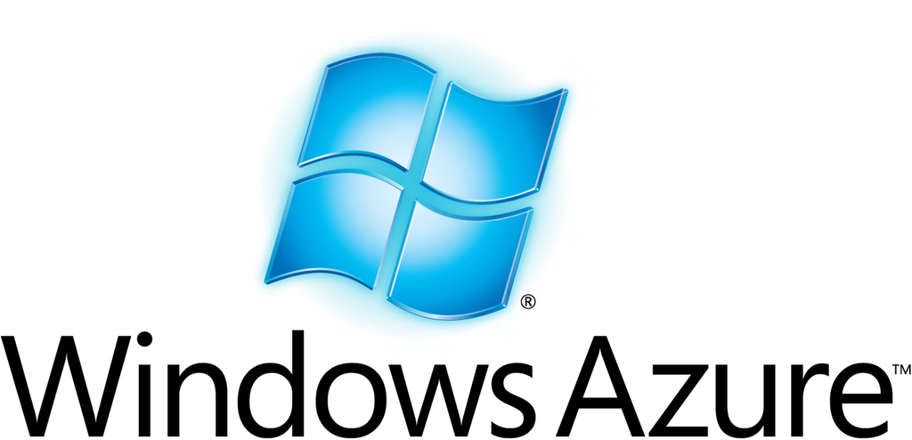
Economy File Project – Why not in the public cloud?
Still uncertainties with storing genomic data in public cloud…
NIH policies and fuzziness – what is really ok?
Genomic data must be secure to protect research participants
Desire to audit data access (which only AWS provides?)
All our compute is still local
But prepared for future migration
Swift has S3 API (e.g. boto, galaxy)
Programmers can develop cloud compatible apps today
No big forklift upgrades prior migration

Slide 20
Economy File Project – Why not in the public cloud?
Costs and perception are changing…
Amazon and Google just dropped storage prices significantly
Cheap compared to high performance NAS tier at $40-60 /TB/month
But you still need a fast POSIX fs
Swift storage very low cost at only $13/TB/month
half the cost/TB of Amazon S3 or Google Cloud Storage
But cloud will be chosen often because we need a “Switzerland”
40
$/TB/Month
27
25
13
NAS
Amazon
Google
Swift

Slide 21
Economy File Project – What we deployed
Setup three zones in Swift for durability
One zone per datacenter / building redundancy and durability
Swift Storage Nodes
Two in each zone –Swift Proxy Nodes
Two proxy nodes initially – will scale based on traffic
SwiftStack Management Node
Management only, not in path of user’s storage requests
Management node in the cloud, local install optional
Filesystem gateway in one zone
Only one initially – currently the only single point of failure
Initial deployment easily scaled/reconfigured with SwiftStack

Slide 22
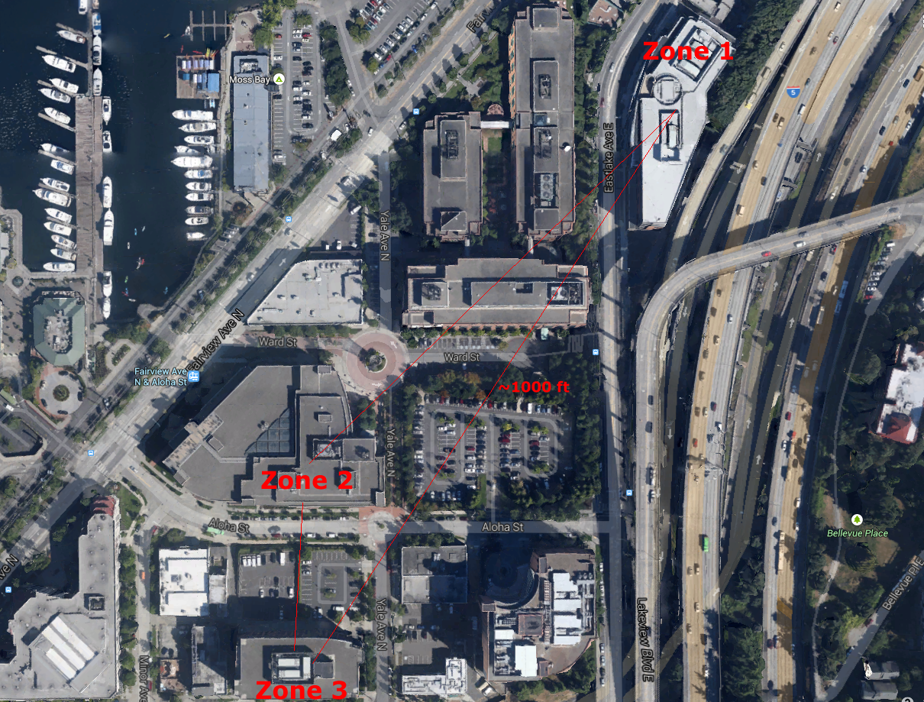
The Hutch Campus & storage resiliency from 3 zones

Slide 23
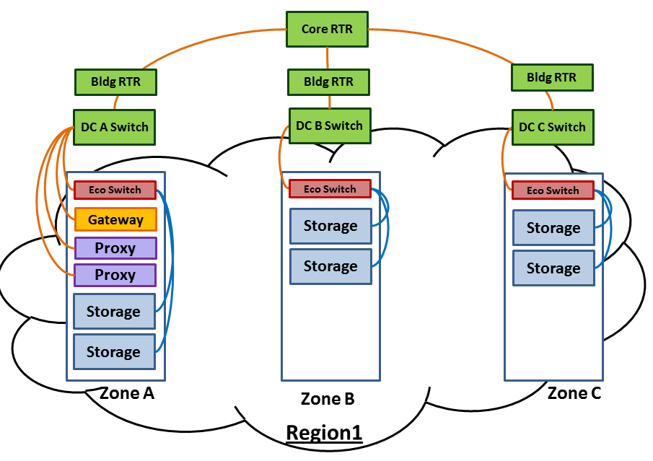
Economy File Project – Architecture View

Slide 24
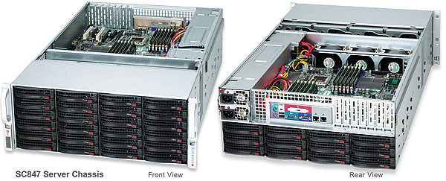
Economy File Project – Swift Storage Nodes
Supermicro SC847 4U Chassis – configured by Silicon Mechanics
144TB raw capacity (~130TiB usable)
No RAID controllers & no storage lost to RAID
36 x 4TB 3.5” Seagate SATA desktop drives (24 front, 12 back)
2 x 120GB SSDs (OS + metadata)
10Gb Base-T connectivity
Two Intel Xeon E5 CPUs and 64 GB RAM
$13,239 each + tax

Slide 25
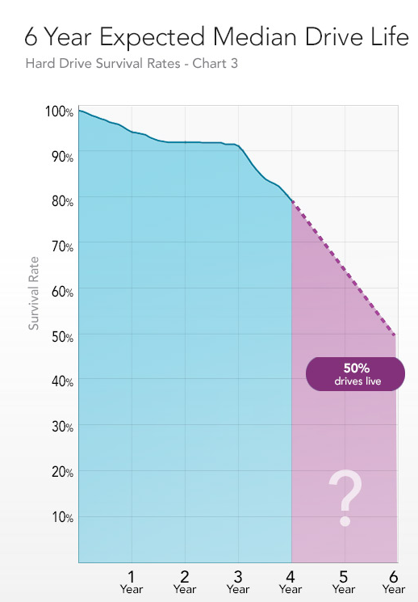
Economy File Project – Swift Storage Nodes
What grade of drive?
Use consumer vs. enterprise grade drives to save cost?
But how long will consumer grade drives live
Open question, but Blackblaze thinks a median of 6 years isn’t bad at all
What’s the server lifecycle?
And how to replace them?
Est. 20 drives/mo will fail (in 3 PiB system) so 1 fails per day
Replace failed drives every day or just once a month?
With a bigger drive?

Slide 26
Economy File Project – Networking Components
NETGEAR PROSAFE XS712T
12 ports 10Gb Base-T (Cat-6)
2 ports 10Gb SFP+
$1,430 each
Used in each zone

Slide 27
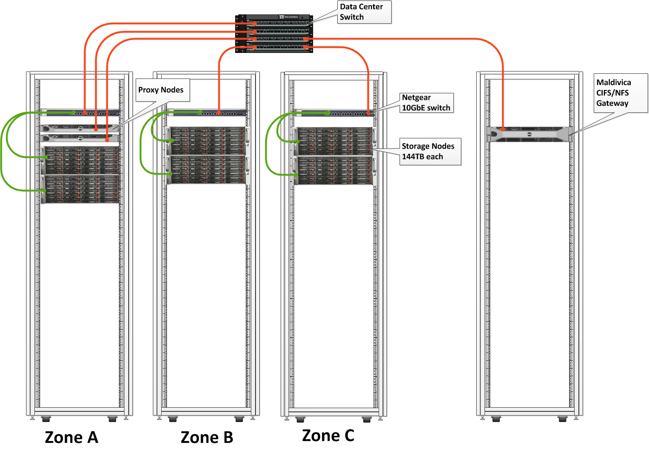
Economy File Project – POC Architecture

Slide 28
Economy File Project – What did it cost?
Totals for storage
216 4TB storage drives across six storage nodes
864TB of raw storage
260TB of usable capacity after Swift redundancy
Costs for hardware alone
Total cost is $83,437 for all nodes and switches
$320 per TB of usable capacity
Expected cost over 5Y life is $5.35/TB/month (plus replacement of drives that are out of warranty)
Operating costs
Mainly from .25 FTE and software licenses
Power/cooling costs very low due to cheap NW hydro power

Slide 29
Economy File Project – How we manage it?
Needed system to require minimal management
Production deployment took about 7 days
Managed by Enterprise Storage Ops team of 3
Find a hardware vendor (e.g. Silicon Mechanics) who
Has experience in Swift deployment
Will offer consumer hard drives ready to go in drive carriers
Should take less than 0.25 FTE to operate
Make sure you have a parts depot for low cost stuff (e.g. switches, drives)
Also needed robust, mature management tools
SwiftStack’s automation made roll-out and management simple and you never need to upgrade this cloud app

Slide 30
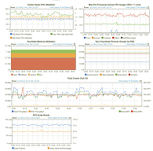
Economy File Project – Managed by SwiftStack
Open source Swift functional but…
Lacking some enterprise features like delete protection, monitoring, user management and cifs/nfs
Deployment requires a lot of manual tasks
With the proprietary SwiftStack Controller
Provides cloud-based management console w/runtime on Swift nodes
Filesystem gateway, undelete feature, user web portal to Swift
Competent Swift support 24x7 (a global company . . staff in Taiwan responding at 2am PST)
SwiftStack FS
Gateway
SwiftStack
Runtime
SwiftStack
Console

Slide 31
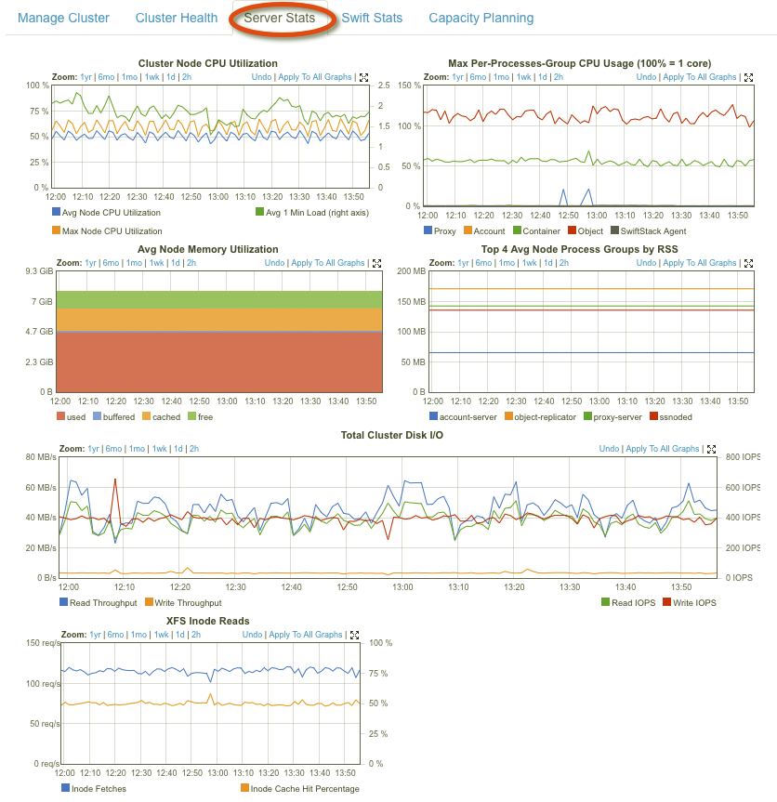
Economy File Project – Management with SwiftStack
SwiftStack provides control & visibility
Deployment automation
Let us roll out Swift nodes in 10 minutes
Upgrading Swift across clusters with 1 click
Monitoring and stats at cluster, node, and drive levels
Authentication & Authorization
Capacity & Utilization Management via Quotas and Rate Limits
Alerting, & Diagnostics

Slide 32
Economy File Project – SwiftStack Architecture
SwiftStack Nodes (2 —> 1000s)
SwiftStack Controller
Integrations & Interfaces
End-user web UI, legacy interfaces, authentication, utilization API, etc.
Deployment Automation
Swift Runtime
Integrated storage engine with all node components
Authentication Services
Ring & Cluster Management
OpenStack Swift
Released and supported by SwiftStack
100% Open Source
Client Support
Capacity & Utilization Mgmt.
Standard Linux Distribution
Off-the-shelf Ubuntu, Red Hat, CentOS
Monitoring, Alerting & Diagnostics
Rolling Upgrades & 24x7 Support
Standard Hardware
Dell, HP, Supermicro, Quanta, Lenovo…

Slide 33
Swift CIFS/NFS Gateway

Slide 34
Gateway Objectives
Lower the barrier to entry for object store usage
Eliminate need to convert all applications to use object store API
NAS paradigm familiar to existing IT workflows
Unify data access using NFS, CIFS, or REST
Preserve data in its original form
No blob-ification
Important for mixed application uses
No technology lock-in
Ideal point for data-grooming and enforcement
Encryption can be performed and controlled by the gateway owner
Can extract metadata from objects and store in metatags or on a separate index server
Plug-in architecture for future use cases
WORM mode (Write Once Read Many)

Slide 35
Gateway Use Cases
Active Data Archiving
Metatags provide direct information about data stored, enabling dynamic cataloging and searching
Having the ability to search without back-hauling data can dramatically simplify specific object retrieval
Key is having an automated way of creating and associating these tags during data ingest
Multisite Data Sharing
Centralized object storage should not preclude distributed work environments
Allow NAS data sharing between multiple locations
Multiple gateways synchronize filesystem view
Keeps data central and controlled
Local cache per gateway can speed access

Slide 36
More Gateway Use Cases
Data Migration
Gateway allows legacy storage to be migrated to object store simply by copying files
Can deploy multiple gateways in parallel to scale load (subject to network limitations)
Leaves content intact and no API programming required (bears repeating!)
Easily centralize remote storage

Slide 37
Gateway Futures
A gateway that preserves data integrity will never fully replace all NAS use cases, but not all applications will be rewritten to object store APIs
Expand data grooming and manipulations capability
Tighter integration with the object store, future API changes and/or middleware
Seamless integration with existing IT services like Active Directory and LDAP

Slide 38
Economy File Project – How well does it work?
Overall costs are very low – exceeded project goals
Only $13/TB/month all inclusive
Much lower than current $40/TB/mo chargeback
Simple to manage
Management focuses on CIFS/NFS gateway
SwiftStack provides one web console for entire cluster
Swift
Node
Files
CIFS/NFS
Gateway
Swift
Node
SwiftStack
Console
Swift
Node

Slide 39
Economy File Project – How well does it work?
Initial performance is adequate
All requests initially threaded via single CIFS/NFS gateway (ca. 300MB/s)
Doesn’t take full advantage of Swift cluster’s redundancy via proxies
SwiftStack provides monitoring of load on Swift nodes
Lots of headroom for future
Swift’s native HTTP API is very fast compared to fs gateway (multiple GB/s)
Direct HTTP access goes from client directly to Swift node(s)
Other options like application integration and web portal
Can use SwiftStack or other load balancers as front-end
Performance scales up linearly as nodes/clusters added

Slide 40
Economy File Project – How well does it work?
Limitations in the CIFS / NFS gateway (bridge)
No symlinks nor hardlinks (it’s on the roadmap)
e.g. Cannot checkout a github repos into FS
Archiving dir structure that contains symlinks will be incomplete
Cannot rename directory structures
Need to rename each file in directory
File renames are slow (copy-then-delete operations)
Renaming a file hangs all other IO in the affected directory tree
du command does not report right file size (wrote replacement)
Recently completed/fixed CIFS / NFS gateway issues
Full support for POSIX permissions. (chmod 2770 myfolder now activates the setgid bit)
vi occasionally complained about inaccurate metadata
File <> Object but they may converge after all
SwiftStack CIFS/NFS Gateway is the only NAS gateway passing through native swift objects (use cifs or boto to access the same object)

Slide 41
Economy File Project – NFS/CIFS Benefits for Users
Researchers use familiar access method
CIFS/NFS gateway gives them same mountable fs access
No retraining needed, same practices work
Performance almost as good as existing legacy storage
Cost savings for users
Big savings over NAS/SAN storage passed on to users
$3/TB/month instead of $40/TB/month chargeback (1/13th cost)
Plus lots of future potential
Simple to grow capacity for continuing -omics data glut
HTTP RESTful APIs allow direct integration with lab automation
Can take on more uses/systems as other storage ages
Can take the CIFS/NFS training wheels off in the future
Files
CIFS/NFS
Gateway

Slide 42
Economy File Project – Timeline
Rapid timeline ?
2 years from 1st contact to go-live in April 2014
Initial evaluation of SwiftStack only took 2 days
Initial targets for Swift storage
Archive data, Large datasets, bam files from external sources, sequencer output (2x HiSeq 2500)
15-20 labs in 1st rollout of Swift production storage
First deployed via familiar access path
All users initially on SwiftStack CIFS/NFS gateway
Provides familiar mountable file system & AD integration
Migration to other Swift clients later
Web portal, HTTP and other APIs
Much faster and more flexible

Slide 43
Economy File Project – Lessons Learned
Communication / testing with users & ops is key
Try to make life easier for ops staff
Assistance from HPC or Architecture staff during initial phase
Incentives such as delegating drive replacements to data center staff
Communicate ALL limitations / unexpected behavior to users prior to first test
And be ultra responsive during test phase (even if the questions are not related to the system)

Slide 44
Economy File Project – Lessons Learned
Prioritize requirements
Near-term success is critical
But don’t ignore need for future potential/headroom
Confirm requirements
(example: symlinks)
“You really need them?” “Yes”
“What for?”, “Why are you asking, symlinks are totally essential!”
(discussion to resume at later time)

Slide 45
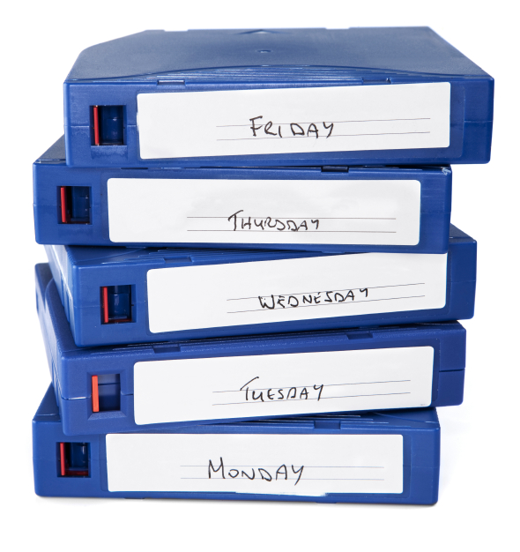
Economy File Project – Lessons Learned
Giving up Tape Backup is a pretty big step
Have to be certain that bugs do not affect data integrity
Want some really big shops to use the same technology to feel comfortable
Risk management to include your staff
Staff errors must not lead to data loss
Restrict access to data centers and management console
Compliance best practices

Slide 46
Economy File Project – Lessons Learned
Think hard before putting a POSIX gateway in front of object store for long term data / archives
Most Gateways put blobs in into objectstore and you cannot use other clients or the cloud API to access data
Always dependent on Gateway appliance vendor
Using a gateway appliance & Glacier is like a Medieval marriage …….. Forever
The SwiftStack CIFS/NFS gateway has limitations but will allow for a more seamless migration to cloud storage as you can continue to use other clients (convergence ?!)
POSIX file system gateways are still good for many other datasets

Slide 47
Economy File Project – What’s Next with Swift(Stack)
Evaluate Data protection alternatives
Backup acceleration (e.g. Riverbed Whitewater)
Endpoint backup backend (e.g. Druva)
SQL / Exchange backup (e.g. Cloudberry Backup)
Other potential use cases
Galaxy storage backend (via S3 compatibility layer)
File sharing backed (e.g. owncloud)
High performance POSIX file system backed: Avere
Software only POSIX fs backend: NuageLabs
Cloud Drive backed (e.g. Cloudberry Drive, Expandrive)
High capacity block storage gateway
Digging deeper
Auditing object access using Syslog and Splunk
Do we need to have a copy outside the earthquake zone?

Slide 48
Economy File Project – What’s Next with Swift(Stack)
FHCRC is collaborating with with SwiftStack and Seagate to evaluate the Kinetic Open Storage Platform
Kinetic is a new cloud storage paradigm
Ethernet-enabled drive + native key/value store
Designed for object storage applications
Improves TCO by removing need for storage servers
Removes layers of redundant legacy technology
Enables dense cloud storage
Optimizes throughput and reduces I/O metadata overhead

Slide 49
Questions
& Answers

