Slide 1
Airship-Deckhand: Realizing Configuration Management Reliably and Predictably
Mark Burnett – Principal Member of Technical Staff
Matt McEuen – Principal Member of Technical Staff
November 14, 2018
© 2018 AT&T Intellectual Property. All Rights Reserved. AT&T, the Globe logo, Mobilizing Your World and DirecTV are registered trademarks and service marks of AT&T Intellectual Property and/or AT&T affiliated companies. All other marks are the property of their respective owners.

Slide 2
Overview
Features
Use Cases
Wrap Up
2
© 2018 AT&T Intellectual Property. All Rights Reserved. AT&T, the Globe logo, Mobilizing Your World and DirecTV are registered trademarks and service marks of AT&T Intellectual Property and/or AT&T affiliated companies. All other marks are the property of their respective owners.
Notes:
Walk through 4 things
Feel free to ask questions throughout

Slide 3
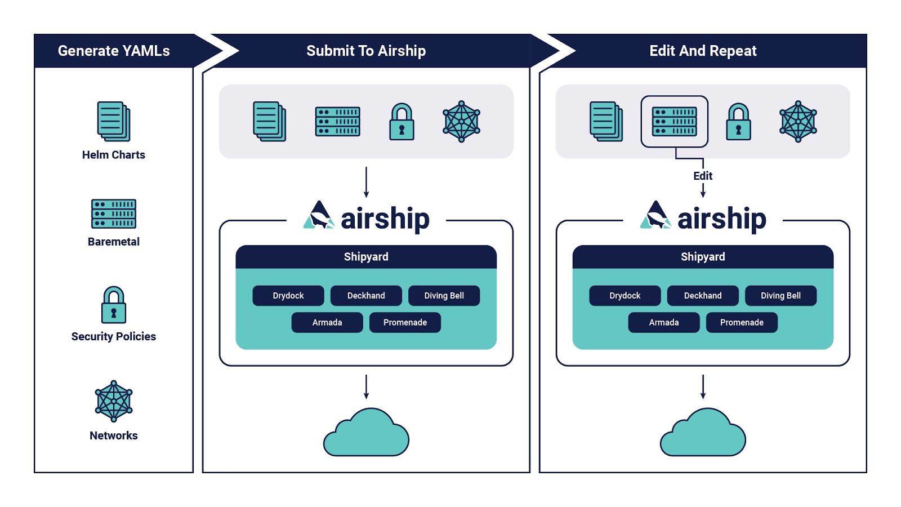
Deckhand Origin & Motivation
3
© 2018 AT&T Intellectual Property. All Rights Reserved. AT&T, the Globe logo, Mobilizing Your World and DirecTV are registered trademarks and service marks of AT&T Intellectual Property and/or AT&T affiliated companies. All other marks are the property of their respective owners.
Notes:
Give the same blurb as Keynote but longer
Emphasize
Lots of YAMLs
Many Airship / deployed software (OSH) components
Many sites

Slide 4
Deckhand Origin & Motivation
June 2017 POC
October 2017
Config
Config
Armada
Shipyard
Config
Armada
Deckhand
Drydock
Promenade
Drydock
Promenade
Config
4
© 2018 AT&T Intellectual Property. All Rights Reserved. AT&T, the Globe logo, Mobilizing Your World and DirecTV are registered trademarks and service marks of AT&T Intellectual Property and/or AT&T affiliated companies. All other marks are the property of their respective owners.
Notes:
- Description Airship with Story of DH [~2 slides w/ graphics; 5-8 min]
- Purpose
- Highlight components
- Story of DH
- Once upon a time, there was Armada -> Drydock + Promenade integration
- Found need for some shared configuration data between DD & P
- Made a firm call to keep DD & P configuration separate, and solve config
duplication as a specific problem with DH.
- First component with a detailed design document.

Slide 5
Deckhand Design
WHY
Configuration de-duplication
Secret management
Configuration history
HOW
Configuration lives on-site
Unopinionated
Immutable
What
5
© 2018 AT&T Intellectual Property. All Rights Reserved. AT&T, the Globe logo, Mobilizing Your World and DirecTV are registered trademarks and service marks of AT&T Intellectual Property and/or AT&T affiliated companies. All other marks are the property of their respective owners.
Notes:
- Purpose [1 slide, bullets; 3 min]
- De-duplicate configuration, while allowing independent service configuration
- Abstract secret management for other services
- Provide traceability/history of site configuration
- NOTE: DH is intended to solve these problems only. Room for other tooling
closer to users (Pegleg, Spyglass). I sometimes think of this config as an
intermediate representation.
- Design Tenets [1 slide, bullets; 1-2 min]
- Configuration lives on-site
- Implies deployed as service into the site
- Unopinionated about other service configuration data
- Implies not based on templating (at the time, we already had cases of
layered gotpl)
- Immutable configuration sets
- Avoids some surprises/races
Re: de-duplication?
What is the overarching use-case for this?

Slide 6
Deckhand Document Format
schema specifies valid contents of “data” key
schema: example/Foo/v1
metadata:
name: a-particular-document
schema: metadata/Document/v1
Metadata section allows complex features without constraining data structure
labels allow filtering documents
labels:
foo: bar
layeringDefinition:
layer: site
…
substitutions:
…
Layering and substitution are primarily
de-duplication mechanisms
storagePolicy allows encryption of any
document
storagePolicy: cleartext
data: …
Structured data section allows
validation through defined schemas
6
© 2018 AT&T Intellectual Property. All Rights Reserved. AT&T, the Globe logo, Mobilizing Your World and DirecTV are registered trademarks and service marks of AT&T Intellectual Property and/or AT&T affiliated companies. All other marks are the property of their respective owners.
Notes:
- Features
- Introduce document structure to ground later examples [1 slide; 2 min]
- Metadata/data separation allows "unopinionated" implementation of a rich feature set
- Trade off is that currently, some other component must convert from DH
document format into whatever the desired case is.
- Future work: Room for a future feature to render into a template of some sort.

Slide 7
Deckhand Document Format
schema specifies valid contents of “data” key
schema: example/Foo/v1
metadata:
name: a-particular-document
schema: metadata/Document/v1
Metadata section allows complex features without constraining data structure
labels allow filtering documents
labels:
foo: bar
layeringDefinition:
layer: site
…
substitutions:
…
Layering and substitution are primarily
de-duplication mechanisms
storagePolicy allows encryption of any
document
storagePolicy: cleartext
data: …
Structured data section allows
validation through defined schemas
6
© 2018 AT&T Intellectual Property. All Rights Reserved. AT&T, the Globe logo, Mobilizing Your World and DirecTV are registered trademarks and service marks of AT&T Intellectual Property and/or AT&T affiliated companies. All other marks are the property of their respective owners.
Notes:
- Features
- Introduce document structure to ground later examples [1 slide; 2 min]
- Metadata/data separation allows "unopinionated" implementation of a rich feature set
- Trade off is that currently, some other component must convert from DH
document format into whatever the desired case is.
- Future work: Room for a future feature to render into a template of some sort.

Slide 8
Deckhand Document Format
schema specifies valid contents of “data” key
schema: example/Foo/v1
metadata:
name: a-particular-document
schema: metadata/Document/v1
Metadata section allows complex features without constraining data structure
labels allow filtering
documents
labels:
foo: bar
layeringDefinition:
layer: site
…
substitutions:
…
Layering and substitution are primarily
de-duplication mechanisms
storagePolicy allows encryption of any
document
storagePolicy: cleartext
data: …
Structured data section allows
validation through defined schemas
6
© 2018 AT&T Intellectual Property. All Rights Reserved. AT&T, the Globe logo, Mobilizing Your World and DirecTV are registered trademarks and service marks of AT&T Intellectual Property and/or AT&T affiliated companies. All other marks are the property of their respective owners.
Notes:
- Features
- Introduce document structure to ground later examples [1 slide; 2 min]
- Metadata/data separation allows "unopinionated" implementation of a rich feature set
- Trade off is that currently, some other component must convert from DH
document format into whatever the desired case is.
- Future work: Room for a future feature to render into a template of some sort.

Slide 9
Deckhand Document Format
schema specifies valid contents of “data” key
schema: example/Foo/v1
metadata:
name: a-particular-document
schema: metadata/Document/v1
Metadata section allows complex features without constraining data structure
labels allow filtering documents
labels:
foo: bar
layeringDefinition:
layer: site
…
substitutions:
…
Layering and substitution
are primarily de-duplication
mechanisms
storagePolicy allows encryption of any
document
storagePolicy: cleartext
data: …
Structured data section allows
validation through defined schemas
6
© 2018 AT&T Intellectual Property. All Rights Reserved. AT&T, the Globe logo, Mobilizing Your World and DirecTV are registered trademarks and service marks of AT&T Intellectual Property and/or AT&T affiliated companies. All other marks are the property of their respective owners.
Notes:
- Features
- Introduce document structure to ground later examples [1 slide; 2 min]
- Metadata/data separation allows "unopinionated" implementation of a rich feature set
- Trade off is that currently, some other component must convert from DH
document format into whatever the desired case is.
- Future work: Room for a future feature to render into a template of some sort.

Slide 10
Deckhand Document Format
schema specifies valid contents of “data” key
schema: example/Foo/v1
metadata:
name: a-particular-document
schema: metadata/Document/v1
Metadata section allows complex features without constraining data structure
labels allow filtering documents
labels:
foo: bar
layeringDefinition:
layer: site
…
substitutions:
…
Layering and substitution are primarily
de-duplication mechanisms
storagePolicy allows
encryption of any
document
storagePolicy: cleartext
data: …
Structured data section allows
validation through defined schemas
6
© 2018 AT&T Intellectual Property. All Rights Reserved. AT&T, the Globe logo, Mobilizing Your World and DirecTV are registered trademarks and service marks of AT&T Intellectual Property and/or AT&T affiliated companies. All other marks are the property of their respective owners.
Notes:
- Features
- Introduce document structure to ground later examples [1 slide; 2 min]
- Metadata/data separation allows "unopinionated" implementation of a rich feature set
- Trade off is that currently, some other component must convert from DH
document format into whatever the desired case is.
- Future work: Room for a future feature to render into a template of some sort.

Slide 11
Deckhand Document Format
schema specifies valid contents of “data” key
schema: example/Foo/v1
metadata:
name: a-particular-document
schema: metadata/Document/v1
Metadata section allows complex features without constraining data structure
labels allow filtering documents
labels:
foo: bar
layeringDefinition:
layer: site
…
substitutions:
…
Layering and substitution are primarily
de-duplication mechanisms
storagePolicy allows encryption of any
document
storagePolicy: cleartext
data: …
Structured data section
Allows validation through
defined schemas
6
© 2018 AT&T Intellectual Property. All Rights Reserved. AT&T, the Globe logo, Mobilizing Your World and DirecTV are registered trademarks and service marks of AT&T Intellectual Property and/or AT&T affiliated companies. All other marks are the property of their respective owners.
Notes:
- Features
- Introduce document structure to ground later examples [1 slide; 2 min]
- Metadata/data separation allows "unopinionated" implementation of a rich feature set
- Trade off is that currently, some other component must convert from DH
document format into whatever the desired case is.
- Future work: Room for a future feature to render into a template of some sort.

Slide 12
Deckhand Deduplication: Substitution
schema: example/Foo/v1
metadata:
name: source-1
…
data:
key1: value1
schema: example/Bar/v1
metadata:
name: dest-1
…
data:
dest_key: value1
schema: example/Bar/v1
metadata:
name: dest-1
substitutions:
- src:
schema: example/Foo/v1
name: source-1
path: .key1
dest:
path: .dest_key
…
7
© 2018 AT&T Intellectual Property. All Rights Reserved. AT&T, the Globe logo, Mobilizing Your World and DirecTV are registered trademarks and service marks of AT&T Intellectual Property and/or AT&T affiliated companies. All other marks are the property of their respective owners.
Notes:
Substitution pulls data from one document into another
Why would you want to do this?
For deduplication (specify once, use many places)
For organization (define related data together - versions.yaml, endpoints.yaml)
Special use case: define secrets separately and supply them (in the cluster) to the needful
The "from" and "to" documents don't have to have the same schema (usually don't)
If substituting more than one thing, include more entries in the substitutions list
You can also replace just a substring of a field (e.g. a port# in a URL), using regular expressions

Slide 13
Deckhand Deduplication : Layering
schema: example/Foo/v1
metadata:
name: child
layeringDefinition:
layer: site
parentSelector:
arbitrary: label actions:
- method: merge
path: .
…
data:
deep: {child: data}
schema: example/Foo/v1
metadata:
name: parent
labels:
arbitrary: label
layeringDefinition:
layer: global
…
data:
deep: {parent: data}
schema: example/Foo/v1
metadata:
name: child
…
data:
deep:
child: data
parent: data
8
© 2018 AT&T Intellectual Property. All Rights Reserved. AT&T, the Globe logo, Mobilizing Your World and DirecTV are registered trademarks and service marks of AT&T Intellectual Property and/or AT&T affiliated companies. All other marks are the property of their respective owners.
Notes:
Layering lets you separate data that is the same among sites from things that are site-specific
Why would you want to do this?
Lots of sites - especially Edge use cases
Drive consistency across sites - (MTU settings!!!!!)
Model site deployment data hierarchically
With layering you typically have concrete documents that inherit from abstract docs
But concrete docs can also inherit from other concrete docs
Child data override parent data
Layered docs must have the same document schema
Child docs select their parents using arbitrary key/value labels
Different "actions" that layering can do:
Merge: a deep merge. Child data win conflicts.
Replace: throw away that section of the parent data & replace with child
Delete: just throw away that section of data in the parent

Slide 14
Deckhand Deduplication: Layering
LAYERING POLICY
OUR AIRSHIP SITE DEFINITION
schema: deckhand/LayeringPolicy/v1
metadata:
name: layering-policy
schema: metadata/Control/v1
data:
layers:
- global
- type
- site
Global | ~24.0k LOC
Type | ~3.5k LOC
Site | ~1.8k LOC
9
© 2018 AT&T Intellectual Property. All Rights Reserved. AT&T, the Globe logo, Mobilizing Your World and DirecTV are registered trademarks and service marks of AT&T Intellectual Property and/or AT&T affiliated companies. All other marks are the property of their respective owners.
Notes:
Example of the LayeringPolicy control document - must have exactly one of these defined.
This defines three layers, and is the current reference implementation that we use in our examples and at AT&T. Global definitions are used across all sites, "site type" definitions define a particular flavor of site (5G cloud vs a Jenkins CICD environment), and Site has the site-specific details like IP addresses and hostnames.
Long-term we'd like to add more flexibility and granularity using service-level layers, enhancing the Pegleg tool to dynamically pull in layers. But Deckhand itself is flexible and agnostic to this.
On the right is an example of how Layering can de-duplicate your data -- these are some current LOC counts for one of our sites, its parent type and the parent global definition. Orders of magnitude - important when we'll have many many sites.

Slide 15
Deckhand Deduplication: Improvements
Replacement
Site-specific overrides for triage
Multiple destination substitution
Reduce boilerplate for repeated substitutions
Recursive substitution
Replace descendent data matching a pattern
10
© 2018 AT&T Intellectual Property. All Rights Reserved. AT&T, the Globe logo, Mobilizing Your World and DirecTV are registered trademarks and service marks of AT&T Intellectual Property and/or AT&T affiliated companies. All other marks are the property of their respective owners.
Notes:
Iterative Improvements [1 slide; 5 minutes]
Replacement
Describe original "stubbing" approach, was considered verbose, but "good enough" for initial work. This proved annoying.
Particularly useful for directly masking armada/Chart/v1 overrides to significantly change configuration for a specific site for triage.
Multiple destination substitution
Found need for same substitution over, and over, and over...
Recursive substitution
But even that was repetative...
Needs expert illustration

Slide 16
Deckhand Stability: Validation
SCHEMA
DOCUMENT
schema: deckhand/DataSchema/v1
metadata:
name: armada/Chart/v1
schema: metadata/Control/v1
data:
$schema: http://json-schema.org/schema#
type: object
properties:
release:
type: string
values:
type: object
…
…
schema: armada/Chart/v1
metadata:
name: nova
schema: metadata/Document/v1
…
data:
release: nc
values:
conf:
logging:
…
policy:
…
…
11
© 2018 AT&T Intellectual Property. All Rights Reserved. AT&T, the Globe logo, Mobilizing Your World and DirecTV are registered trademarks and service marks of AT&T Intellectual Property and/or AT&T affiliated companies. All other marks are the property of their respective owners.
Notes:
(Unopinionated) User-supplied JSON schemas to validate configuration data

Slide 17
Deckhand Security: Traceability
git
Shipyard
Pegleg
Deckhand
API
12
© 2018 AT&T Intellectual Property. All Rights Reserved. AT&T, the Globe logo, Mobilizing Your World and DirecTV are registered trademarks and service marks of AT&T Intellectual Property and/or AT&T affiliated companies. All other marks are the property of their respective owners.
Notes:
Pegleg collects documents together
Git – expression of intent, not reality
API – forward looking – e.g. query vault or other API
Updates are sent to SY based on operational policy
Deckhand
Retains complete history of configuration that was delivered to the site
Supports multiple ownership chains for document delivery (buckets)
E.g. you can separate ownership and delivery of certificates from configuration
SY
Records auditing information for what revisions were uploaded by whom
Annotates DH revisions with tags indicating updates, etc.

Slide 18
Deckhand Security: Encryption
schema: deckhand/Passphrase/v1
metadata:
name: application-password
storagePolicy: encrypted
…
data: secret-password
13
© 2018 AT&T Intellectual Property. All Rights Reserved. AT&T, the Globe logo, Mobilizing Your World and DirecTV are registered trademarks and service marks of AT&T Intellectual Property and/or AT&T affiliated companies. All other marks are the property of their respective owners.
Notes:
Some of the data in your YAML documents may be sensitive, such as passwords or keys. Encrypting these data is as simple as passing `storagePolicy:encrypted` in a deckhand document, and then DH will encrypt it at rest.
This lets you focus on your data in an generic abstract way, let DH worry about details.
Consumers of the API don't need to know what of their data was encrypted -- it's decrypted as its rendered at runtime.
Deckhand uses OpenStack Barbican as the encrypted backend data store.
As a sidenote, DH uses Postgres as the data store for unencrypted data.

Slide 19
Deckhand Security: Integrations
14
© 2018 AT&T Intellectual Property. All Rights Reserved. AT&T, the Globe logo, Mobilizing Your World and DirecTV are registered trademarks and service marks of AT&T Intellectual Property and/or AT&T affiliated companies. All other marks are the property of their respective owners.
Notes:
In fact, Deckhand leverages a number of OpenStack projects that have already gone to the trouble of getting security right.
DH uses Keystone for Identity - in fact all Airship services do
DH uses Oslo for RBAC Policy definition - again, all Airship services do
As mentioned, DH uses Barbican for secure secret storage. Barbican itself is pluggable and supports a number of storage providers, making it flexible and enterprise friendly.
Same goes for Keystone integration with backends such as LDAP.
OpenStack-Helm provides the helm charts we use for these and many other supporting projects that Airship uses, such as PostgreSQL, k8s ingress, and Ceph

Slide 20
Deckhand Use Cases
Full Airship deployments
Armada + Deckhand-only deployments
Standalone YAML document repository
15
© 2018 AT&T Intellectual Property. All Rights Reserved. AT&T, the Globe logo, Mobilizing Your World and DirecTV are registered trademarks and service marks of AT&T Intellectual Property and/or AT&T affiliated companies. All other marks are the property of their respective owners.
Notes:
We've been talking about DH largely in the context of Airship, but that's not the only way you can use it
Full Airship deployments - that's what it was built for, is how AT&T uses is
A number of orgs use Airship Armada by itself - DH is a great way to manage docs there – the same deduplication problems need to be solved
We'd love it if DH got use in completely different contexts -- it's a general-purpose document persistence and rendering engine, and as more projects adopt YAML as their configuration or data store format, we hope it can fill a niche there.
That's one of the main drivers for this talk, to let you know what DH can do for you!

Slide 21
Deckhand: Future Work
More use-cases
Simplify implementation
Improve consumability for client code
16
© 2018 AT&T Intellectual Property. All Rights Reserved. AT&T, the Globe logo, Mobilizing Your World and DirecTV are registered trademarks and service marks of AT&T Intellectual Property and/or AT&T affiliated companies. All other marks are the property of their respective owners.
Notes:
- Future Work [1 slide; 1 minute]
- Understand and support more use-cases
- Simplify implementation
- Based on compute graph
- Split into multiple modules for easier consumption

Slide 22
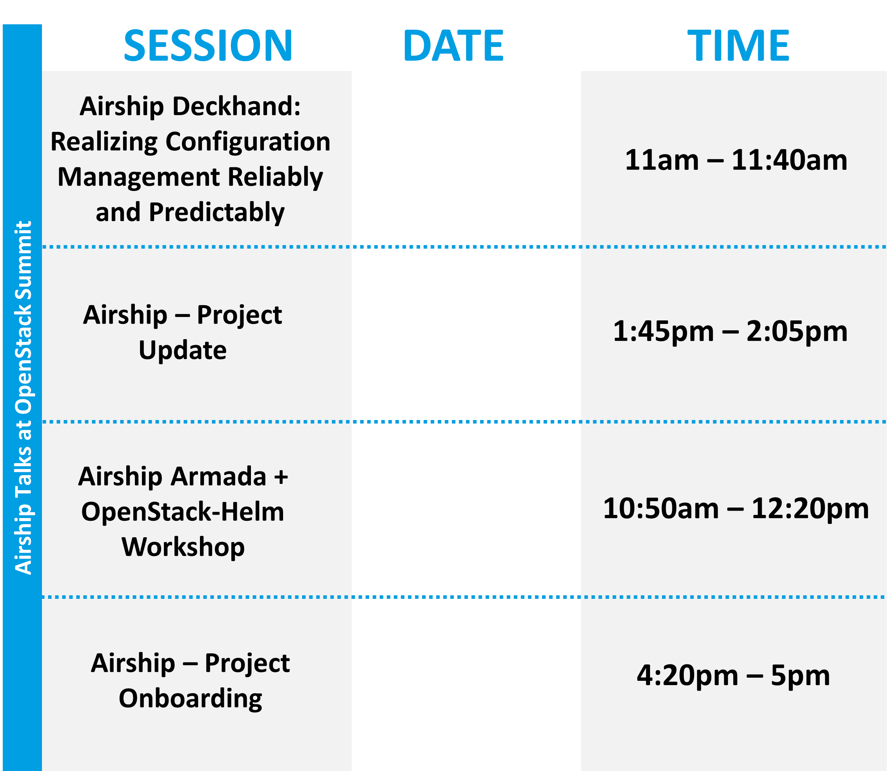
Thanks!
More Resources:
airship-deckhand.readthedocs.io
Airship Treasuremap
airshipit.org
#airshipit
17
© 2018 AT&T Intellectual Property. All Rights Reserved. AT&T, the Globe logo, Mobilizing Your World and DirecTV are registered trademarks and service marks of AT&T Intellectual Property and/or AT&T affiliated companies. All other marks are the property of their respective owners.
Notes:
DH has really good documentation in readthedocs
See examples of a full configuration set in TM

