Slide 1


An Edge-Cloud Architecture China Unicom Case Study
Gao Chengshan - China Unicom
Jianfeng Ding – Intel OTC

Slide 2



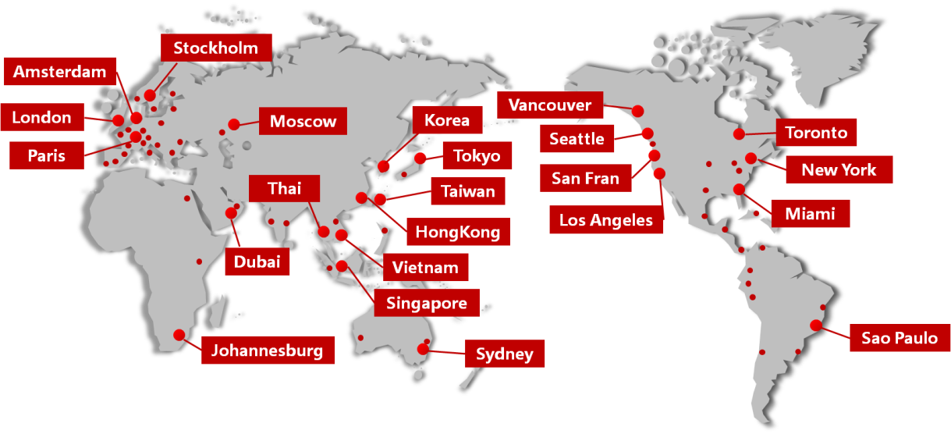
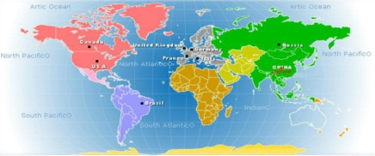
Global Data Center
China Unicom Intro
Customers & Markets
28 PoPs
63 vPoPs
Cover 69 Countries and Regions
Customers
263m mobile customers
67m fixed-network customers
75m broadband customers
Over 23m TV customers
Markets
Present in 69 countries
Fully integrated service provider

Slide 3












China Unicom's Carrier Cloud Architecture
China Unicom released ‘Network Reconfiguration plan — CUBE-NET2.0’, supporting digital transformation.
5G network will be constructed based on three-tier data centers at the regional, local, and edge levels.
Edge-Cloud
Access
Edge DC
Local DC
Regional DC
Multi-access
APP
Wireless
APP
APP
vCPE
APP
BNG-U
APP
OLT-U
MEC
OLT-C
MEC
vCPE
SBC
BNG-C
NB-IoT
IMS
DU
UPF
GW-U
UPF
CU
GW-U
UPF
CDN
GW-C
AMF
SMF
Household
BBU
CU
Access
城域网
骨干网
…
Compute
Network
Storage
Compute
Network
Storage
Compute
Network
Storage
通用硬件平台
通用硬件平台
通用硬件平台
Enterprise
60,000-70,000
6000-7000
600-700
70-80
<1ms
2-5ms
<10ms
<20ms
<50ms

Slide 4
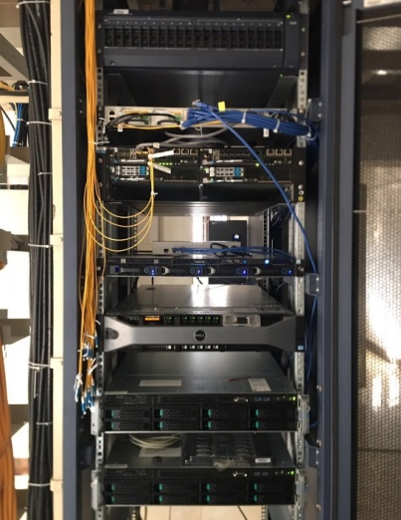
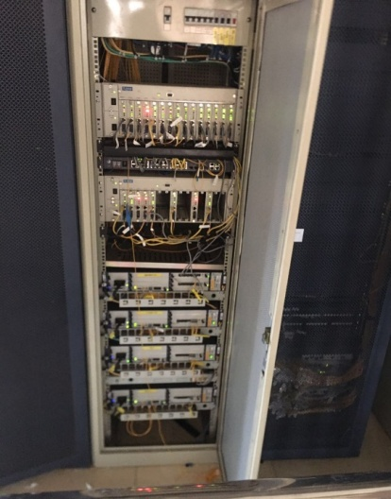
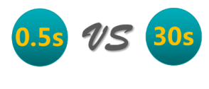
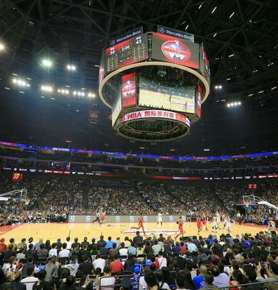
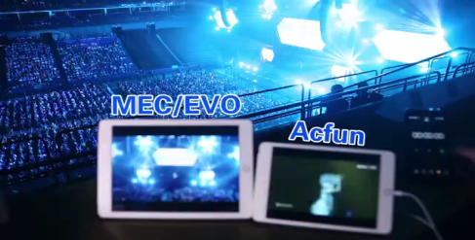







Achievements in Edge-Cloud（1）
Build the Global Largest Virtual Edge-Cloud Test-Bed in China
01
As the leading global telco operator, deploy the first virtual Edge-Cloud test-bed in China(Tianjin)，Beyond AT&T，CMCC etc.
Infrastructure：10 IA servers and 4 accelerator cards
Deployed APP：Tencent video, iQIYI Video, Wo Video, Indoor localization …
Implement business：Video optimization, sink of CDN, Campus security monitoring based on AI, VR teaching …
Based on the analysis of business scenarios, analysis the requirements of the computing, storage, network, and accelerator resources of edge DC
02
Propose the first 5G Edge-Cloud commercial resolution for “Smart Stadium” in 2017 Shanghai MWCS
Partner: INTEL, Nokia, Tencent
Deploy 5G edge-cloud in Mercedes-Benz Center in Shanghai
Realize the multi-angle EVO and support live video in stadium
Holding China Unicom 5G edge-cloud conference and publish "China Unicom Edge Computing Technology White Paper”
Image Capture
Host
Small cell
Edge-Cloud
（”Smart Stadium” ）
EPC
authorized user
Unauthorized user

Slide 5
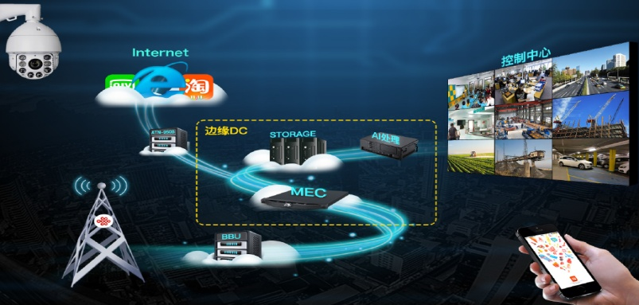
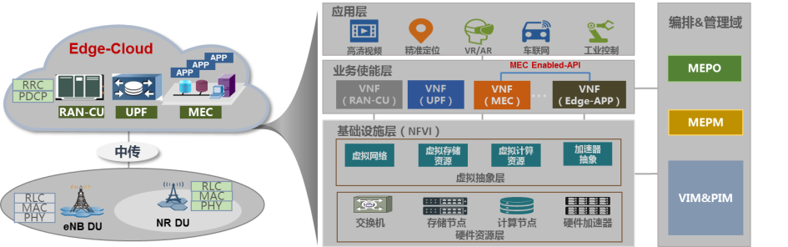
Achievements in Edge-Cloud（2）
03
Propose the first “Video cross-layer optimization based on Edge-Cloud”of China Unicom
Practical effect：The scheme can adjust the application layer code rate and TCP congestion window mechanism according to the wireless channel and the resource. Also according to the VIP information and other application layer parameters, it can provide users with wireless bandwidth resources and other security.
Propose the first “Edge-Cloud & AI Intelligent Security business platform”
04
Aim：Aiming at security problem of existing network. Solve the problem of large wireless video echo bandwidth and unbearable end to end delay.
Practical effect ：In this scheme，The video of 4G camera is processed locally by Edge-Cloud. Reducing the use of the bandwidth resources of the core network and shortening the time delay. Edge-Cloud execute the AI Inference，local decision，real-time response
05
Research on Edge-Cloud unified platform architecture
Participate in standardization of Edge-Cloud: ETSI, 3GPP SA2, CCSA….
Build China Unicom MEC unified business platform
Propose the Edge-APP end-to-end business orchestration management of Edge-Cloud

Slide 6
Future Plan in Edge-Cloud
01
Edge-Cloud Construction
02
Platform Construction
The network template of Edge-Cloud expanded to 15 provinces：Including Beijing, Fujian, Shandong , Shanghai, Chengdu, Chongqing, Hubei …
Edge cloud investment over 100 million in 2018： Previous research results have been included 2018 platform & pilot program, with total investment of ¥89200,000.
To 2020：Construct 10000 Edge-Computing nodes, provide service to 1000 enterprises, bear 30T traffic. (2018 NDRC "Internet + edge computing platform" project)
Leading the initiative of OPENSTACK open source organization “Edge computing OPENSTACK virtualization platform“ with INTEL.
Submit the application requirements of China Unicom in Edge-Cloud.
Contribute the open source code with partner. Build the maintenance and support team in Openstack community.
Promote the commercial progress of item and promote industrialization process
03
Emphasis on standardization
04
Build Edge-Cloud ecosystem
Exporting the experience in edge-cloud construction and deployment to ETSI. Carry on the project of requirement of OTT.
Accomplish the 3GPP SA2 and CCSA item of edge computing:
Participate in the ECC alliance: Build national demonstration project Edge-Cloud in industry.
Build an open edge-cloud ecosystem and be a leader in the industry chain.
Build open, open source, controllable MEC edge PaaS platform.
Accelerate the implementation of MEC commercial construction, To jointly promote business applications
More than 50 Partners now

Slide 7
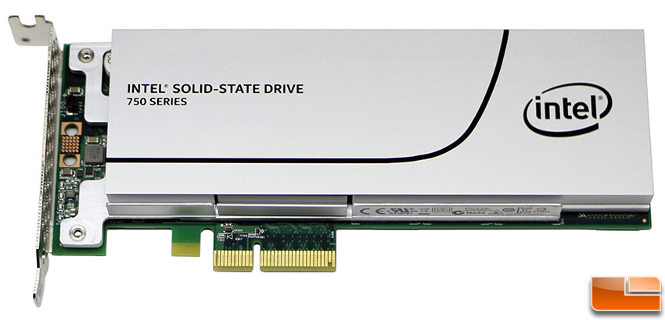
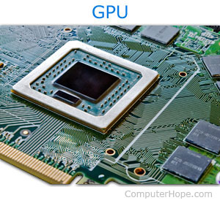
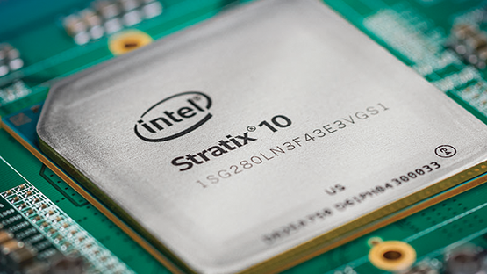
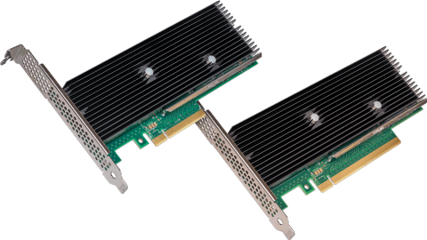

Edge-Cloud Need Acceleration

Slide 8
Accelerator Devices Management in Edge-Cloud
Cyborg is an OpenStack project that aims to provide a general purpose management framework for acceleration resources (i.e. various types of accelerators such as Crypto cards, GPU, FPGA, NVMe/NOF SSDs, ODP, DPDK/SPDK and so on).
Cyborg-api
Control Node
Cyborg-conductor
Cyborg-db
Compute Node
Cyborg-agent
local cache
vendor-a-driver
Cyborg-generic-driver
vendor-b-driver
vendor-a-FPGA
vendor-c-ipsec
vendor-b-gpgpu

Slide 9
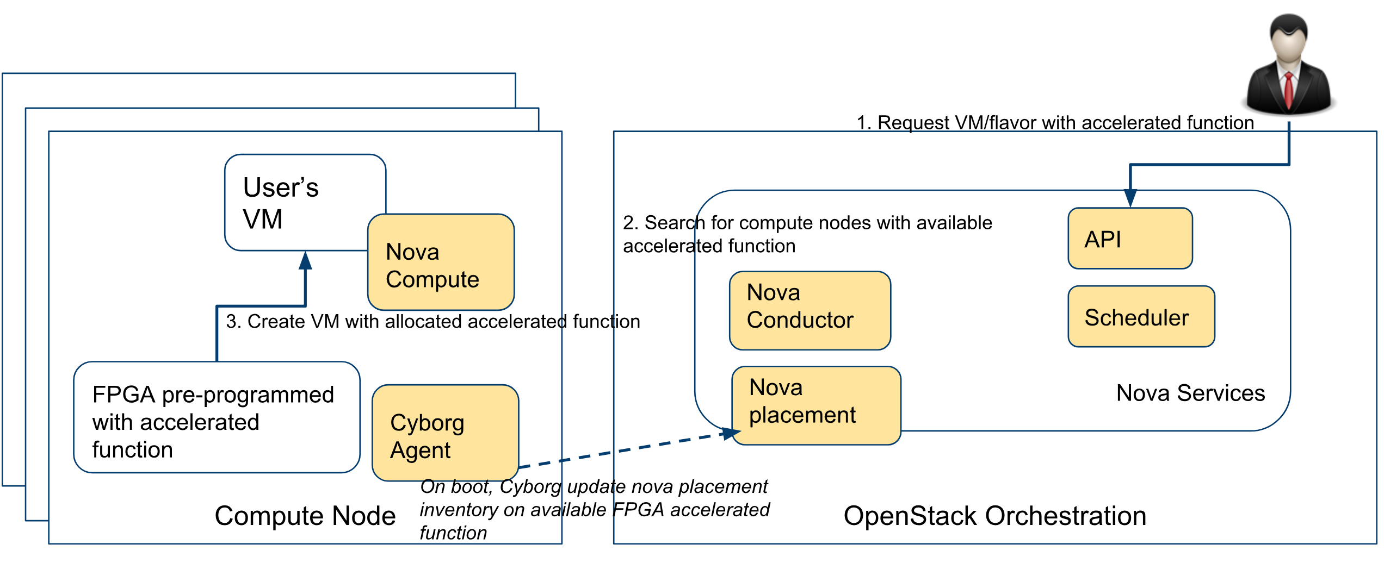
How FPGA works in Edge-Cloud – Case A
AFaaS – Pre-Programmed

Slide 10
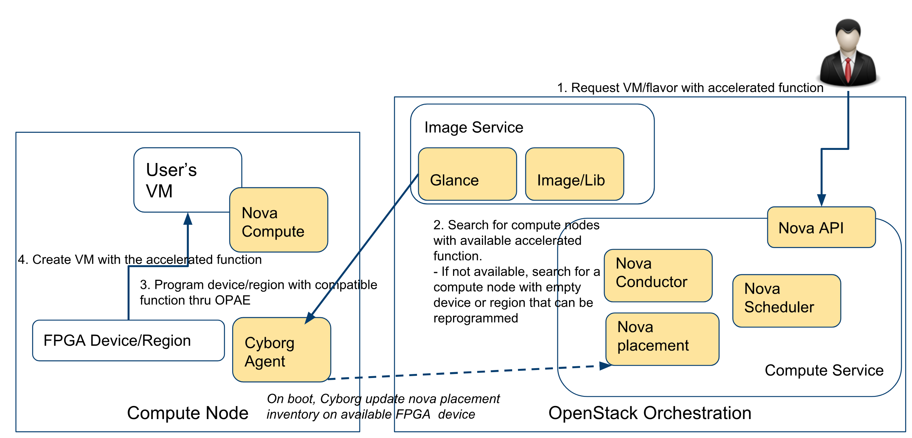
How FPGA works in Edge-Cloud – Case B
AFaaS – Orchestrator Programmed

Slide 11
Thank You
2018.5.21-24 Vancouver

