Slide 1
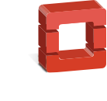
hello,
We are OpenStack: a global community of users and developers building the ubiquitous Open Source Cloud Computing platform.

Slide 2
The OpenStack Community
665
AVERAGE MONTLY
CONTRIBUTIONS
593
179
52,944
5.2M+
COUNTRIES
SUPPORTING COMPANIES
COMMUNITY MEMBERS
CUMULATIVE CONTRIBUTIONS
104
PRODUCTS IN THE MARKETPLACE
579
20M+
ECOSYSTEM COMPANIES
LINES OF CODE
NUMBERS PROVIDED HERE ARE AS OF JUNE 2016

Slide 3
who uses openstack?

Slide 4
Enterprise Private Cloud

Slide 5
Public Cloud

Slide 6
Research & Big Data

Slide 7
Telecom & NFV

Slide 8
OpenStack Summit Barcelona
October 25-28, 2016
Registration is now open! openstack.org/summit

Slide 9
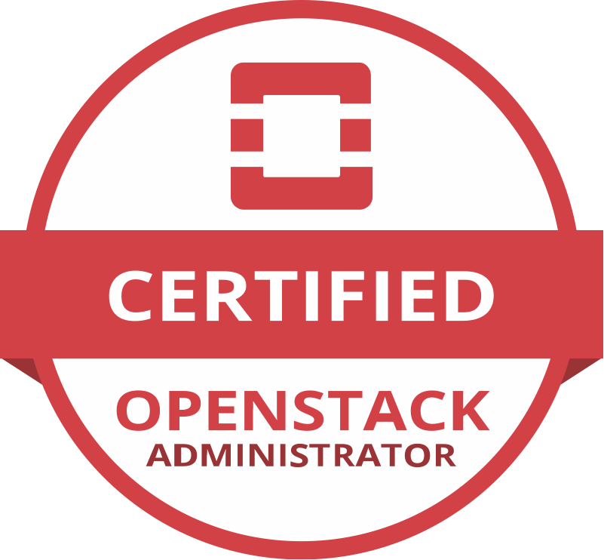
Demonstrate Your Skills
Become a Certified OpenStack Administrator
openstack.org/coa

Slide 10
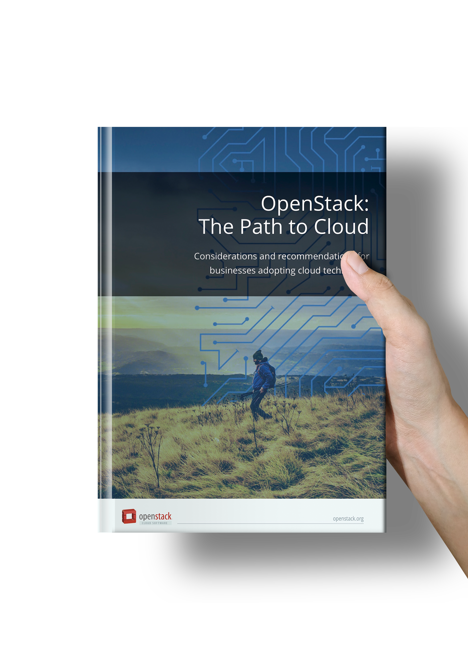
OpenStack: The Path to Cloud
Recommendations for planning and implementing an OpenStack cloud from the enterprise community.
Order the book or download at http://www.openstack.org/enterprise

