Slide 1
OpenStack Highlights
03.08.2017
Key points about our technology, community, and growth
PROVIDED FOR THE BOARD OF DIRECTORS, OPENSTACK FOUNDATION March 8, 2016

Slide 2
Overview
Adoption momentum
OpenStack Users
Scale is increasing rapidly.
How OpenStack creates a competitive advantage.
Business drivers
Analyst & media views
Why users choose OpenStack.
Opinions & Ocata software release coverage.
The community
Resources
A healthy and growing ecosystem.
About OpenStack software, organization, and quick links.

Slide 3
Source: OpenStack study, February 2017

Slide 4
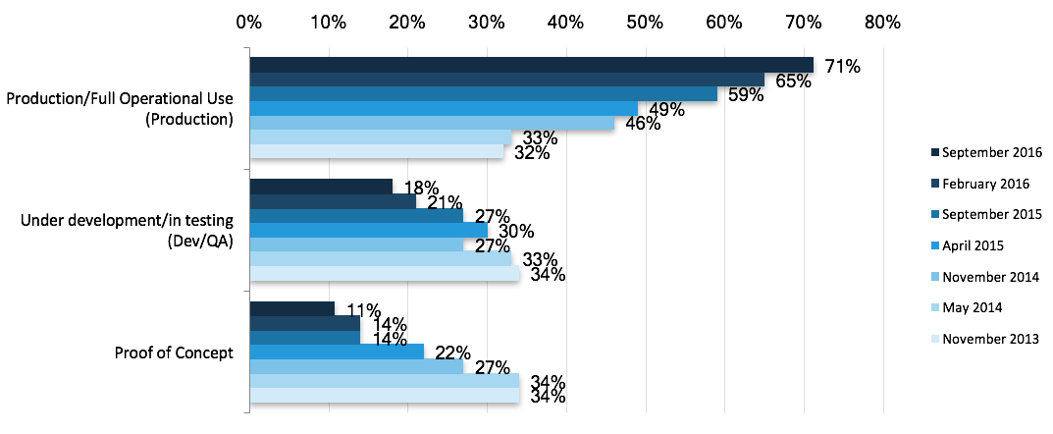
20% more deployments in production, YoY
Source: User Survey, October 2016

Slide 5
Source: OpenStack Study, April 2016

Slide 6
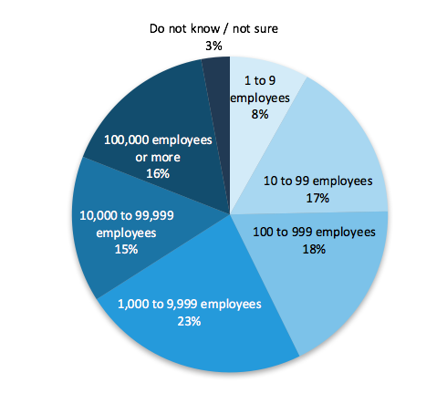
The number of mid-sized companies using OpenStack is also growing: 43% of users have less than 1,000 employees
Source: User Survey, April 2016

Slide 7
Source: User Survey, April 2016, 1183 responses

Slide 8
Cost comparison: Snapdeal vs. Snapchat
SNAPDEAL
SNAPCHAT
“Public cloud stops being cost-efficient after a certain scale.”
—Rajiv Mangla, Snapdeal CTO

Slide 9
“In all private cloud-based applications … we expect approximately 70% of cost savings as compared to classical IT solutions.”
–Holger Urban, Volkswagen

Slide 11
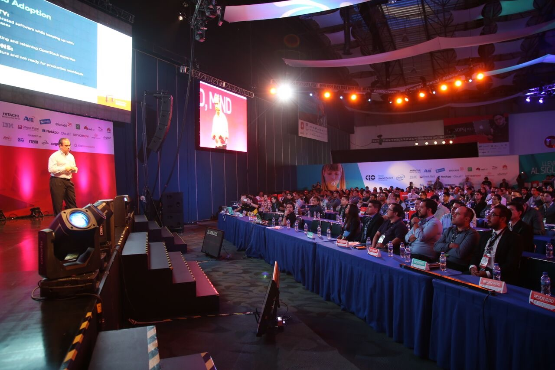
More than 70,000 registered community members
649 supporting organizations
181 countries represented
116 global user groups

Slide 12
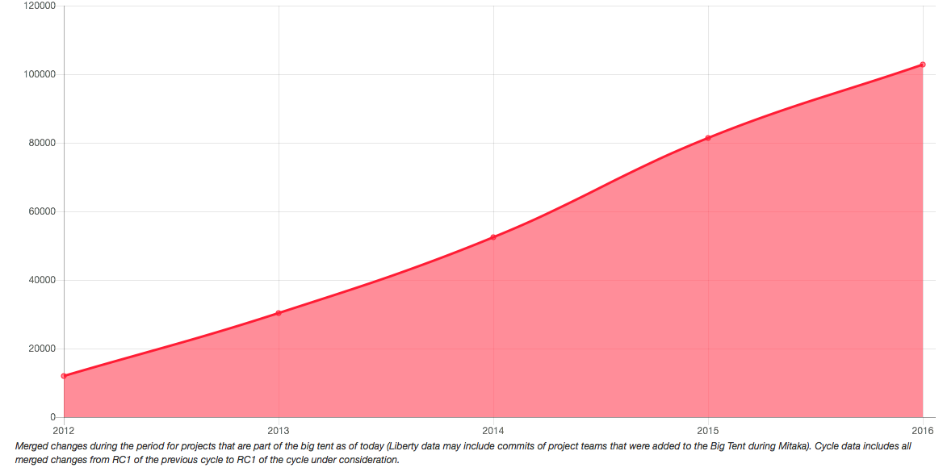
Developers and contributions growing YoY
In 2016 alone, there were 3,479 developers who contributed to OpenStack
The number of merged changes grew 26% in 2016
And in 2016, OpenStack added the greatest number of new contributors with 1,631 new developers out of the 3,479

Slide 13
Collaboration with other open source communities

Slide 14
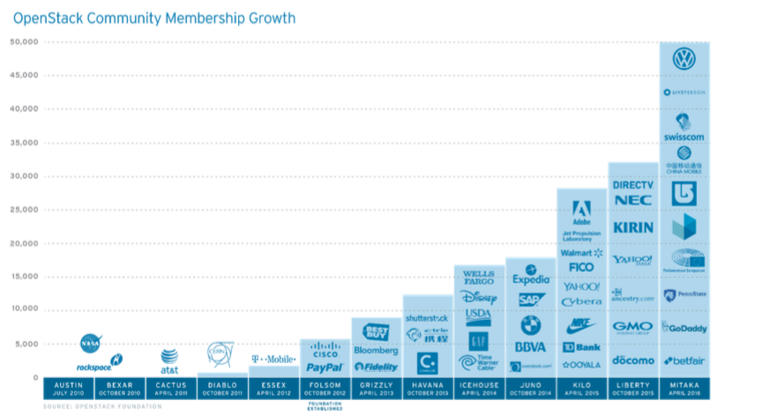
OpenStack adoption continues to grow
Source: OpenStack Pulse Report, 451 Research, October 2016

Slide 15
OpenStack users span industries
See more at openstack.org/user-stories

Slide 16
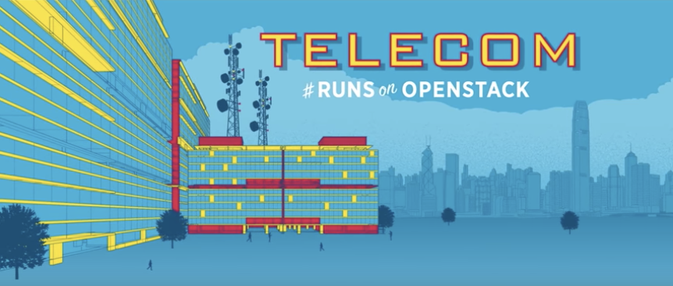
See more at openstack.org/users

Slide 17
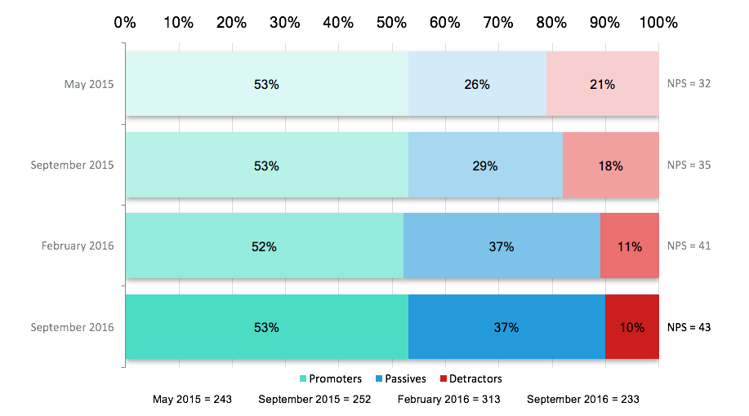
User satisfaction (NPS) is increasing
Source: User Survey, October 2016

Slide 18
“Today, OpenStack compatibility is a requirement for all private cloud solutions.”
“OpenStack’s powerful ecosystem ... [has] driven customer demand for OpenStack API support.”
“86% of Global Telecoms report OpenStack is important or essential
to their success.”
“Telecoms are already using or currently testing OpenStack for NFV (98%)
Internet of Things (91%) and 5G (80%).”
“80% of private cloud users run OpenStack.”
“5% of OpenStack clouds among enterprises top the 100,000 core mark.”
“80% of CIOs polled expecting to use OpenStack in three years, up from 60% using the technology today.”
“One of the most important open source projects and de-facto standard when implementing an infrastructure-as-a-service.”
“OpenStack … has lowered the barrier for creation and set up of new cloud services.”

Slide 19
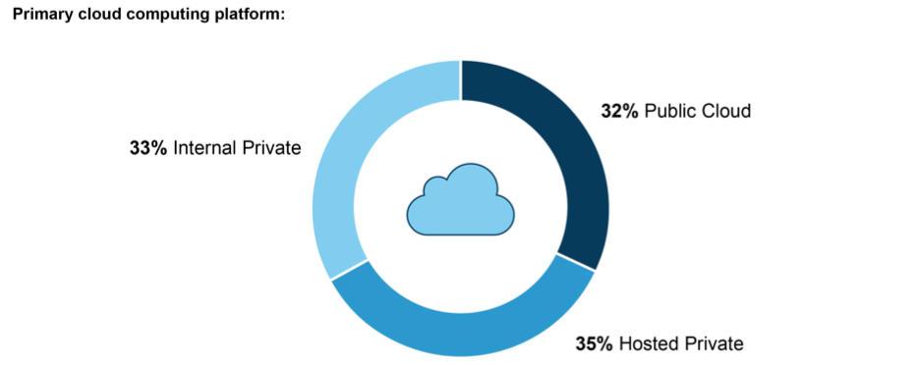
Private clouds make up 2/3 of cloud platforms
Source: Forrester Research, 2017

Slide 20
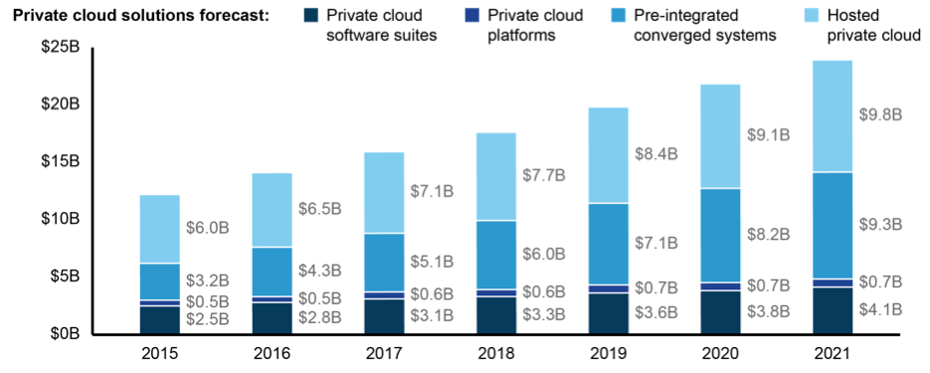
Private cloud solutions topping $25B in 2021
Source: Forrester Research, 2017

Slide 21
OpenStack is the de facto standard for private cloud
“OpenStack has “grown into a de facto standard platform for the private cloud market and now serves as the foundation for public clouds, particularly in Europe and China.”
“80% of private cloud users run OpenStack.”

Slide 22
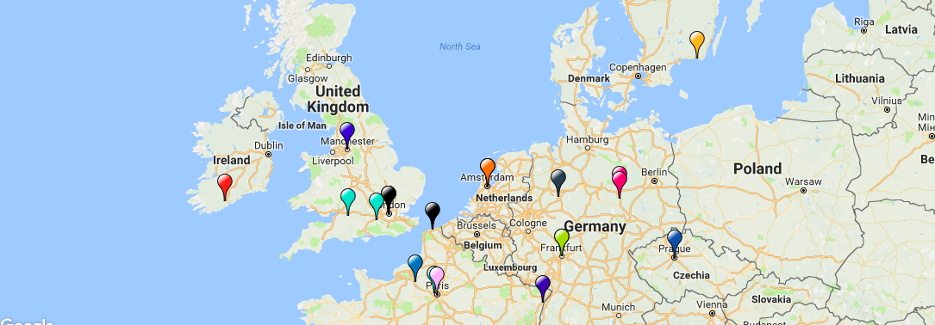
There are also 30+ OpenStack public cloud providers around the world

Slide 23
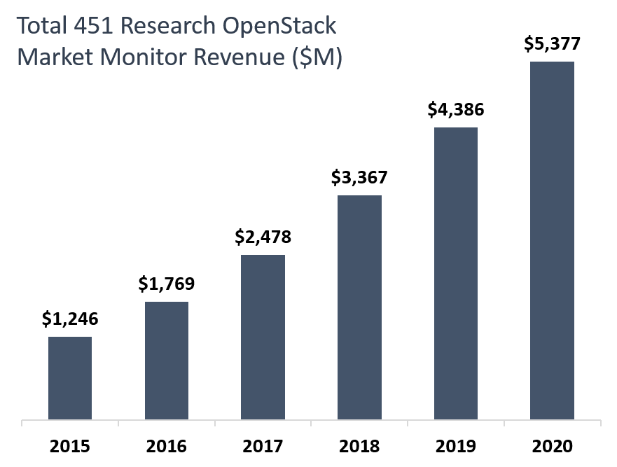
OpenStack software market opportunity exceeds $5b in 2020
Source: 451 Research, October 2016
Notes:
Numbers do not include hardware and supporting components

Slide 24
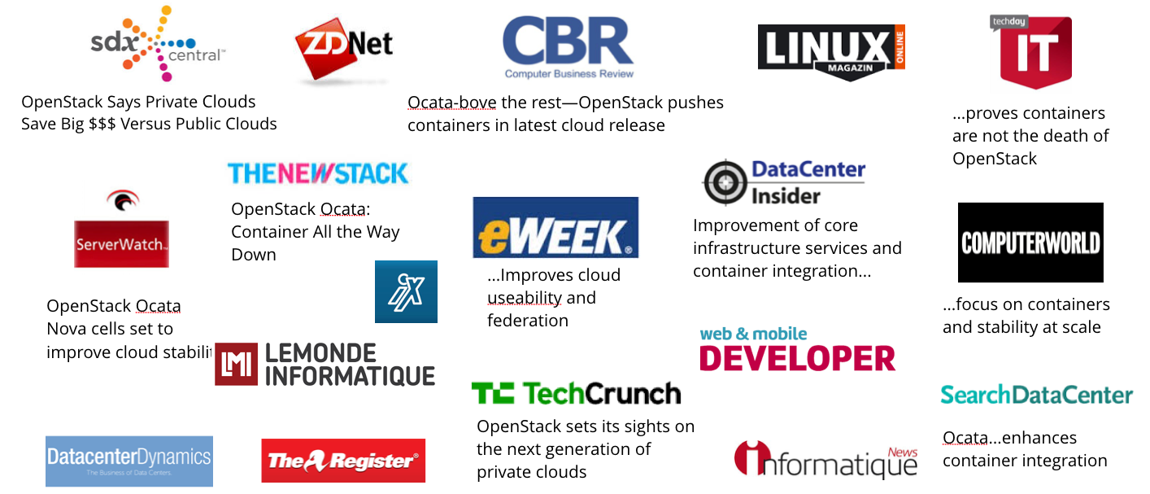
Ocata software release coverage

Slide 25
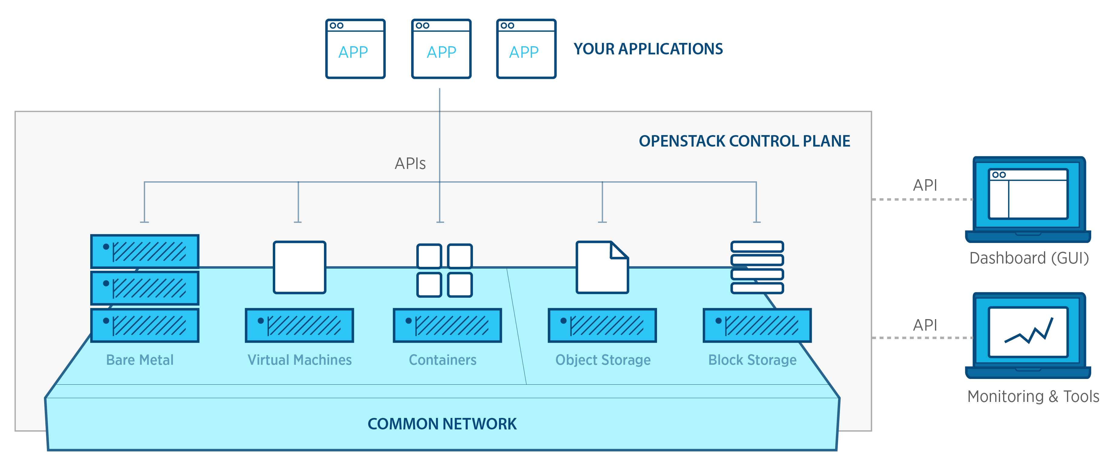
One platform for bare metal, VMs and containers
OpenStack provides one platform to orchestrate bare metal, containers, and virtual machines on a single network, allowing private users to optimize for their application without creating more silos in their datacenters, and giving service providers more delivery options.

Slide 26
About OpenStack
OpenStack is the standard for private clouds and is also available as a service via dozens of public cloud providers around the world. At its core, OpenStack is an open source integration engine that provides APIs to orchestrate bare metal, virtual machine and container resources on a single network. The same OpenStack code powers a global network of public and private clouds, backed by the largest ecosystem of technology providers, to enable cost savings, control and portability.
OpenStack is a global community of more than 70,000 individuals across 180 countries supported by the OpenStack Foundation, which facilitates the development of many innovative projects in the open infrastructure space. The community delivers two software releases each year, which are Apache 2 licensed and productized by a large ecosystem of technology vendors in our Marketplace. For more information and to join the community, visit www.OpenStack.org.

Slide 27
Quick links to resources
User stories: www.openstack.org/user-stories User survey: www.openstack.org/user-survey www.openstack.org/analytics
Analysts: www.openstack.org/analysts News: www.openstack.org/news
Projects: www.openstack.org/software/project-navigator Software: www.openstack.org/software/ocata Roadmap: www.openstack.org/software/roadmap

