Slide 1
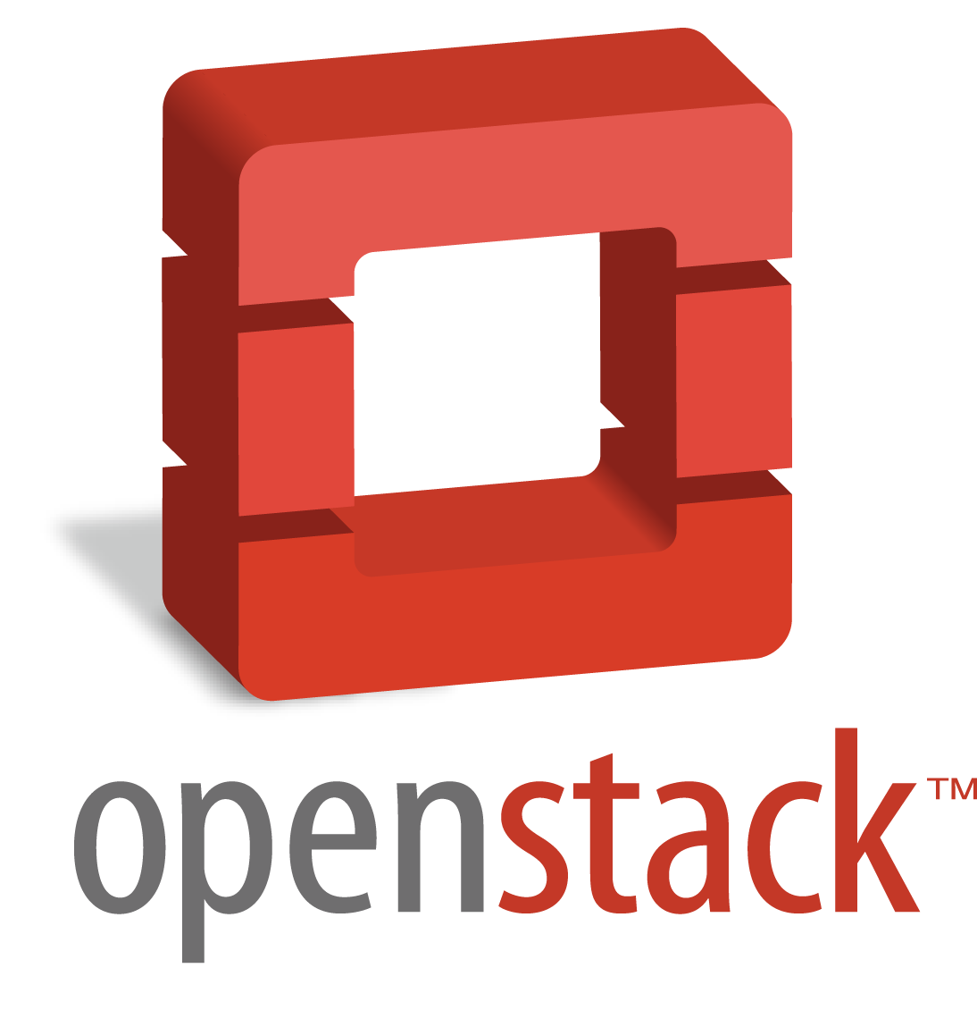
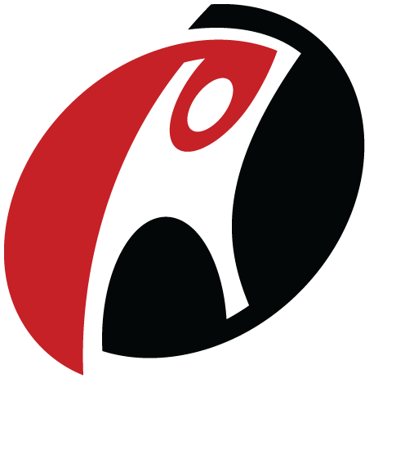

OpenStack Summit Hong Kong
Rackspace
Hybrid Cloud and Brocade vRouter
Notes:
Sameer Satyam, Rackspace
Sandeep Singh Kohli, Brocade
Shashi Sastry, Vyatta, a Brocade Company

Slide 2
Building Open Clouds with Brocade and OpenStack
Background on Brocade
90%+
#1
#2
SAN
market share worldwide
WW data center networking market share
Deployed in Global 1000 company data centers
1,400+ Ethernet fabric customers
FIRST TO MARKET
200,000+
Ethernet fabrics
Brocade SANs in production worldwide
~30 MILLION
1.3+ MILLION
1 MILLION+
SAN ports shipped worldwide
Virtual routers downloaded worldwide
OpenFlow router ports shipped
Notes:
Most of you know Brocade’s leadership in the SAN space but let me point out some of our milestones in the IP business. Highlights:
Brocade is deployed inside of the data centers of more than 90% of the world’s largest companies
We were first to market in the Ethernet fabric category. We were also the first to provide Fabric level orchestration through OpenStack.
We are No. 1 in market penetration in network functions virtualization by the virtue of our 1.3 million virtual routers that customers have downloaded worldwide
We are also a major player in the SDN market with more than 1 million OpenFlow routing ports that we have shipped in some of the largest Internet backbones in the world

Slide 3
OpenStack Networking at Rackspace
Current deployment:
Three networks – Public, SNET and Isolated
Isolated (Private) networks
Broadcast and Multicast on Isolated networks
Attach / Detach Networks
Shared IP on Isolated networks
Additional IPs on PublicNet
L3 Router, VPN and Firewall: (Brocade Vyatta vRouter)
Future enhancements:
Self-service Shared IP/ Additional IP
Routes on Isolated networks
Floating IP
L4-L7 services

Slide 4
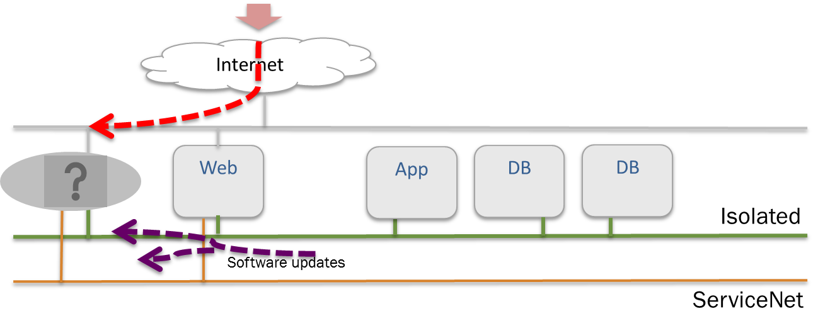
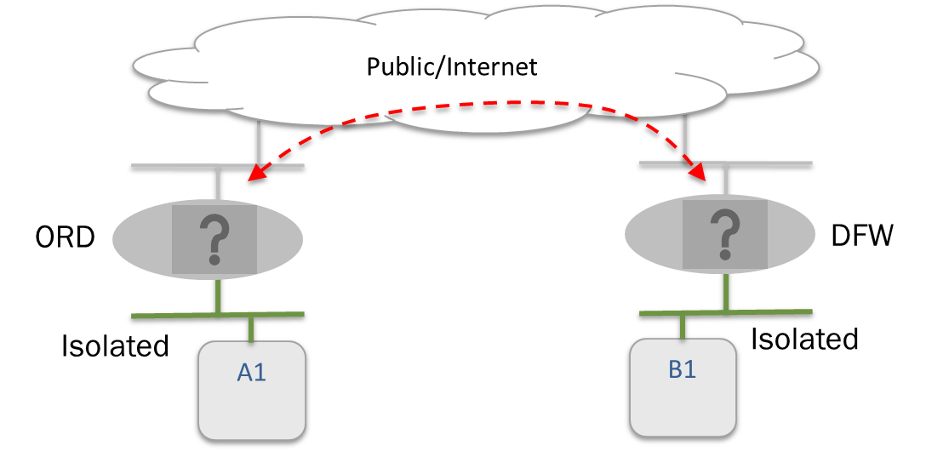
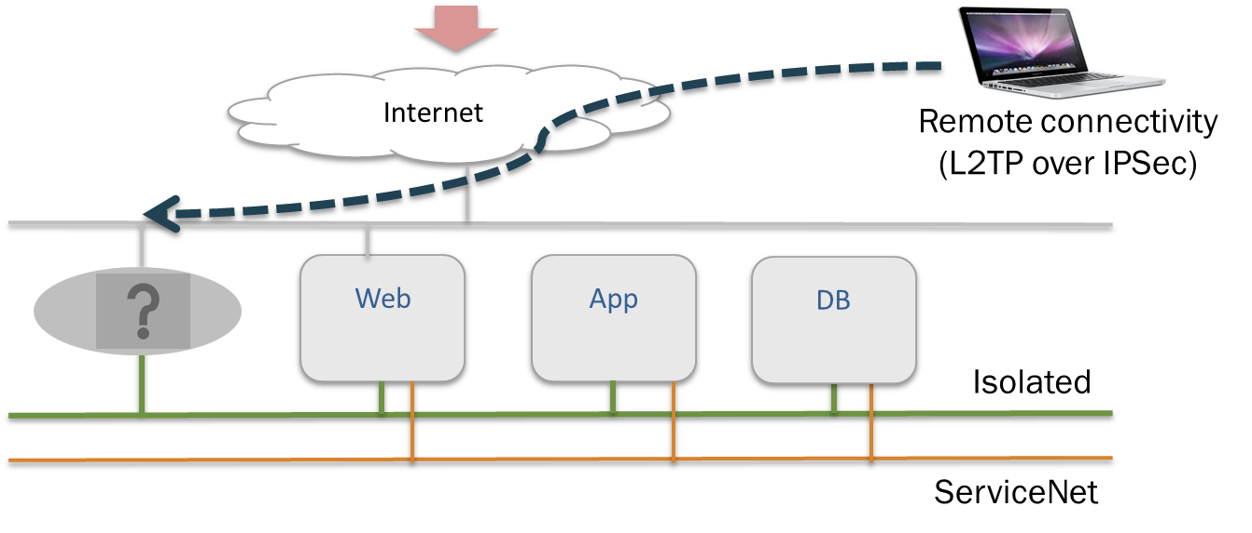
Rackspace Open Cloud Requirements
Security and isolated networks
Secure traffic between sites
Remote access to application for clients

Slide 5
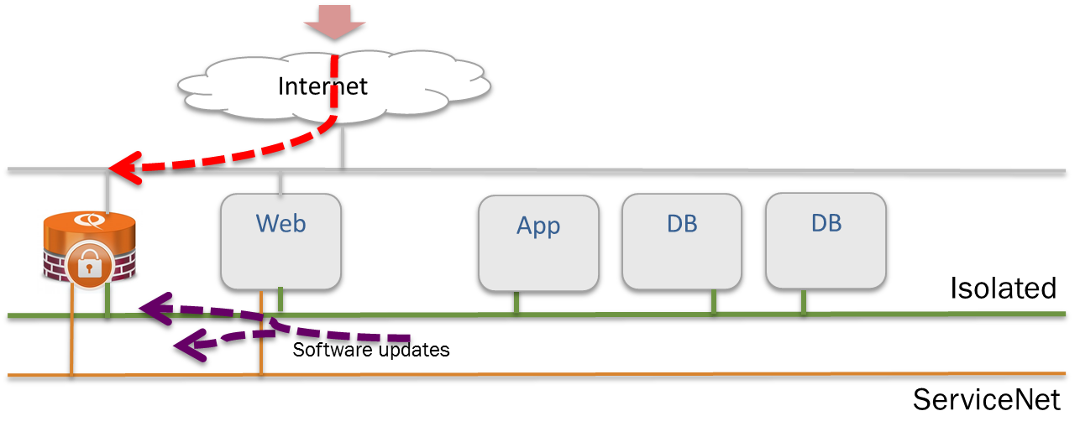
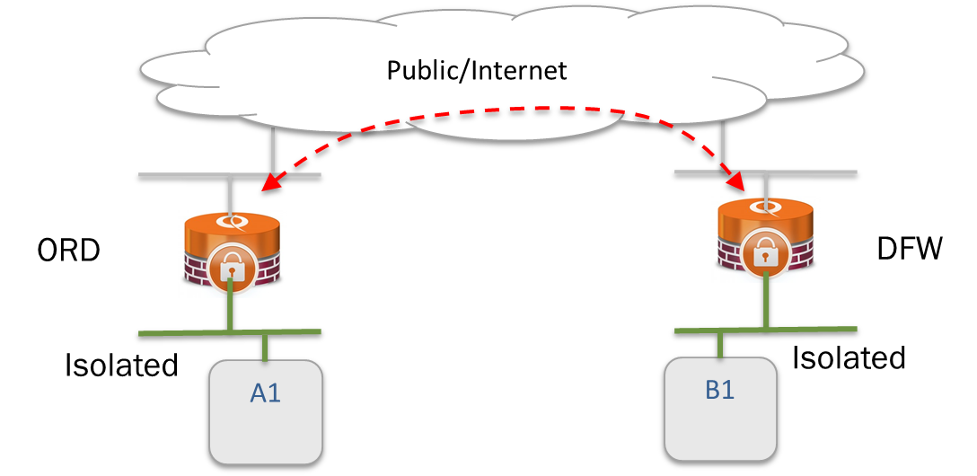
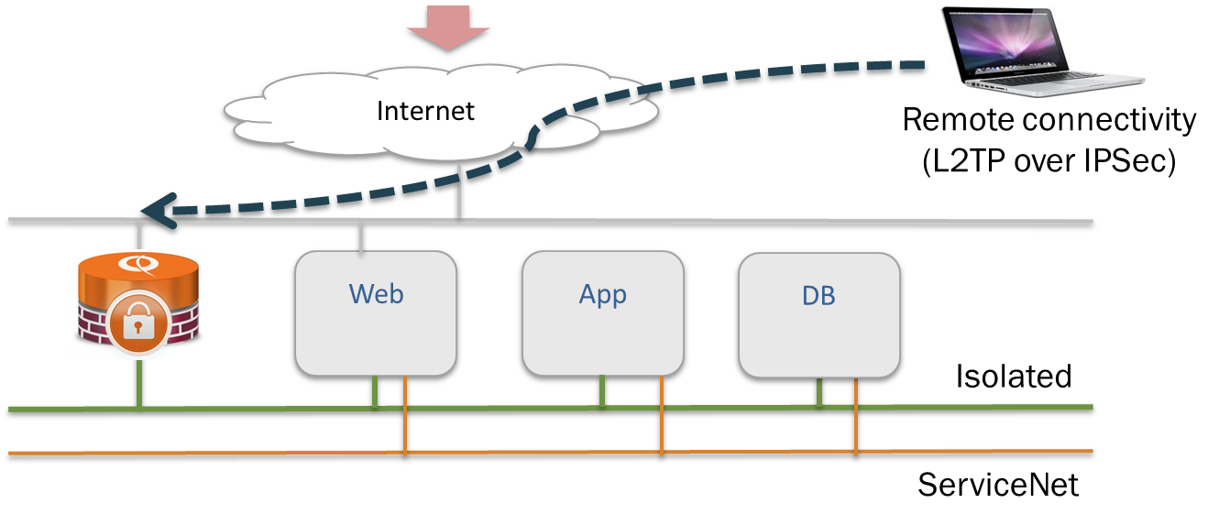
vRouter Use Cases in Rackspace Open Cloud
Firewall and NAT for isolated network
Site-to-site VPN
Remote access IPSec VPN

Slide 6
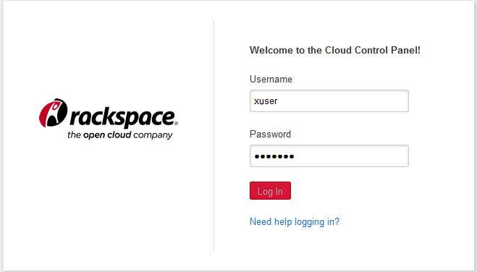
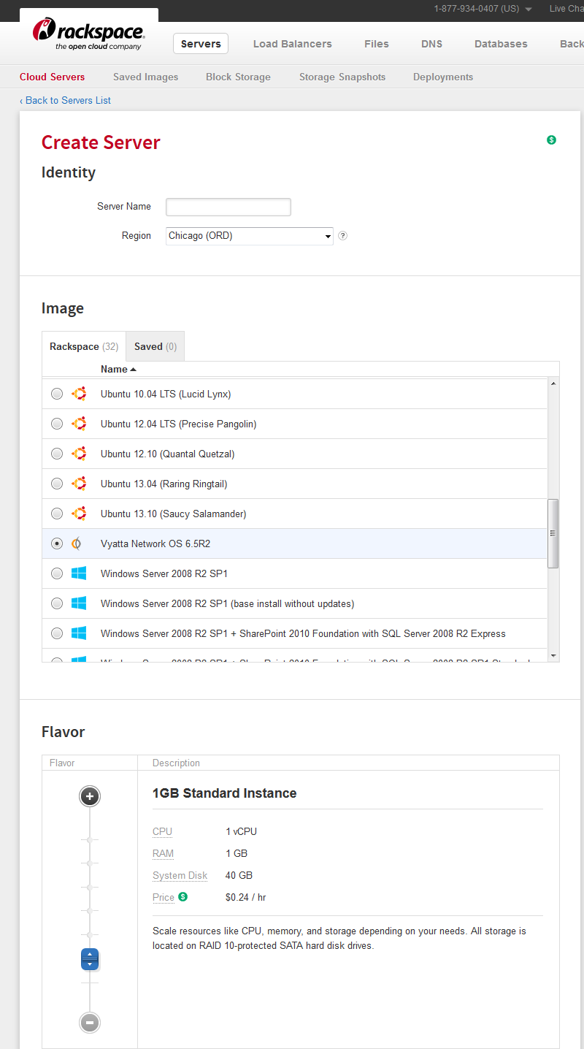
Server Creation in Rackspace Open Cloud

Slide 7
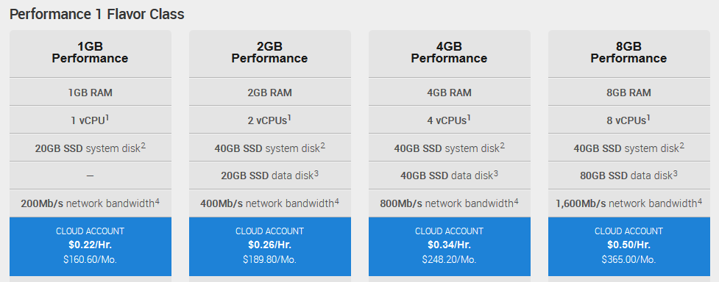
Rackspace Vyatta Offerings
200 Mbps
400 Mbps
800 Mbps
1600 Mbps

Slide 8
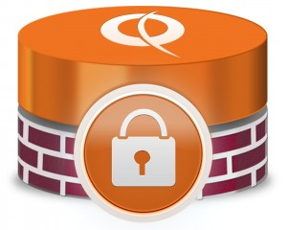
vRouters in Rackspace Open Cloud
API call to create VM
Client
SSH or REST API for management
OpenStack deploys the Brocade Vyatta vRouter as a Virtual Machine (VM)
  Customer calls Rackspace API to “Create a Server” (Vyatta) and obtains IP addressing information
  Customer then configures the vRouter directly through SSH or REST API

Slide 9
Learn more
Visit Brocade booth at C43 and check out our demos to learn more
Visit Rackspace booth
https://mycloud.rackspace.com
www.brocade.com/Openstack

Slide 10
OpenStack Summit Hong Kong
Thank you!

