Slide 1
The True State of Cloud Adoption
James Staten, VP and Principal Analyst
Charlie Dai, Principal Analyst

Slide 2
The True State of Cloud – Q4 2013
Most cloud adoption is Public and driven by the business, not IT
Empowered developers, business units driving public cloud use
Heaviest investments are in SaaS
Majority of cloud platform apps are “systems of engagement,” SaaS integrations
Private clouds remain a work in progress
32% of APAC enterprise IT shops prioritized it in 2013
But their efforts are slow and mostly cloud-washed virtualization
Higher adoption of Virtual Private Clouds than internal clouds
Hybrid cloud is now, not future
Hybrid cloud = a cloud service connected to anything
Not just public cloud + private cloud
Key question: Is your strategy starting from this reality?
Notes:
Charlie to talk to Point #2

Slide 3
Cloud adoption is accelerating
“What are your firm’s plans to adopt the following as-a-service technologies?” (Respondents who selected “implementing, not expanding,” “expanding/upgrading implementation,” “planning to implement in the next 12 months,” or “planning to implement in a year or more”)
APAC is approx. 12 months behind in adoption
Base: 2,200 to 2,444 IT software decision-makers US & Europe
Source: Forrsights Software Survey, Q4 2012
*Planning to implement in the next 12 months
**Planning to implement in a year or more
Notes:
Charlie to talk to the box

Slide 4
Enterprises are adopting cloud faster
“What are your firm’s plans to adopt the following as-a-service technologies?”
By the end of 2013, about 40% of all companies will be using IaaS (50% by 2014!)
SaaS
IaaS
PaaS
Base: 2,200 to 2,444 IT software decision-makers
Source: Forrsights Software Survey, Q4 2012

Slide 5
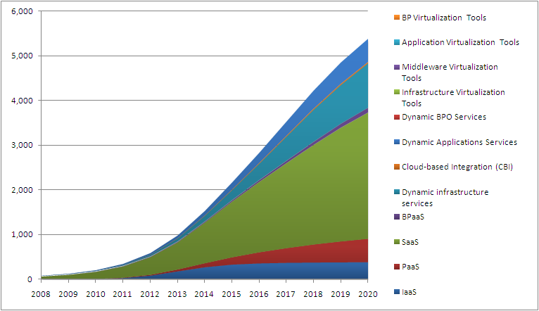
China will be a key engine of this growth
$ millions
Virtual private cloud services evolved from a traditional managed model and will also gain market momentum in China moving forward.
Public cloud services will reach $40.8 billion globally and $3.83 billion in China by 2020.
Public cloud services will reach $40.8 billion globally and $3.83 billion in China by 2020.
Source: Forrester Research Inc., December 2011
Notes:
Charlie to talk to this slide

Slide 6
The Chinese government’s cloud strategy
14 provinces have announced cloud data center projects.
Investments range from $794 million to $3.2 billion
Initial data center sizes are mostly above 10,000 to 50,000 m²
5 pilot cities: Beijing, Shanghai, Shenzhen, Hangzhou and Wuxi; transportation, eGovernment, and healthcare are top categories.
Beijing: IaaS/PaaS (serving large enterprises to SMEs)
Shanghai: IaaS, healthcare
Wuxi: IaaS/SaaS/testing cloud
Government/enterprise collaboration model:
Local cloud service companies
District government direct investment
Telecom operators
Revenue-sharing model
Local government incentives: focus on public cloud projects, get:
Benefits on land, tax, and energy
Provinces with announced cloud projects
Notes:
Charlie to talk to this slide

Slide 7
Why enterprises are leveraging cloud services: Speed
“How important were the following benefits in your firm’s decision to use cloud services?”
(Respondents who reported “Important factor” or “Very important factor”)
Agility and speed
Cost is secondary
Source: Forrsights Software Survey, Q4 2012
Base: 1,429 software decision-makers at firms who are using or planning to use SaaS

Slide 8
Integrations, mobile, and intranet apps are most common
“Which of the following types of applications are you currently developing using cloud environments or have you delivered in a cloud environment in the past 12 months?” (Select all that apply)
Base: 124 North American and European enterprise software developers using cloud; Source: Forrsights Developer Survey, Q1 2013

Slide 9
Cloud developers favor open source technologies
“Which of the following classes of open source software tools/frameworks have you used for development or deployment in the past 12 months?” (Select all that apply)
Base: North American and European enterprise software developers; Source: Forrsights Developer Survey, Q1 2013
Notes:
Charlie to talk to this slide

Slide 10
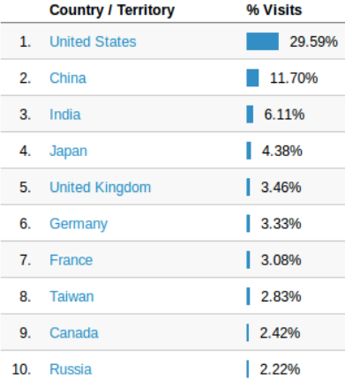
OpenStack trending in China
Awareness of OpenStack is strong in China thanks to COSUG (China OpenStack User Group)
OpenStack users: Sina, Baidu, NetEase, Game Wave, JD (360Buy), AutoNavi and PubYun
Solution builders: Aliyun, Tencent, UnitedStack
Service providers: Sina working to consolidate OpenStack with SAE (highest contribution to OpenStack project in China, supporting Sina Weibo)
China Telecom and China Unicom doing research in their internal R&D and strategy teams. China Telecom officially started evaluating OpenStack since 2011
Traffic on docs.openstack.org
Source: COSUG, as of 2012
Notes:
Charlie to talk to this slide

Slide 11
Wide expectations for OpenStack in China
Source: COSUG, 150 cloud/virtualization practitioners in China 2012
Notes:
Charlie to talk to this slide

Slide 12
Data protection
Privacy
QoS
PII
IP
BCDR
Notes:
Image: http://1.bp.blogspot.com/-q0uM3IIV5QY/TeaYlb7zVlI/AAAAAAAAAEg/kMVAP8U0beo/s1600/Wait.jpg
But wait! They can't do this?
a. Concerns about data protection, IP protection, vulnerabilities, DR, etc.
ALT: http://www.istockphoto.com/stock-photo-7792788-businessman-both-hands-up-whoa.php?st=0506765

Slide 13
And the business often doesn’t know (or care) about the risks
“What is preventing your firm from using/using more public as-a-service offerings?”
Business concerns
IT concerns
Source: Forrsights Business Decision-Makers Survey, Q4 2012, Base: 2,192 enterprise business decision-makers
Source: Forrsights Services Survey, Q3 2013, Base: 1,050 enterprise IT services decision-makers

Slide 14
IT Ops is beginning to take control of the cloud strategy
“How would you describe your approach to using [cloud] services, today and in 12 months?”
“We have no formal [cloud] strategy/approach”
“We are executing on a formal [cloud] migration plan”
IT priority in the next 12 months: Create a comprehensive strategy and implementation plan for public cloud and other as-a-service offerings
High 34%; Critical 21%
Source: Forrsights Services Survey, Q3 2012 & Q3 2013*
Base: : 1,058 enterprise IT services decision-makers ;*1,050 enterprise IT services decision-makers

Slide 15
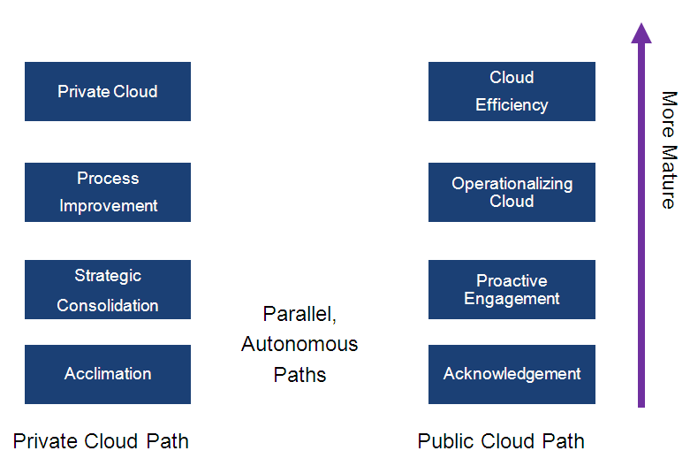
The cloud evolutionary paths are independent of each other
Notes:
Charlie: Key APAC Stats about the public cloud path –
Creating an inventory of existing cloud usage – Yes 29%
Implementing cloud pilot(s) – Yes 33%
Completing a cloud ROI assessment – Yes 25%
Creating a dedicated cloud team – Yes 24%
Hiring new staff with cloud skills – Yes 20%
Engaging external consultants on trends or cloud strategy development – Yes 20%

Slide 16
Business service over cloud is most popular scenario
Source: COSUG, 150 cloud/virtualization practitioners in China 2012
Notes:
Charlie talk to this slide

Slide 17
Nearly half of OpenStack projects in China are making substantial progress
Source: COSUG, around 105 (150*69%) cloud/virtualization practitioners in China using OpenStack 2012
Notes:
Charlie talks to this slide

Slide 18
Collectively, Open Stack is the most popular choice
Which internal private cloud vendor do you use?
VMware-based
Unique platform
OpenStack
CloudStack
Eucalyptus
Custom
Source: Forrsights Hardware Survey, Q3 2013 Base: 244 North American and European IT decision makers at enterprise firms with 1,000 or more employees that are using/planning to use internal private cloud

Slide 19
OpenStack trends in China
Visionary local technology vendors are using OpenStack
Companies in non-Internet industries is gaining knowledge and experience
End users in traditional industries are tracking global trends in IaaS to enable their IT infrastructure for business transformation
Local Companies | Chinese Name | Briefing
 | 华为 | Telecom equipment manufacturer and service provider
 | 海辉 | IT outsourcing service provider (merged as Pactera)
 | 中标软件 | Operation system and OA software ISV
 | 广联达 | IT service provider in construction industry
Notes:
Charlie talks to this slide

Slide 20
Lack of professional training and poor ease of use are major concerns of end users to adopt OpenStack
Source: COSUG, 150 cloud/virtualization practitioners in China 2012

Slide 21
Recommendations
Engage your empowered leaders
Understand the business reasons for their actions
Identify the next steps that will help them be more successful
Determine how IT can help
Don’t go it alone
Work with companies with more cloud experience, who can accelerate your success
Give the business what it is looking for
The cloud is not a threat to IT
It’s part of your portfolio
Get cloud right
Notes:
Charlie talks to the second major bullet

Slide 22
The hybrid end game
Decision tree
Workload management
GRC
Internal cloud
Virtual
Physical
Traditional Outsourcing
Virtual hosting
Public cloud
CapEx
OpEx
Flexible OpEx
Common
Custom
Custom
Common
Transient
Fixed
Fixed
Transient
Metered
Owned
Owned
Metered

Slide 23
James Staten
jstaten@forrester.com
@staten7
Charlie Dai
ckundai@forrester.com
@CharlieKunDai

