Slide 2
OpenStack Mission
To produce the
ubiquitous open source cloud computing platform
that will meet the needs of public and private clouds regardless of size, by being simple to implement and massively scalable.

Slide 3
Three years in…
Expanded scope from Compute and Object Storage to Compute, Storage, Networking and Shared Services, with rich ecosystem of Integrated projects emerging
OpenStack has public clouds in more cities than Amazon has regions
Major private cloud users at Best Buy, Bloomberg, Comcast, Fidelity, PayPal and more
OpenStack has become the center of cloud innovation – more than 1,000 developers, supported by major IT companies

Slide 4
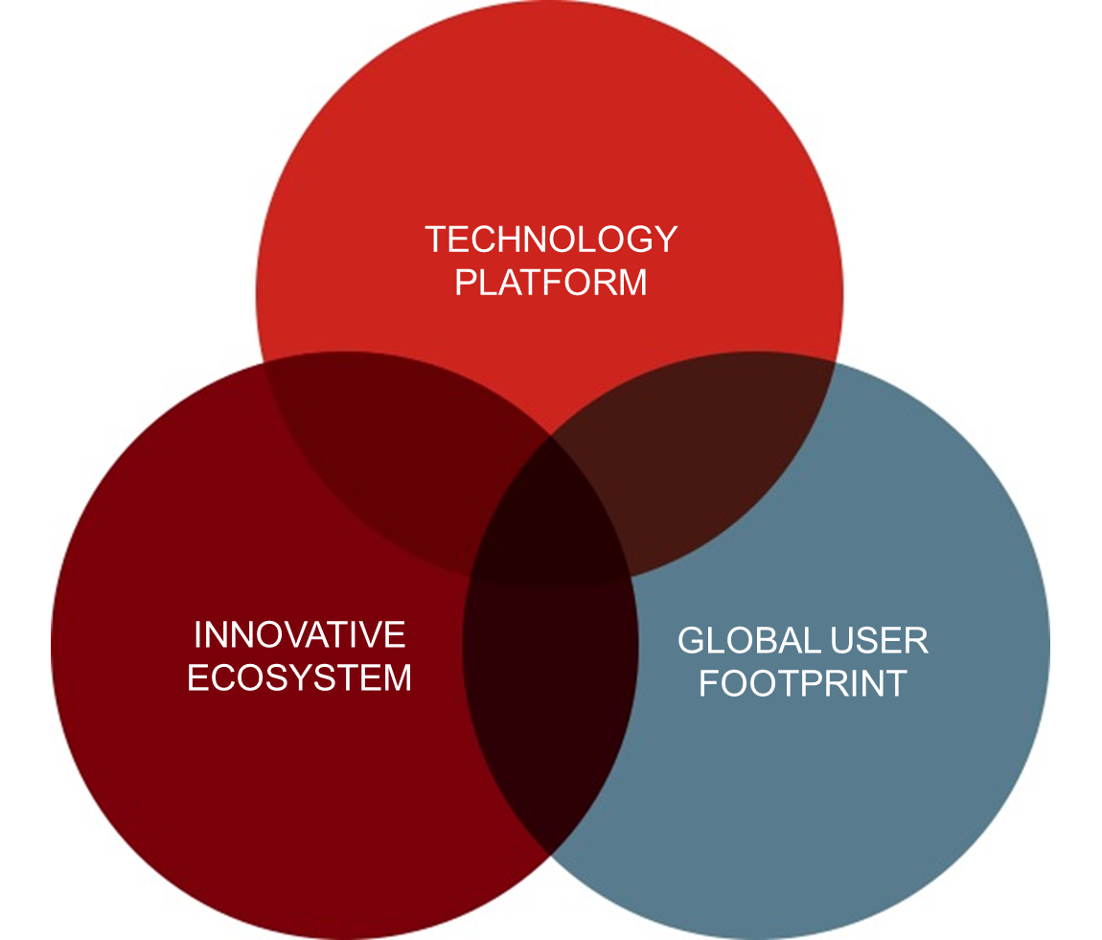
Why are we succeeding?
Successful platforms have three forces:
Technology
Ecosystem
Users
GLOBAL USER
FOOTPRINT
Notes:
It’s more than…
…cloud infrastructure software
…a global open source community
…a collaboration among technology vendors

Slide 5
Fastest Growing Global Open Source Community
COMPANIES
COUNTRIES
231
121
INDIVIDUAL MEMBERS
10,149
TOTAL CONTRIBUTORS
AVERAGE MONTHLY CONTRIBUTORS
CODE CONTRIBUTIONS
1,036
238
70,137
As of July 2013
Notes:
More than 10k members! You should join!
Of the total contributors, 800-900 are still active, which shows that people stick around.
Even had downloads from Antarctica!

Slide 6
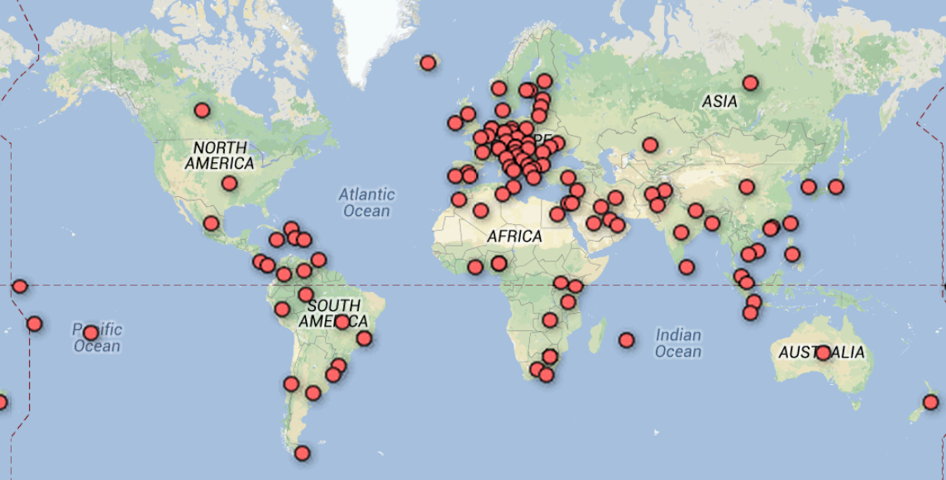
Global Community
Countries with members

Slide 7
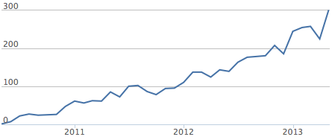
Developer Growth
Contributors per month (ohloh)

Slide 8
1 Million+ Lines of Code
Lines of code (ohloh)
Notes:
We’re also deleting hundreds of thousands of lines as well
Eg last 12 months:
Added 2,936,791 lines
Removed 1,594,506

Slide 9
Ecosystem Growth
Participating Companies

Slide 10
Major Users
See these videos and more at http://www.openstack.org/summit/portland-2013/session-videos/
Add your organization at openstack.org/user-survey
Notes:
Best Buy
Continuous delivery, massive demand spikes
Bloomberg
Infrastructure agility and efficiency
Comcast
Moves set to box intelligence into the cloud
CERN, 15000 hypervisors by 2015.

Slide 11
Summit Attendee Growth
Notes:
We’re planning for 4000 in Hong Kong.

Slide 12
Core Values Remain
We’re keeping sacred what has made OpenStack so successful
Open source is essential to unlock the value of cloud computing
Four opens:
Open Design
Open Development
Open Community
Open Source
Notes:
OpenStack Started with a technical meritocracy…. It’s still there, ensrined in the governence so it will never die.
== Open Source ==
We are committed to creating truly open source software that is usable and scalable. Truly open source software is not feature or performance limited and is not crippled. There will be no "Enterprise Edition". We use the Apache License, 2.0.
== Open Design ==
'''We are committed to an open design process.''' Every six months the development community holds a design summit to gather requirements and write specifications for upcoming release. The design summits, which are '''open to the public''', include users, developers, and upstream projects. We gather requirements and produce an approved roadmap used to guide development for the next six months.
== Open Development ==
We maintain a publicly available source code repository through the entire development process. We do public code reviews. We have public roadmaps. This makes participation simpler, allows users to follow the development process and participate in QA at an early stage.
== Open Community ==
One of our core goals is to maintain a healthy, vibrant developer and user community. Most decisions are made using a lazy consensus model. All processes are documented, open and transparent.
http://wiki.openstack.org/Open

Slide 13
On the horizon
New projects & functionality, but also focus on stability and maturity
Orchestration and Metering become integrated in Havana
DBaaS and Bare Metal currently Incubated projects
Focus on education and talent development
New Operations and Security Guides
Ecosystem and community discussions to accelerate training and certification
Reaching application developers

Slide 14
Important Dates
May, 2014 “J” Design Summit
January, 2014 **Board of Directors elections for 8 individual directors openstack.org/join
April, 2014 Icehouse Release
October 17, 2013 Havana Release
**Orchestration & Metering become integrated
November 5, 2013
Hong Kong Summit
**First International Summit
outside the US
**(Icehouse Design Summit)
September 19, 2013 Foundation One Year

Slide 15
How you can help
Infrastructure Team
Want to help run systems powering OpenStack development?
Read the documentation at http://ci.openstack.org/
Documentation
Contact Anne Gentle <anne.gentle@rackspace.com>
or visit http://wiki.openstack.org/Documentation/HowTo
Translations
Do you speak multiple languages?
Join the Internationalisation team: https://wiki.openstack.org/wiki/I18nTeam
Or contact Ying Chun “Daisy” Guo <guoyingc@cn.ibm.com>
Ask.OpenStack.org
Please participate and help answer questions
User Profile
If you are an OpenStack user, please create a profile (public or private) at openstack.org/user-survey

Slide 16
Hong Kong Summit
November 5-8, 2013 – Hong Kong!
Registration and sponsorships now open
New: Two tiers of registration, please read carefully
Call for speakers deadline July 31
Book your travel early, room blocks are filling up!
Travel Assistance Program – applications in July
More details at openstack.org/summit

