Slide 1
OpenStack Juno: The 10th Release October 16, 2014

Slide 2
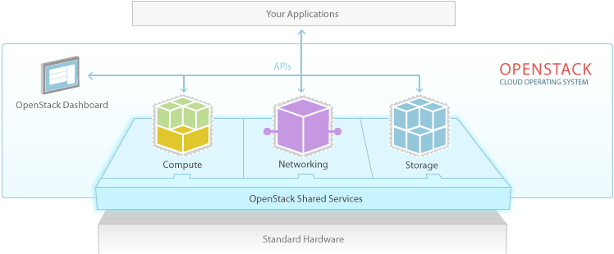
OpenStack Cloud Platform
Notes:
Now 11 integrated projects with the addition of Data Processing, most widely-supported cloud platform

Slide 3
With its 10th release, OpenStack supports the widest set of enterprise and open source technologies, enabling new use cases across finance, manufacturing, technology and many industries.

Slide 4
OpenStack Juno Key Themes
Most widely-supported cloud platform, expanded testing for plugins
Storage policies for object storage
Federated identity enhancements
Operational improvements
Enterprise
Maturity
Laying the Foundation for NFV Support
OpenStack infrastructure natural home for implementing NFV
NFV workgroup established, new features landing in Nova
New Data Processing capability part of integrated release
Quickly provision and manage Hadoop and Spark
New Data Processing Capability

Slide 5
Key Themes Across the Community
Voice of the user & operator continues to shape software
Operator meetups continue to drive valuable feedback. Many operational enhancements and thousands of bug fixes accepted.
Users spanning enterprise and various verticals bringing new requirements, including NFV, Win The Enterprise and End User working group efforts
Marketplace offers new paths to adoption
One size does not fit all: that’s why OpenStack is still the right choice for many. Helping simplify options for users.
Added Hosted Private Cloud to Marketplace
New active consumption model
Mix and match technology options in every datacenter
Users desire more control and leverage with technology providers

Slide 6
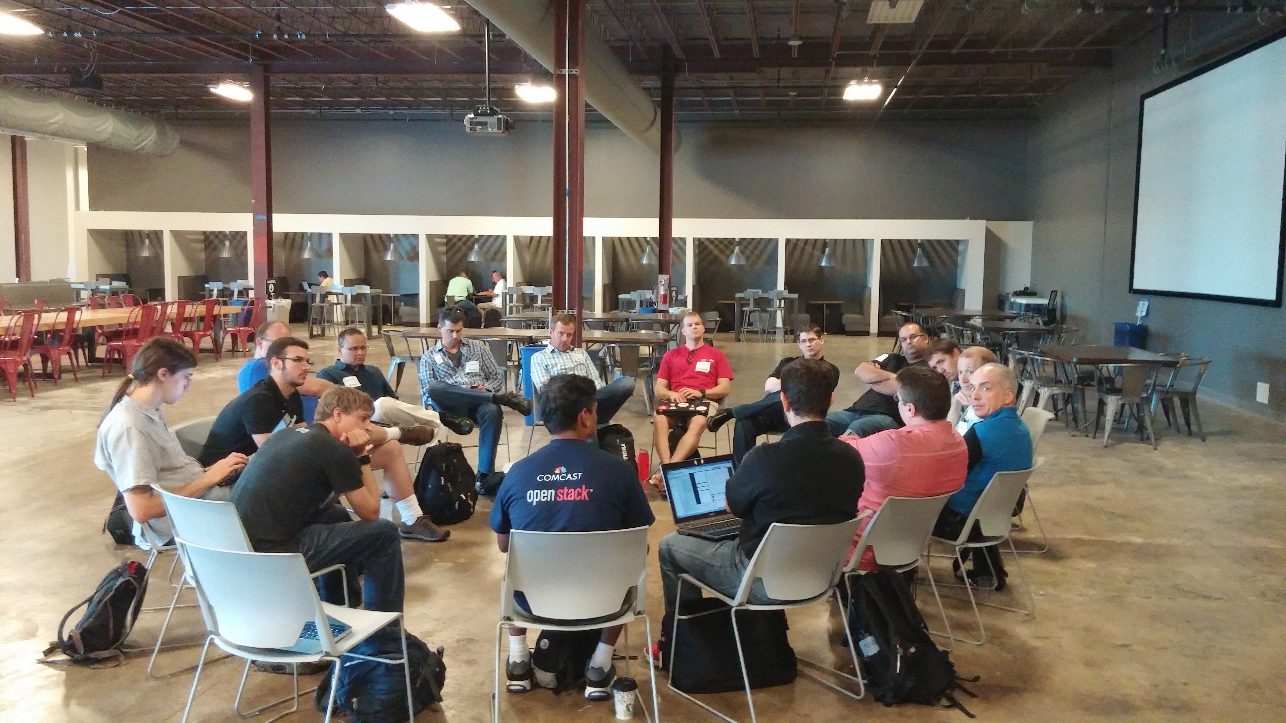
A New Approach: Users Get Involved in Software Development Process
At the Ops Summit, August 25-26, OpenStack users from companies including Comcast, Time Warner Cable, GoDaddy, Yahoo, Sony Playstation, Symantec, Cisco, Workday, IBM, Bluebox, Intel, and PayPal provided feedback on the software platform and shared best practices. See the full story:
http://superuser.openstack.org/articles/report-from-the-mid-cycle-meetup-for-operators

Slide 7
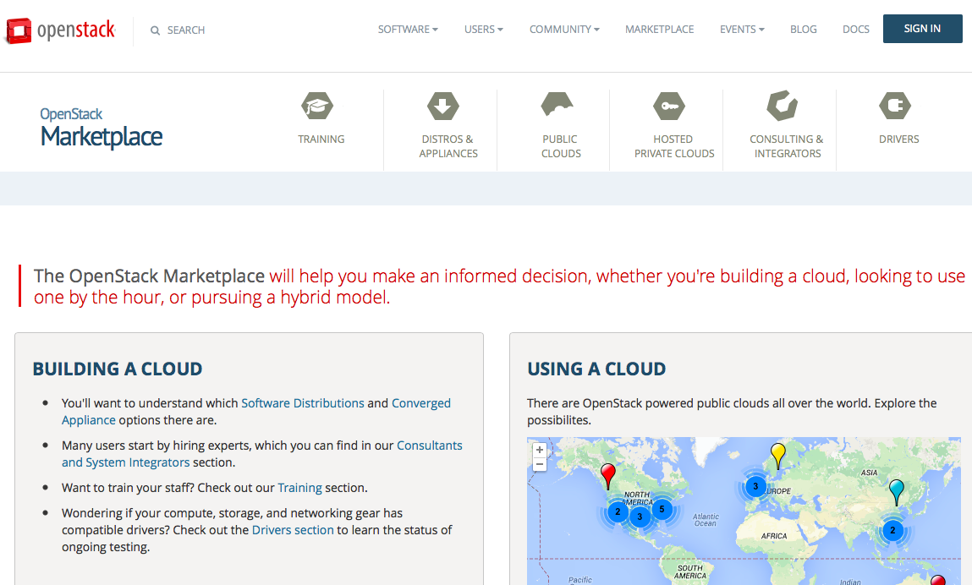
Marketplace Adds Hosted Private Clouds

Slide 8
Key Growth Stats
Contributor Growth | 1,419 contributors affiliated with 133 organizations contributed to Juno; a 16% increase from the Icehouse release
Total Number of Features | 342 new features in the Juno integrated release and common libraries
Bugs Fixed | 3,219 bugs fixed during the Juno release cycle, a 10% increase from Icehouse
Top Companies Committing Code | HP, Red Hat, Mirantis, Rackspace, IBM, Cisco, NEC, VMware, OpenStack Foundation, Independents; top users contributing include Yahoo!, Time Warner Cable and eBay
Documentation | Nearly 500,000 lines of documentation modified; new Architecture Design Guide produced during Juno cycle
Drivers & Plugins | 97 drivers and plugins supported across the compute, storage and networking capabilities

Slide 9
New Features by Category

Slide 10
Compute
Network Functions Virtualization
Subteam formed in Atlanta
Multiple use cases split out (9)
Operational Updates
Improvements for rescue mode: boot from alternate image and attach all local disks
Improve nova-network code to allow per-network settings
Other updates
Ironic driver added
Docker support with StackForge driver
Rolling upgrade improvements
Scheduling updates to support scheduling services and extensibility

Slide 11
Storage
Object Storage
Storage policies: major update, allows flexibility to use different types of storage devices, replication settings
Ongoing work on erasure coding, potentially coming in Kilo
New features:
Keystone v3 support
Account to account copy
Block Storage
10 new storage backends supported and improved testing of third-party storage systems
Project maturing, consistent contributors building out core functionality
Cinder v2 API in Nova

Slide 12
Networking
nova-network to Neutron Migration Path
Initial path for eventual deprecation
Back-end plug-in enabled
NFV Work
Support for IPv6 networking
Third-party driver testing ensures consistency and reliability across network implementations
Focus on Compute during Juno release cycle, but updates for Networking coming too
L3 High Availability
Networking layer now allows a distributed operational mode

Slide 13
Shared Services
Identity service: Federated authentication improvements; easier to connect to LDAP
Orchestration: Rollback on failed deployment, delegation improvements for non-admin users
Telemetry: Efficiency improvements; increase in performance
Dashboard: Data Processing integration, RBAC support for Block Storage and Images
Database: New options for MySQL replication, Mongo clustering, Postgres, Couchbase
Data Processing: Newly integrated big data provisioning service with support for Hadoop and Spark
Image Service: Image service expanding to broader artifact catalog service

Slide 14
Kilo and Beyond
Kilo is expected to be released April 30, 2015. New capabilities integrated in the Kilo release:
Bare Metal (Ironic); note that the Compute driver is available in the Juno release
Additional projects being incubated, expected to land in late 2015 and beyond:
Manila (shared file system)
Zaqar (queue service)
Designate (DNS service)
Barbican (key management)

